Slide 1
Greater Manchester Autism in Schools Project
Enabling Environments module 2

Slide 2
About the Module
Module 2 is about enabling school environments
Today we will:
-briefly recap what we learned in module 1;
- think about how you can enable communication;
- think about organising the environment so it is more enabling;
-think about sensory accommodations you can make in school.

Slide 3
Recap: What is Autism?
Autism affects how a person communicates with, and relates to, other people and how they experience the world around them.
Like anyone else, autistic people will have different life experiences, strengths, interests and support needs.
From medical and legal standpoints, autism is a disability, but not every autistic person identifies as being disabled.
Notes:
Source: NHS England People with a learning disability, autism or both Liaison and Diversion Managers and Practitioner resources (2019)
EMPHASISE – everyone is different – no two autistic people are the same in the same way no two non-autistic people are the same
It is important to understand and work with individuals AS individuals
Equality act and SEN COP – You are legally responsible for accommodating for autistic people in school!

Slide 4
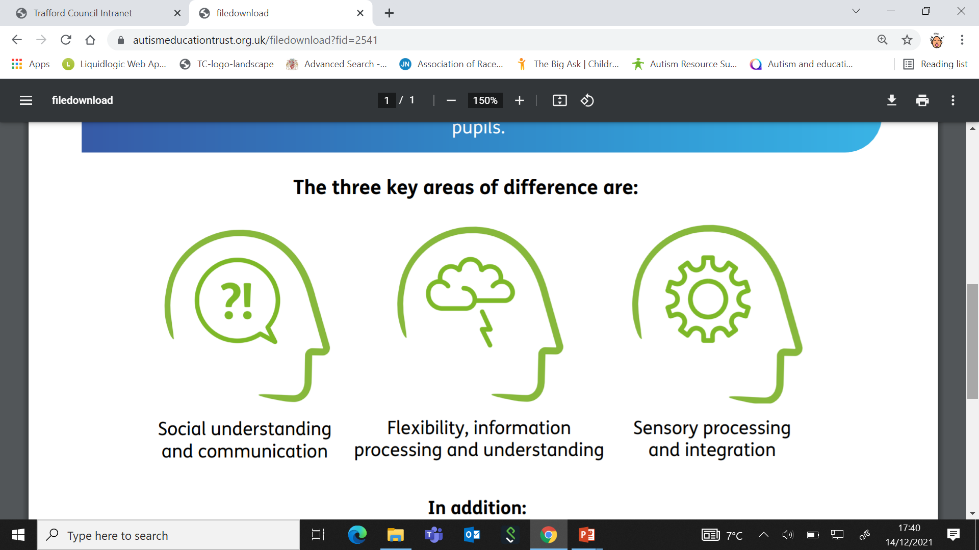
Last time we also introduced…
Logical Processing
Executive Functioning
Spikey Profiles
Notes:
Areas 1,3 and 4 from AU’s areas of difference – these were all covered in Module 1
Logical processing
Sensory differences
Executive functioning differences
Spiky profiles
Lack of understanding from society
Autistic culture

Slide 5






Some autistic people may need help to…
listen and focus
plan, sequence and organise
understand spoken language but may be able to process visual and kinaesthetic information more easily
understand social rules
(e.g. personal space, turn taking)
follow instructions
Remember things
Notes:
Emphasise MAY – not every autistic person will need help with all of these things
Some people may need more/less help at different times of in different contexts (autism + environment = outcome)

Slide 6
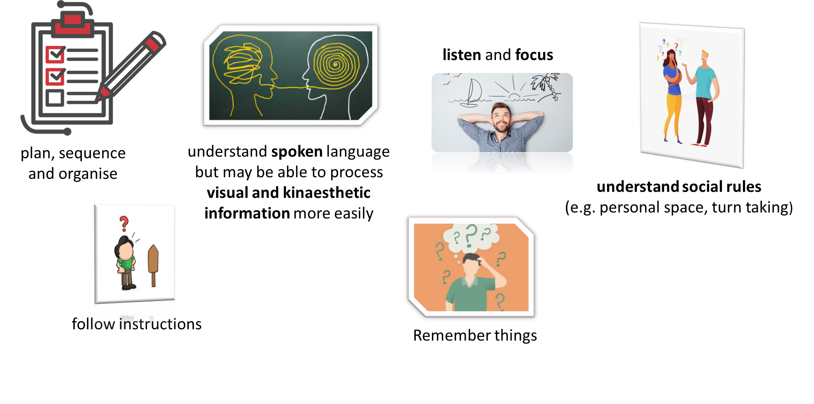
Some neurotypical people may also need help to…….
…So this information is good for everyone!

Slide 7
Recap:
Autistic people at all levels of intellectual ability may have difficulties in understanding the communication and language of neurotypical people and in communicating effectively across neurotypes.
In the same way, non-autistic people will struggle with understanding the communication and language of autistic young people.
Autistic and neurotypical people may need support and strategies to help them communicate effectively with each other.
Notes:
Neurowild – squirrels vs beavers
Recap:
We covered this last time – remember that the double empathy problem (introduced by Damien Milton) emphasises that it is equally true that non-autistic people have difficulty communicating with autistic people – it works both ways!

Slide 8
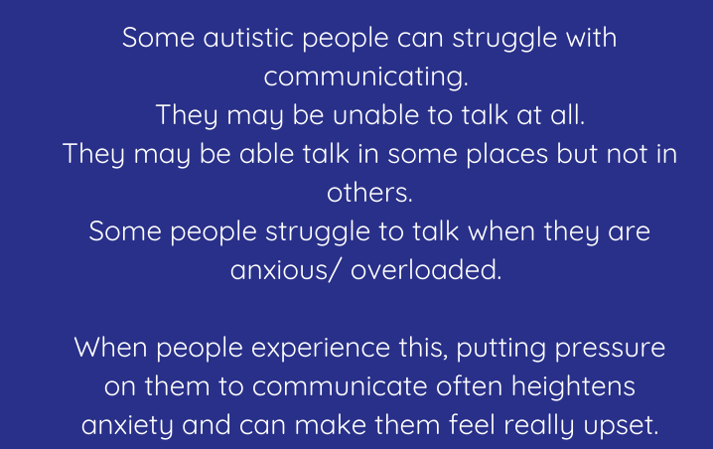
Why might autistic people have difficulty speaking?
Notes:
Emphasise there is no ‘one reason’ and not all autistic people have difficulty speaking – it also may be something that a person experiences different degrees of difficulties with in different contexts.
Possible helpful link: https://autismunderstood.co.uk/co-occurring-conditions/selective-mutism/

Slide 9
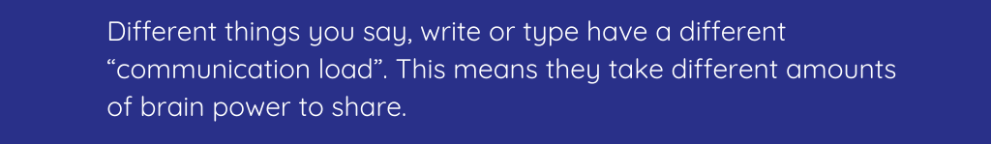
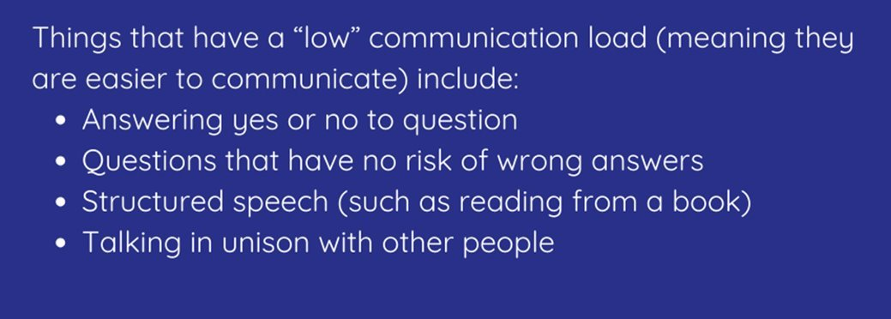
This can sometimes be linked to “communication load”
Notes:
All com not equally difficult: Think if you had to ask a colleague to shower more often – this would cause you anxiety, you’d think carefully, rehearse etc.
Or think about how confident you (or a child) would feel reading out loud 1:1 vs in front of the whole class/a large audience – the pressure is very different!
When reading from boxes emphasise CAN/MAY/MIGHT etc – these are examples
This is all linked to:
Communication load, stress, anxiety and inhibition
Communication load can be understood in relation to cognitive flexiblity – changing information, adapting it, taking perspective, sorting to create an argument etc.

Slide 10
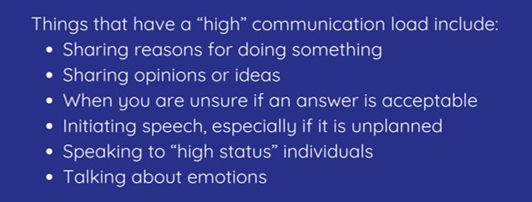
Notes:
How can we help?
Include them without pressure to talk
Don't forget to invite them to join
Don't pressure them to speak

Slide 11

Why might autistic people have difficulty processing language?
Notes:
After watching this video briefly explain that when visuals are introduced, either as gestures or as images, it becomes increasingly easier to understand what is being said, process the information and follow the instruction without relying solely on verbal language
Emphasise SLOW from RTR

Slide 12

Processing Time
Although additional processing time can be helpful when someone is highly stressed, it may not be necessary when they are calm and relaxed.
Stress levels can depend on the environment, the activity and lots of other things that have happened that day.
Looking for signs of stress and checking back understanding of shared information may be helpful in judging processing time.
Notes:
Some autistic young people report frustration when they are talked to “like they are a baby”, people assume that they need lots of time and simple language all the time, but that isn’t necessarily the case. However, this time and simple language is important if a young person is stressed or overwhelmed,
Remember – if you repeat an instruction too soon, a young person may still be processing the information and now they have twice as much to process
You are not being ignored – give people time to process what you have said
Reiterate from previous slides – visuals help with processing
Sometimes if you give too much time, others can shout the answer out and it isn’t possible – but as a teacher you could maybe speak with the whole class to explain that everyone processes things differently and having time to process can be really helpful.

