Slide 1
Greater Manchester Autism in Schools Project
Enabling Environments module 2

Slide 2
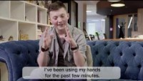
Notes:
https://youtu.be/o_NbDdBq0pU
1:39 mins
Clear message that everybody wanted/ needed something different
Please ask and take time.

Slide 3
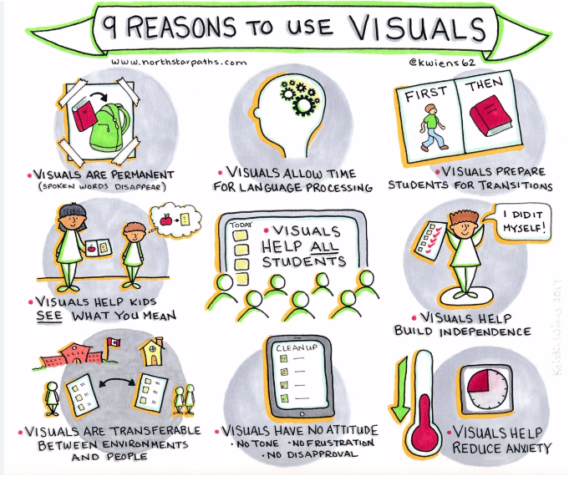
Notes:
Visuals don’t just help with spoken communication but also with lots of other things!
When we say “visuals” we don’t just mean symbols on a lanyard – visual structures and supports can take a number of different forms!

Slide 4
We all use visual supports
Activity
What visual supports do you use in your everyday lives?
Why do we use them?
Notes:
Shout out activity.
What visual supports do we all use in our every day lives.
Prompting questions:
How do you get to a new destination? (follow a map, use road signs etc)
How do you remember what to pick up at the shops? (shopping list)
How do you remember people’s birthdays? (calendar, diary etc)
How do you find the toilet in a restaurant? (toilet this way sign, or symbol on door)
What about a restaurant in a foreign country? (symbol on door – quite often universal)
How do you find the bathroom in your friend’s house? (it has a bath or a toilet in!)
Examples of other everyday systems we use frequently:
Recipe books
Road signs
Shopping lists
Calendars
Diaries
To do lists
Post it notes
Physical markers like ‘stand here’ dots on the floor during covid
Arrows (think about walking around IKEA – there is a system!)
Furniture organisation
2) Why are they important?
Discuss

Slide 5
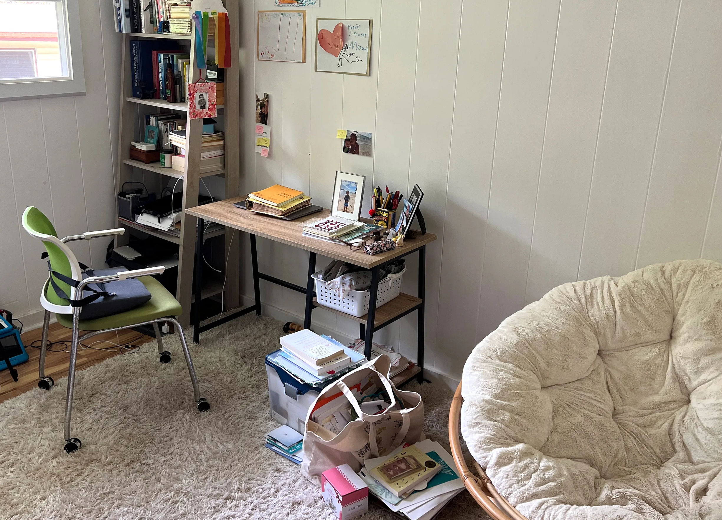
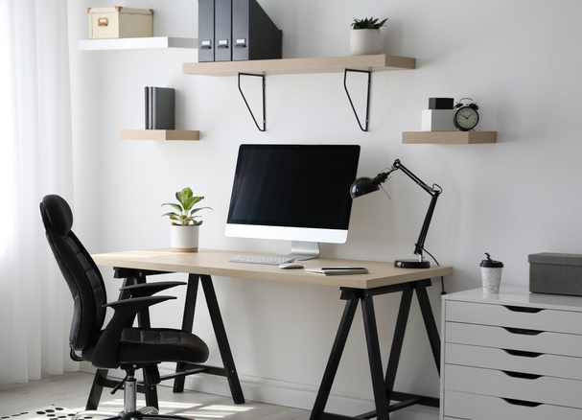
Which space are you more likely to be productive in? Why?
Notes:
Let’s think again about our own sensory profiles – which space works best?
Be aware of visual overload. Clear areas around displays and be thoughtful around visuals.
Which work space do you prefer? Why? Think about furniture, equipment, exclusive/designated space, etc
Where would you be most productive? Why?
What might be distracting you in the first environment? E.g. wanting to tidy up, wanting to sit on sofa/watch tv? Think about comfort/ suitability of furniture etc.
For some people, the first one might be more productive, people may need a comfy seat, background noise like a tv etc.
What in a space might be distracting for a young person, what can be helpful for a young person? What is the most enabling environment for them as an individual?

Slide 6
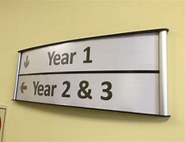
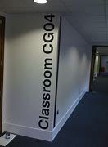
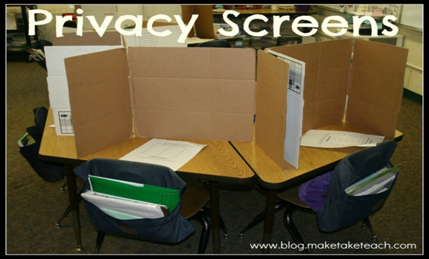
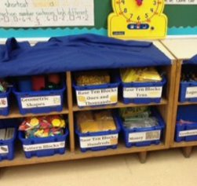
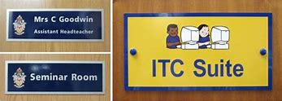
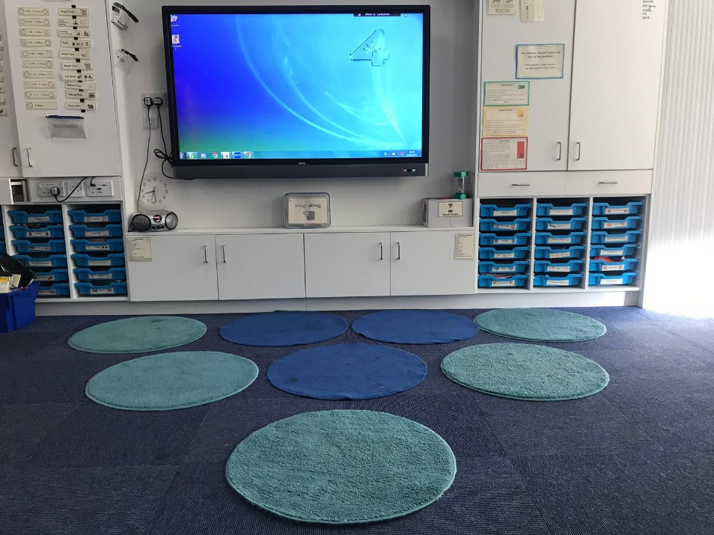
Notes:
Wider environmental systems:
How can we enable the environment to ensure processing of information …….
Consider the physical learning environment
Furniture and layout can help us know what is expected in different parts of school reducing distractions and ambiguity
Think about:
Independence
Availability of equipment
Labels
Clearly organised resources
Accessibility of resources
Unnecessary equipment being out of sight etc

Slide 7
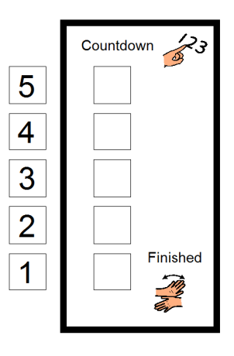
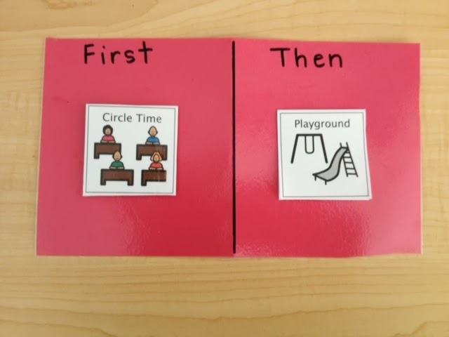
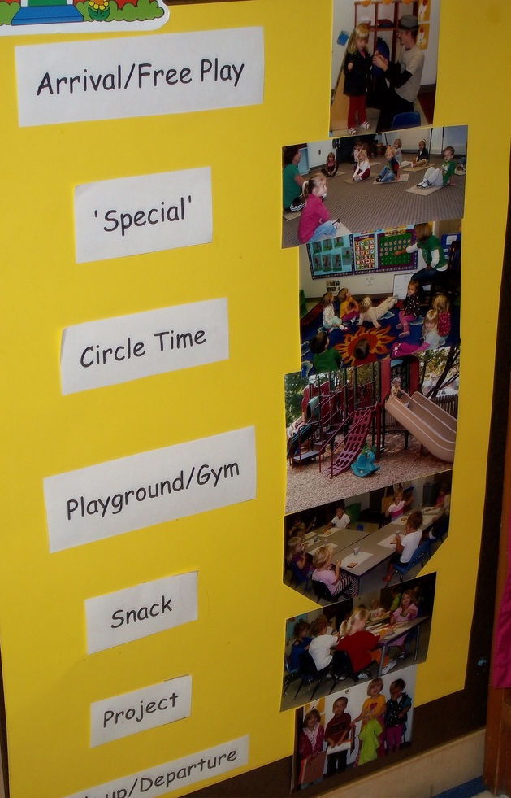

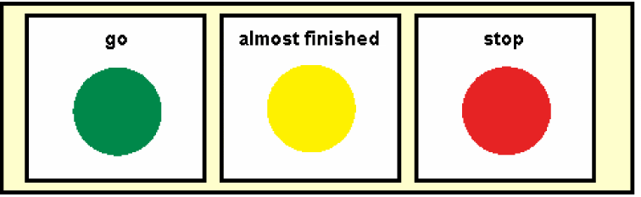
Notes:
Individual support systems:
Provide structure in lessons
Give an overview of the lesson plan
Manage changes and transitions – give notice
Allow processing time
EMPHASISE – now/next is not about compliance it is a tool for supporting transitions by reducing anxiety around what is happening and when
It is sometimes used to say “do this thing then you get a reward”, but this isn’t what it is there for.
What works for the individual people? Can you ask them and personalise the strategies – each autistic person will have different individual preferences.

