Slide 1
Sensory Processing
We all have:
sensory differences
fluctuating arousal levels
strategies we use to regulate
Notes:
Emphasise – we are all different – everyone is individual

Slide 2
Our Senses
  We all know about our 5 senses:
Visual (sight)
Auditory (hearing)
Gustatory (taste)
Tactile (touch)
Olfactory (smell)
Notes:
We will cover these but in less detail than the 3 introduced on the next slide….

Slide 3
But do you know about the 3 Internal Senses?
Proprioception (awareness of body position and movement)
Vestibular (balance)
Interoception (awareness of internal body cues and sensations)
Notes:
We will explain these in more detail shortly…

Slide 4
Sensory Sensitivity
This could include:
Hypo or Hyper sensitivity to sensory stimuli
- Lower or Higher sensitivity to sensory stimuli
Lower sensitivity (hypo sensitivity) may present as:
Seeking additional sensory input
Being underwhelmed/ under stimulated by input
Not reacting to or noticing sensory input
Higher sensitivity (hyper sensitivity) may present as:
Avoiding sensory input
Reacting strongly to sensory input
Notes:
Everyone experiences the sensory world in a different way. However, the intensity of the experience can differ for autistic people.
Your sensitivity can be lower:
Not being aware you are hungry, or feeling pain. Losing balance easily. We can pick up less sensory information which can mean the world is less overwhelming, but it also means we can miss out on sensory information we might find useful.
The intensity can be higher:
Shower water can feel like knives piercing through your skin. A fluorescent light can feel completely blinding or can buzz at an uncomfortable frequency. A school bell can feel like a lion roaring inside your ear.
Often, autistic people have more significant sensory differences, compared to non-autistic people.
Autistic brains take in vast amounts of information from the world, and many have considerable strengths, including the ability to detect changes that others miss, great dedication and honesty, and a deep sense of social justice.
e.g. higher visual sensitivity may = exceptional attention to detail, high auditory sensitivity may = particular musical talent etc.
But, because so many have been placed in a world where they are overwhelmed by pattern, colour, sound, smell, texture and taste, those strengths have not had a chance to be shown.
Instead, they may be plunged into sensory crisis, which can lead to either a display of extreme behaviour – a meltdown, or to an extreme state of physical and communication withdrawal – a shutdown.

Slide 5
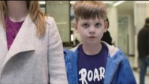
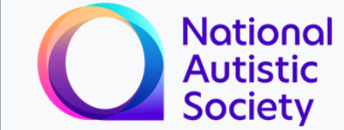
What might Sensory Sensitivity feel like?
Notes:
https://youtu.be/aPknwW8mPAM
1:28 minutes

Slide 6

Auditory Sensitivities
What helps?
Notes:
What is auditory sensitivity?
This sense is responsible for our hearing
The organ of hearing is the cochlea in the inner ear
Hearing is switched on 24/7
We can filter out unimportant information
Hearing has a protective function and alerts us to danger

Slide 7
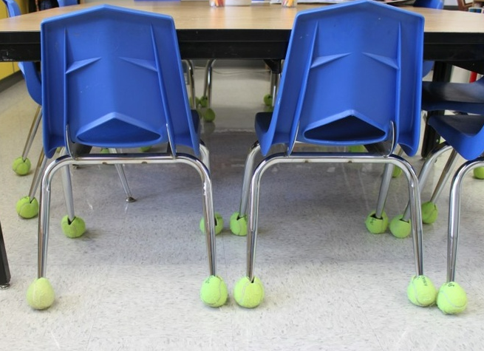
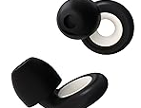
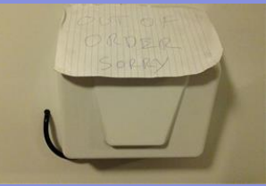
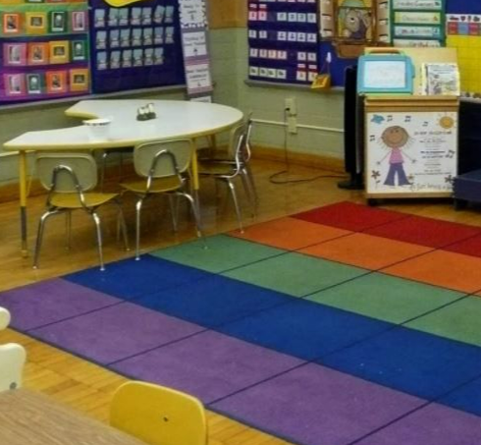
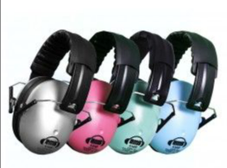
Auditory Higher Sensitivity
Provide ear defenders
Noise cancelling headphones
White noise machine
Decrease auditory stimuli to decrease distraction
Make others aware of auditory sensitivity
Put ‘out of order’ signs on hand dryers
Use soft objects, such as rugs and pillows to absorb noise
Notes:
See handout for what this may look/feel like

Slide 8
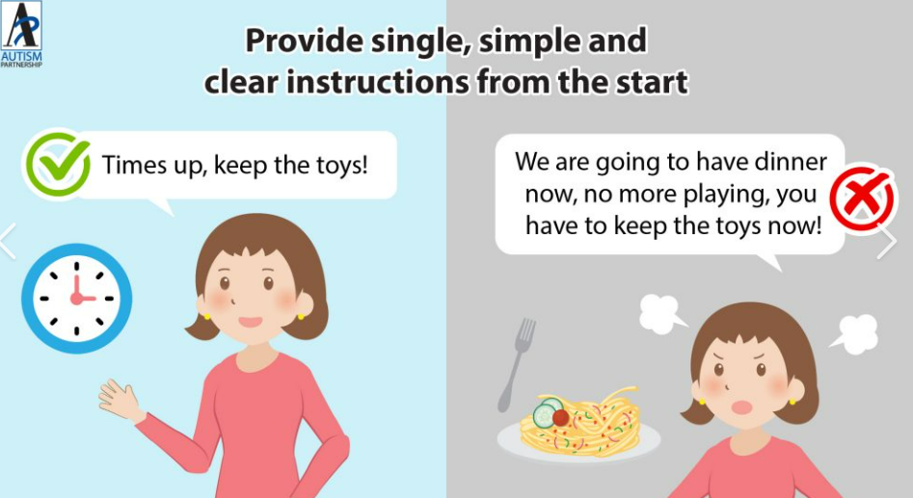
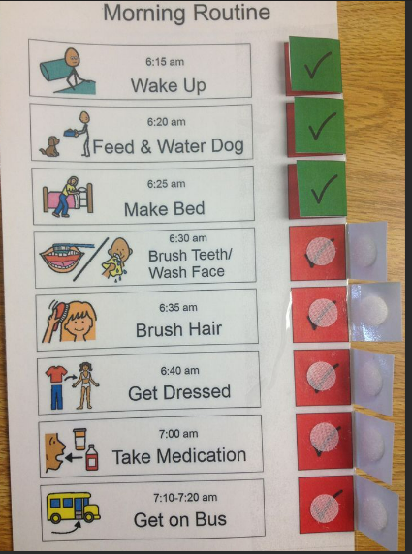
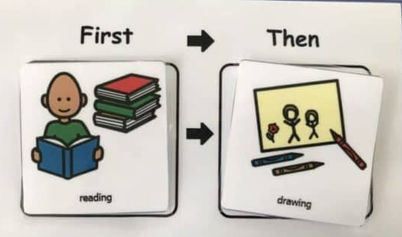
Auditory Lower Sensitivity
Back up verbal instructions with visuals
Visual timeline
Use clear instructions
Remove auditory distractions as much as possible
Speak loudly
Use touch to gain attention (if appropriate)
Notes:
See handout for what this may look/feel like

Slide 9

Visual Sensitivities
What helps?
Notes:
This sense is responsible for our sight​
​
The eye and the brain communicate and work together to help us interpret our physical surroundings​
​
It provides information about people and objects in front of and to the side of us​
​
It helps us to define distance, depth and colour as we move through and negotiate space
Vision is closely integrated with all of our other senses

Slide 10

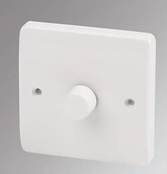

Visual Higher Sensitivity
Decrease visual stimuli to decrease distraction
Have the right type and right amount of light for child
Use soft lights as much as possible
Dimmer switches on lights
Consider blackout curtains
Be conscious of young person’s response to colour
Give both visual and auditory queues
Minimise clutter as much as possible
Use plain colours on walls
Wear plain clothes whenever possible

Slide 11
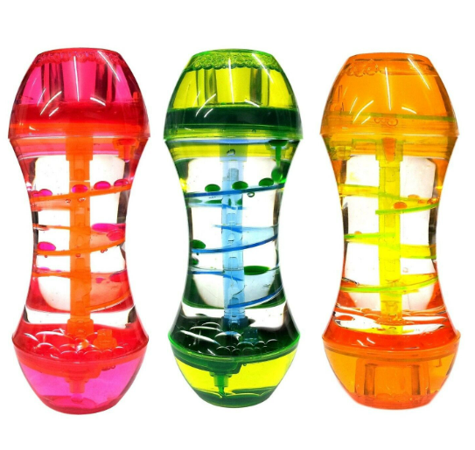
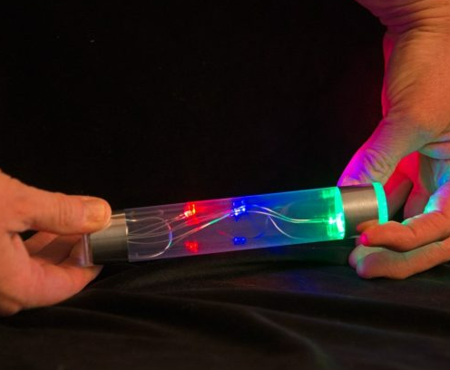
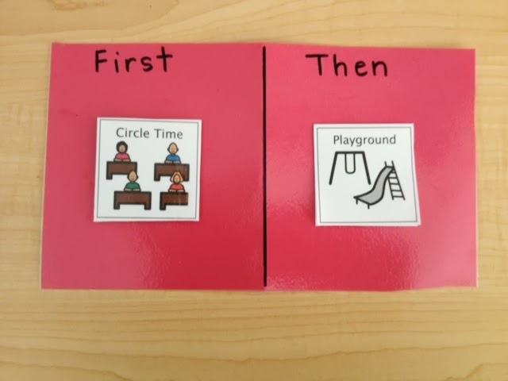
Visual Lower Sensitivity
Offer lots of highly visual activities
Make things you want the person to pay attention to very bright and colourful
Give both visual and auditory queues
Offer visual toys e.g. bubble tubes, water play

Slide 12

Gustatory Sensitivities
What helps?
Notes:
This sense is responsible for our taste ​
​
Receptors are located on tongue​
They recognise taste sensations, sweet, sour, salty and bitter​
Taste can be protective e.g. poisonous food often bitter

Slide 13
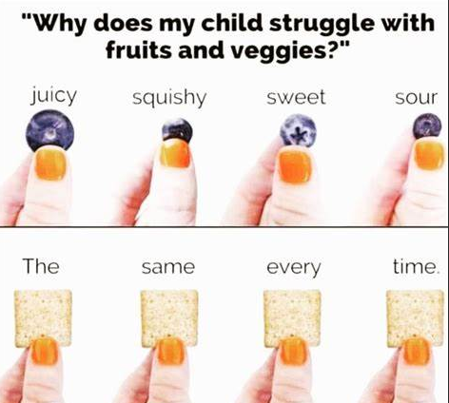
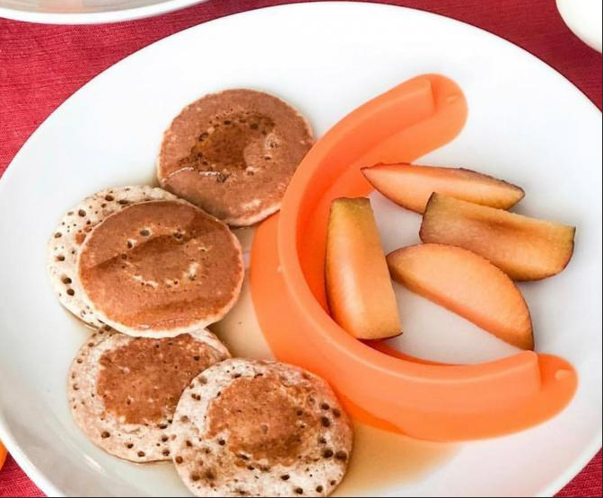
Gustatory Higher Sensitivity
Use plate with divided sections
Use unflavoured toothpaste
Don’t pressure to try food they are uncomfortable with
Ensure eating can take place in a calm environment to reduce anxiety
Use a desensitisation process to introduce new food (seek professional support)

Slide 14
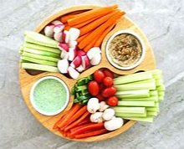

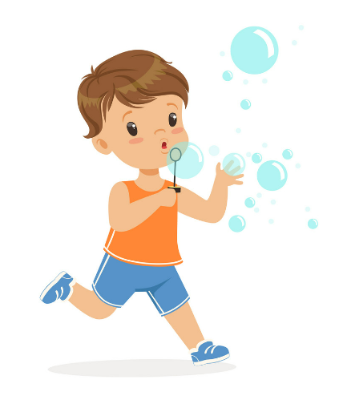

Gustatory Lower Sensitivity
Provide strong tasting foods
Offer crunchy foods
Offer spicy food
Offer food with a variety of textures
Oral motor activities

Slide 15

Tactile Sensitivities
What helps?
Notes:
This sense is responsible for touch​
​
Is responsible for processing touch information from the body​
​
It's how we feel all touch sensations, including vibrations, temperature, textures and pain​
We have receptors in our skin all over our bodies that send signals to our brains​
Touch is very important for overall organisation.

Slide 16


Tactile Higher Sensitivity
Adaptive Clothing for Kids | Assisted Dressing | M&S (marksandspencer.com)
Alert the person if you are going to approach them
Try plastic or wood utensils rather than metal
Have dry clothes ready for if theirs gets wet
Provide a quiet corner where child can relax and be safe from touch
Cut labels off clothing, buy seamless socks
Turn socks and underwear inside out to avoid labels and seams
When tooth brushing warm water may be tolerated better than cold water
If hair brushing, try to do it in front of a mirror to increase predictability
Notes:
Sensory sensitive clothing: https://www.sensorysmart.co.uk/ • Marks and Spencer special needs clothing range • http://www.smartknitkids.com/ • 3-sided toothbrush for quicker brushing, or a natural bristle toothbrush as this is softer and more tolerable

Slide 17
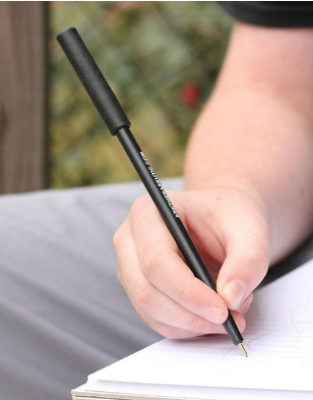
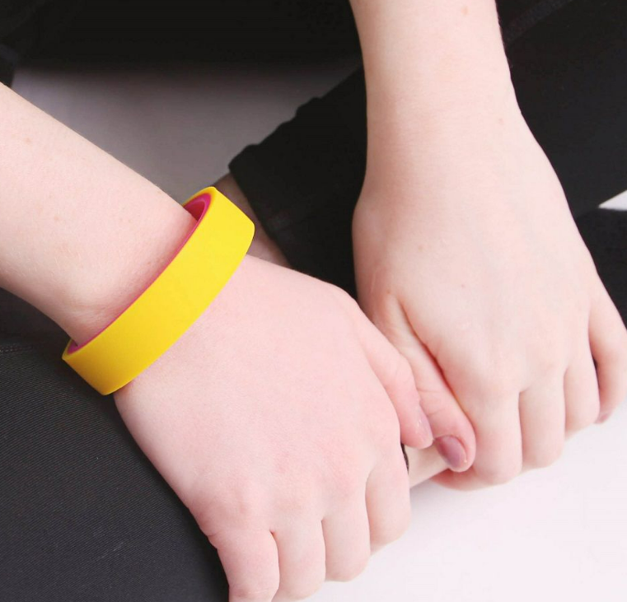
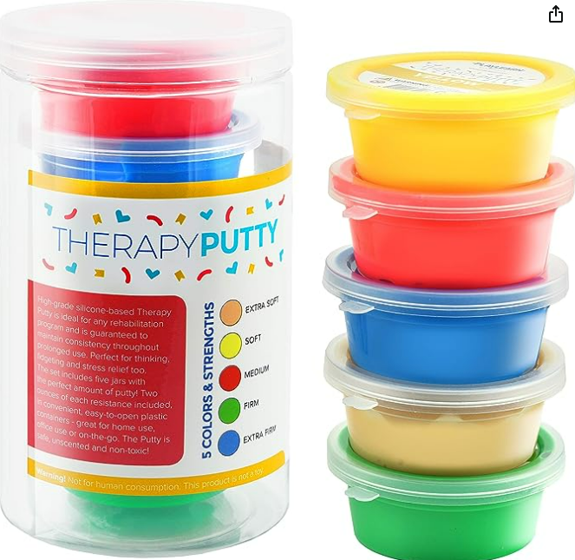
Tactile Lower Sensitivity
A chew necklace to meet mouthing/tactile needs https://www.tinknstink.co.uk/
Try a vibrating toothbrush, or a toothbrush that is heavier or has a bigger grip for more tactile input
Use heavy cutlery or cutlery with big grips
Give lots of deep pressure to fulfil their need for tactile input throughout the day
Give lots of opportunities for messy play
Theraputty
Notes:
Use a visual support to help understanding e.g. typed notes on a handout, pictures, keeping instructions on board

Slide 18

Olfactory Sensitivities
What helps?
Notes:
This sense is responsible for our smell ​
​
Receptors are located in nasal structure​
​
There is a direct connection to the limbic system​
​
Smell has a protective function as a general alarm system alerting us to fire, decayed food
APPROXIMATELY 80% OF WHAT WE PERCEIVE AS TASTE IS ACTUALLY SMELL

Slide 19

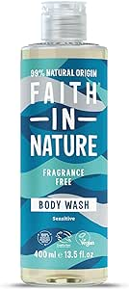


Olfactory Higher Sensitivity
Make the environment as fragrance free as possible
Ask cleaning staff to use fragrance free cleaning products
Use un-perfumed toiletries
Seat student away from the rubbish bin or other objects that may produce strong odours
Keep rooms well ventilated, especially when using strong smelling materials
Allow student to sit beside open window
Help the pupil to recognise their senses:
Cover nose with tissue
Inform teacher that smell is unpleasant

Slide 20

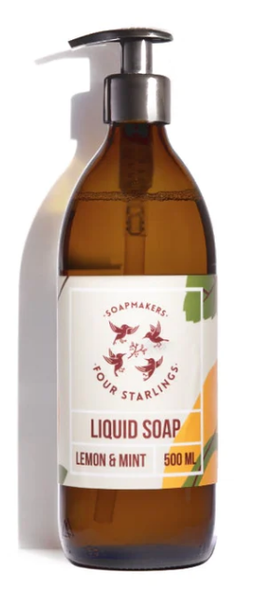
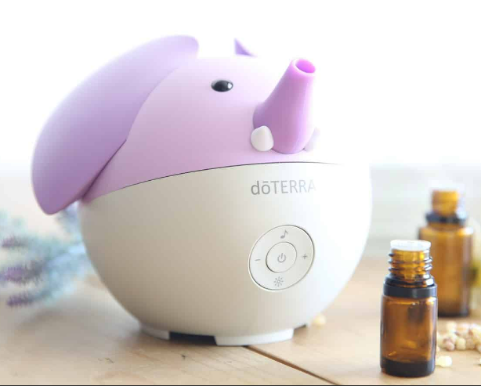
Olfactory Lower Sensitivity
Aromatherapy Necklace For Diffusing Essential Oils
Provide activities which stimulate the olfactory senses:
Playing in grass
Using smelly or scented play doh
Cooking with strong smells
Set up a Smelling Station:
Use containers filled with different cotton balls containing essential oils, spices, smelly objects e.g. cheese and rubber bands
Have a scented lamp, candle, lotions, liquid soap, scented markers or stickers available to smell to alert student
Provide the student with a scent they prefer and allow the student to sniff the scent to stay alert

Slide 21



Supporting Sensory Sensitivities
We will explore these senses in more detail today as well as exploring support strategies.
Notes:
Still refer to the handout for more information

Slide 22
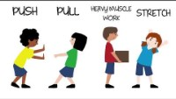
Proprioception
Notes:
This sense is responsible for body awareness
Organs of proprioception are the receptors in muscles and joints
It relates to the body's ability to sense its location, movements and actions
Unconscious awareness of body position. Communicates how much pressure we must exert

Slide 23
Proprioception Sensitivities
What helps?
Notes:
If a young person is dysregulated, struggling to sit still and needing movement to satisfy their proprioceptive space, there are some activities that can be really helpful.
It helps to get a better understanding of where your body is in space.

Slide 24

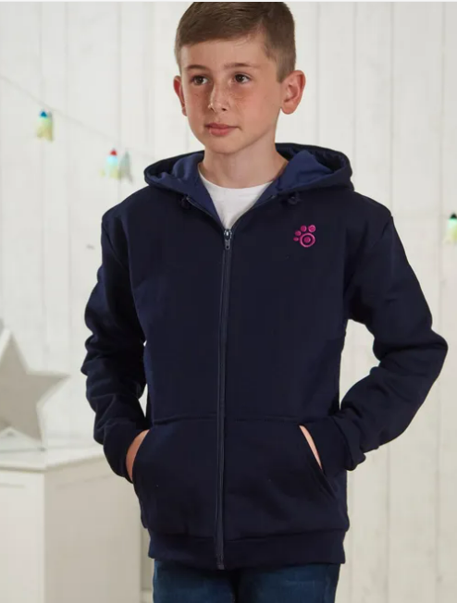
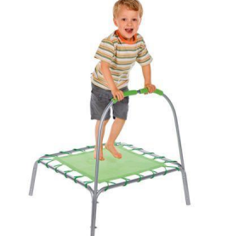
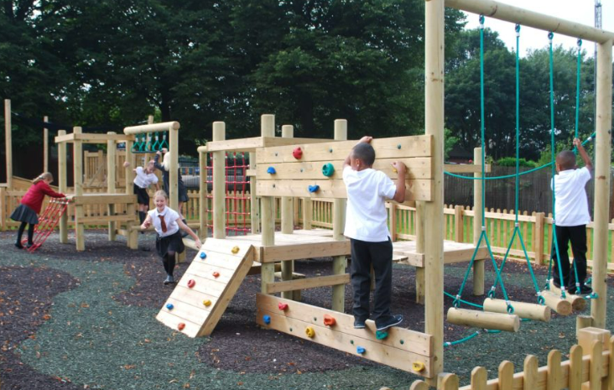
Proprioception Activities
Weighted blanket/ Heavy quilt/ Compression vest/ Heavy backpack. Check weight guidance before use.
Have ‘heavy jobs’ available e.g. carrying shopping, carrying laundry, pushing and pulling things – especially when changing to a different location or going down the stairs
Provide lots of opportunities for active play e.g. trampoline, swimming, biking, rollerblading, climbing, skiing – Work on muscle strength, this improves the feeling of proprioception!
Weighted Compression | Weight & Compression | Weighted Hoody (sensorydirect.com)
Notes:
EXAMPLES: (taken from Andy Smith’s ‘Autism and Sensory Sensitivities’ booklet)
‘Liam was always crashing into things. He would crash into classmates when lining up at the door. When he held the door open for his teacher, he would push too hard on the door and it would crash into the wall. He had difficulty colouring because he would always press too hard and rip the paper’
Jamie and Lion reports sometimes completely losing where he is in a room, so he lies on the floor until the pull of gravity on his body makes him realise where he is.
Tom was over-responsive to touch and sounds, but he liked to be squished and cuddled. He pushed against everything. He loved rough play and could only sleep when the blankets were pulled tightly around him. When he was frustrated, angry or disorganised, Tom would push his chin into the arm, back or legs of his parents. Tom’s parents often gave him back rubs to help him stay calm. He would find tight spaces to climb into and would often bury himself under pillows. Tom’s search for pressure seemed to occupy most of his time and energy.’

Slide 25

The Vestibular System
Notes:
This sense is responsible for our balance
The vestibular system includes parts of the inner ear
It is stimulated by movement of the head
It gives information about movement and rotation in all directions.
It has a role in maintaining posture and organising motor actions.

Slide 26
Vestibular Sensitivities
What helps?
Notes:
It is worth keeping in mind how sensory differences can be a barrier.
For example, if a student is refusing to do PE, could it be because they have a high sensitivity to balance and have a fear of rapid movements, or could it be that they have a lower sensitivity and they are worried about falling over and being laughed at?

Slide 27
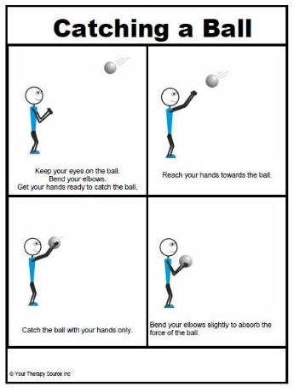
Vestibular - Higher Sensitivity
Allow individuals to control their own movements as much as possible
Provide alternative games and activities in P.E. and the playground which do not involve fast, unpredictable movement
Encourage the student to participate in activities which involve up/down movements and this is easier to tolerate than backward or spinning movements
Set up a games room in school for break and lunchtimes and provide a range of board games as an alternative to playground activities
Use visual strategies to explain what it expected in an activity as this may also increase participation e.g. visual work system, written instructions
Provide a calm card so the student can request a break from the movement activity if he is feeling overwhelmed.
Notes:
Provide alternative games and activities in P.E. and the playground which do not involve fast, unpredictable movement
Encourage the student to participate in activities which involve up/down movements and this is easier to tolerate than backward or spinning movements

Slide 28
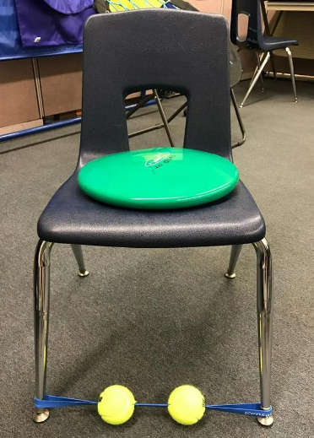
Vestibular - Lower Sensitivity
Provide lots of opportunities for active play; trampoline, swimming, biking, rollerblading, climbing, skiing
Put a Movin’ sit cushion on the floor: this acts as a ‘foot fidget’ which again provides increased movement input.
Use rocking-chairs, swings, egg chair/ whizzy dizzy/ swivel cushion etc. to help to understand their sense of balance.
Find a swing that also spins round for more excitatory input and give child access to this throughout the day
Facilitate movement breaks, e.g:
Taking a message to the office or another teacher
Handing out books
Collecting in homework
Tidying away materials and resources
Tie a ‘Theraband’ around the front legs of the student’s chair, using it as a foot fidget.

Slide 29

Interoception

Slide 30
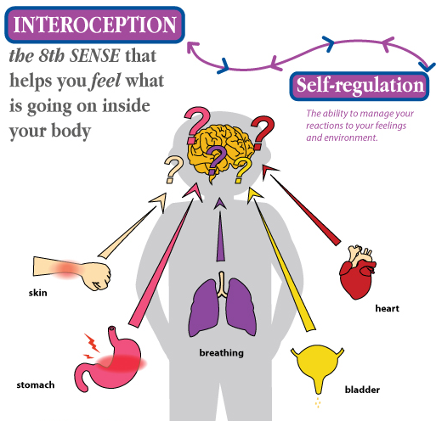
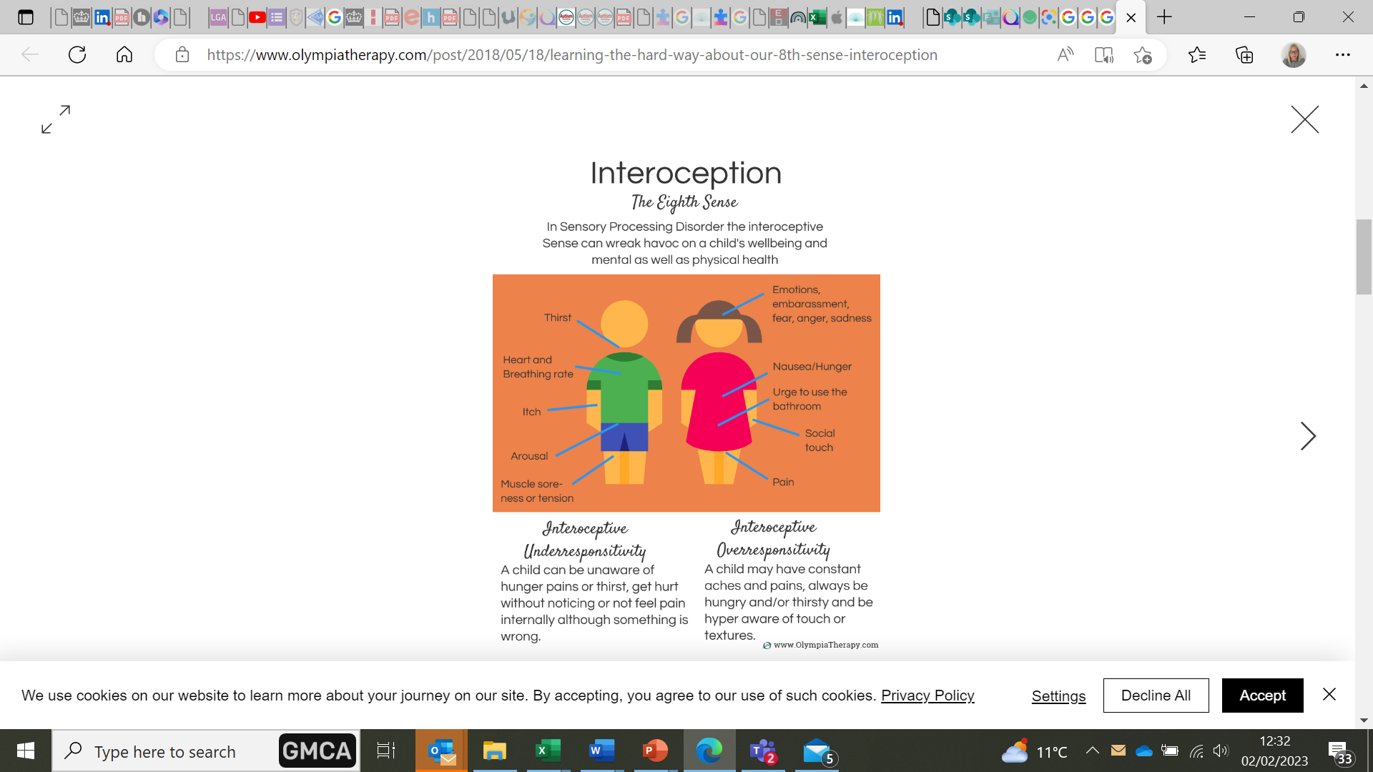
Interoception
Notes:
Interoception – what is it?
Interoception is the ability to detect and attend to internal bodily sensations
It helps to understand what is going on inside of the body like hunger, thirst, feeling hot or cold, fatigue, or a full bladder
It is also linked to how we identify emotions
Additional Factors: Interoceptive discrimination difficulties when you cannot always pinpoint the exact feeling you sense internally. You may have a vague or general feeling but have difficulty identifying exactly what the sensation means.

Slide 31

Alexithymia
What if I can’t understand what I’m feeling?
Notes:
This slide is an optional extra video about Alexithymia – if time!
https://youtu.be/gyMOSsg3Nps?t=91
What if I Can't Tell What I'm Feeling? (Alexithymia) – YouTube
3:40 mins
Full clip 4:24 mins

Slide 32
Interoceptive Sensitivities
What helps?

Slide 33
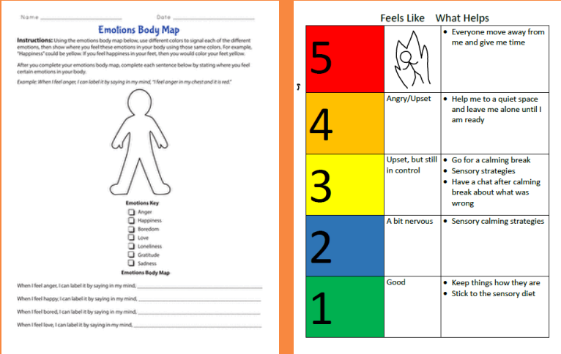
Interoception Activities
Talk more openly about internal sensations they feel and work together to investigate what they might mean
Use body map and connectors
Learning by experience (when they are calm/ relaxed!)
Offer verbal or visual prompts to eat, drink and/or go to the toilet
Link physical state to a name and action e.g. sweating-too hot-drink water
Talk about emotions and feelings and what they look like
Provide access to calm spaces
Visit: https://www.kellymahler.com/printableresources for free resources
Notes:
Activities here have not been separated for higher and lower as ‘tuning in’ to internal feelings benefits both high and low sensitivities
When we are supporting young people with this, the best way to do this is be genuine – do it ourselves, model identifying your emotions/ feelings. It is also really important to never invalidate what a young person is saying.
If they say the rain is difficult, they are telling the truth from their perspective even if it isn’t the truth for you. It is really important this is respected so young people safe and comfortable or they are not going to be able to learn.
Encourage people to maybe have a go at making a 5 point scale for themselves?

Slide 34
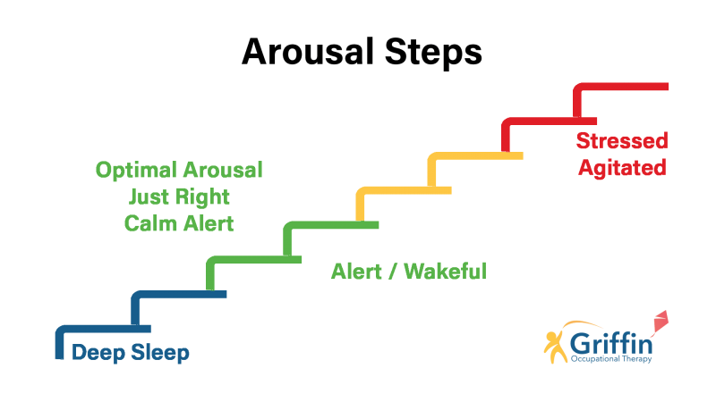
Arousal Levels
Arousal levels fluctuate throughout the day.
Autistic pupils may need more support and input to regulate their arousal levels.
If arousal levels are too high or too low, it is very difficult to learn.
If the brain is in over-arousal, we may be jumpy, hyper or anxious
If the brain is in under-arousal, we may appear sleepy, lethargic or disinterested
Notes:
Useful Resources:
https://autismunderstood.co.uk/autistic-differences/being-sensory-smart/
https://autismunderstood.co.uk/autistic-differences/being-sensory-smart-in-more-detail/
For more information and examples, see:
Sensory Circuits - Autism Advice - YouTube
Sensory circuit random choice ppt | Teaching Resources (tes.com)
Sensory Circuits - Childrens Choice Therapy
What are sensory circuits and how can I use them at school? - GriffinOT

Slide 35
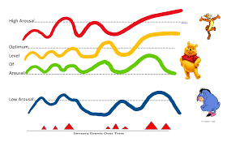
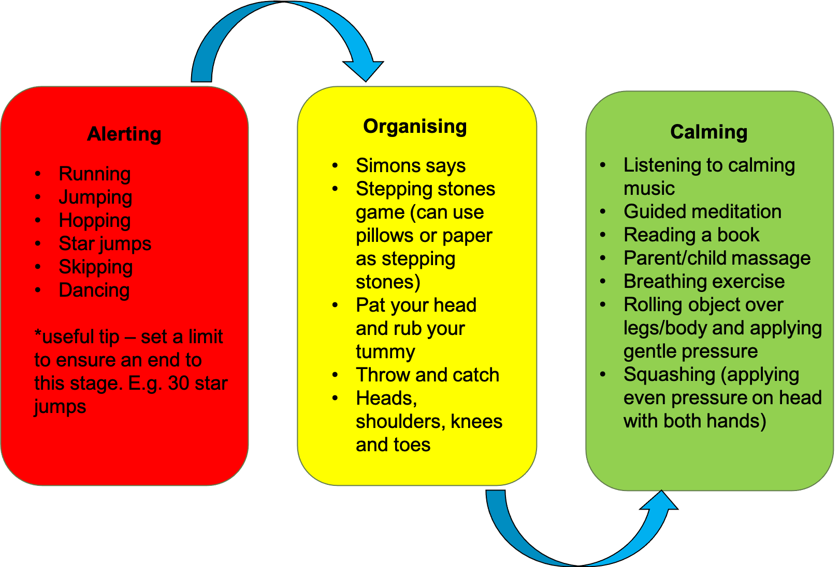
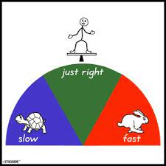
Regulating Arousal
Notes:
We all have arousal levels and things we naturally do to regulate them.
Discuss ‘real life’ examples, e.g.:
In the morning we may do something like have a shower or a coffee to wake up from low arousal, etc….
If stressed we may go for a run
May have a glass of wine to unwind

Slide 36

Sensory Overload
Notes:
https://youtu.be/zWPL3QPD4p0
4:05 mins

Slide 37
Key messages
Creating a low arousal environment is really helpful:
It is difficult to feel relaxed and happy if you are distressed by sensory input in the environment.
In addition, have sensory tools available for:
Blocking out harmful sensory input
Providing calming or alerting sensory input, depending on what you need in the moment.
A combination of a low arousal environment and the right sensory tools to meet a variety of sensory needs is key to an autistic person’s sensory needs being met.
Notes:
Autism + environment = outcome (Luke Beardon)
It is really important to add that young people aim to be “good” and follow the rules like sitting still, giving eye contact etc. and they try their best to follow this, but by doing this they may not be meeting their needs and this may lead to them struggling in the environment – their views are really important for making environments accessible, and it is important to recognise that every young person needs different things to be comfortable – so is your environment a place where it is ok for young people to meet their individual sensory needs?

