Slide 1
Understanding the implications of common learning patterns in autism in British schools
Claire Carroll Area Lead educational psychologist,
One Education Manchester

Slide 2
Aims of the session
To have a clearer understanding of a common learning style in autism and its interaction with the National Curriculum.
To have a better understanding of the reasons why some able autistic young people may struggle with their work.
To understand the competing pressures on the school and the autistic student.
To have a clearer idea of how we can support young autistic people in school.

Slide 3
Traditional advice about autistic learning to teachers
‘Visual learners’
Use visual timetables to facilitate transitions; use social stories to facilitate social understanding
Be mindful of the sensory environment
Autistic students may show advanced rote skills compared to comprehension, especially when young (eg echoed speech without meaning, hyperlexia)
Use ‘more structure’ in work
It’s pretty vague and unhelpful, and talks very little about what is expected to be taught!
Notes:
The point of this slide is, to show how limited our traditional advice is to teachers working with autistic students. What do they get told about learning? Just ‘be more visual’ and ‘use more structure’ and that some autistic students may be able to recall rote tasks without true deep understanding. This doesn’t give teachers much to go on with regards to how to adapt their TEACHING (rather than advice on adapting the sensory aspects of the class, their relationships and interactions. These are also important of course – but only part of the picture).
Not all autistic people have visual preferences. Some are verbally oriented and derive meaning best from written or verbal concepts. Not enough attention paid to inidivdual patterns of learning

Slide 4
Further analysis of one common autistic learning style
Not all autistic people have the difficulties described in this talk. Some thrive in education; some are very musical or are fabulous at writing or highly artistic.
For some youngsters, who have externalising (outwardly expressed) behaviours, it is of course obvious when they are struggling.
The pattern of strengths and issues described in this talk is however, quite common in autistic people who internalise their behaviours. This causes issues for the young person as they move through school, because their difficulties are often hidden until they fall out of education or develop severe school-based anxieties or burnout.
Notes:
It’s important to understand the key concepts in order to understand WHY the person can often struggle
Young people who have “externalising” behaviours are more likely to get support, as others can see the distress more easily and it affects them more. The difficulties of young people who have “internalising behaviour” are often missed or misunderstood. This group of people tend to “cope until they can’t”, or appear fine in school, but are struggling a lot with their mental health or eventually get to the point where they are unable to attend school due to the distress they experience.

Slide 5
Key concepts discussed in this session
categoriser / classifier
inhibition
anxiety
communication load
executive functioning
Notes:
Inhibition: Difficulty with the ability to initiate things

Slide 6
Activity – Ben Case Study
Have you ever taught a Ben?
Read the pen portrait and highlight key assumptions made by those around Ben.
Any ideas what is going wrong for Ben?
Notes:
First, talk about Ben in general. What could have happened? Why does he feel misunderstood? How can he be able, but struggling?
Then discuss the key assumptions people are making – does ‘high functioning’ autism mean ‘mild’ autism? people interpreting him as lazy, taking evidence of when he does succeed as evidence that he is not trying, his parents think he needs more pushing, more discipline etc
Also the idea that any inability to write is ascribed to either motivation or ‘slow processing’ . But it’s more complex than that as we will explore.

Slide 7

Categorisers / classifiers in autism
Detail focused
Bottom-up processors – identify differences within categories, enjoy this (e.g. Thomas the Tank Engine, dinosaurs, Pokémon)
Comfortable with precision, perceive precision as ‘truer’ –it’s not correct to say that I was jumping in the puddle, I was stepping in it
This comes across as highly intelligent / wide vocab in early years
Shows a preference for factual information, rote learning and excellent memorisation
Often excel at early acquisition of literacy/numeracy – so expectations are set high early on
Notes:
Not every autistic child will present this way of course, or show every one of these traits – but this is a common history we find in casework referrals – in part because these youngsters start so successfully and then begin to struggle – and no one quite understands why. It tends to get ascribed to motivation or occasionally organisation.
It's really important to see the impact of that very early skill development on the young person’s sense of self – as someone who finds work ‘easy’, who does well – and this impacts parental expectations and teacher expectations as well

Slide 8
Categorisers: areas where school causes stress
Likely to find “non-autistic” language usage baffling/irritating (often find computers more helpful)
May find interpreting the intent (‘parsing’) of imprecise “non-autistic” language usage genuinely difficult esp. when younger (‘I can’t write about what I am going to do at Easter because I haven’t done it yet’)
Accuracy is comfortable; so mistakes are very difficult
Likely to struggle with perception of endpoint/aim/finished version/gestalt
Likely to conversely experience imprecision/ambiguity as anxiety provoking
Sensitive to perceived ‘risk’ in work – especially as they get older
Notes:
Idea of ‘risk’ is very important to understand. Risk is related to the concept of how likely it is that this piece of work will be ‘right’. When mistakes are perceived as ‘wrong’ and to be avoided non-black and white tasks can be experiences as highly stressful as there’s no clear way to be ‘correct’. Often people will seek to be perfectionists, memorising ideal responses, or conversely be unable to write extended ‘risky’ answers – those pertaining to opinion, perspective, using information to construct a particular argument.
PARSING is the ability to understand the speaker’s intent via common usage rather than making a direct and precise interpretation of their words. For example, a 5 year old child was asked to write under the heading ‘What I will do at Easter’ – he couldn’t respond as he didn’t know what he would do yet, because it hadn’t happened. The teacher intended them to write about ‘what I might do at Easter’ or ‘Easter customs’ or ‘Things people do at Easter’ – but that isn’t what she asked him to write.
The example here is about a young person who was given a detention when he was in year 1 for not doing work. He was then taken to the headteacher and they still didn’t do it. Their parent was brought into school and it was discovered the reason he couldn’t answer is being asked “What are you going to do at Easter?” – he didn’t know as it wasn’t Easter yet. If the question was something like “What do families typically do at Easter?”, he would have been able to amnswer.

Slide 9
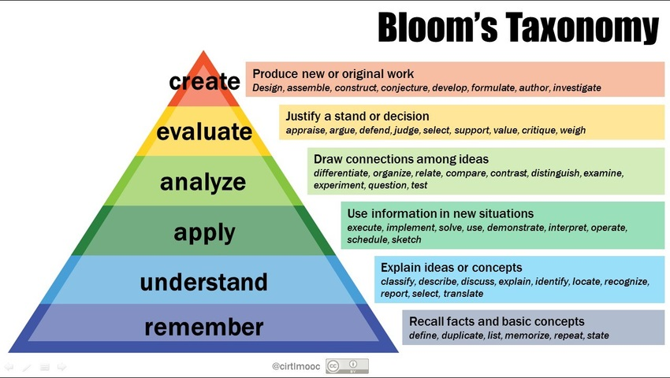
Bloom’s Taxonomy
Notes:
NOTE: Blooms in controversial in some education circles and it is not a perfect model in that skills are not taught fully hierarchically. This session is using blooms as a proxy to discuss hierarchical and higher-order thinking in order to make it clearer when, why and how some autistic children begin to struggle academically.
Blooms lowest two segments are inherently less ambiguous
Apply, analyse and evaluate are inherently more ambiguous. The difficulty is, from the autistic person’s point of view, there is a sort of ‘acceptable answer’, but its convoluted and hidden and complex to get to.
Create is sometimes actually easier for some (not all) autistic people as at this level there can in fact be more freedom – its not that you have to produce the acceptable response, but that any response is genuinely ok.
For many of the autistic children we are discussing – the Bens - Skills excel in lower two segments of the taxonomy – recall, regurgitation, and sometimes explain or describe a concept.
Analyse, evaluate create, involve ambiguity and are often harder for ‘categorisers’ who excel at identifying difference and subcategories but find it harder to draw connections amongst ideas.
There is inherent clarity in remembering and understanding , and inherent ambiguity in analysing and evaluating. There is theoretically a correct response, but it’s not that clear what it is. Creating can be easier because there is no hidden ‘correct answer’ – its easiest when its totally unambiguous, but where there is complete freedom and no risk of an ‘incorrect’ or ‘unacceptable’ response this can be easier than that mid section of ‘hidden correct answers’
Example – an autistic girl in year 11 said ‘I actually prefer writing stories to writing essays, as in stories I really can write what I like, but in essays there is a correct answer, a correct way to do it, but its hidden’
The freedom of creativity and learning outside of expectations is why self-directed learning can be successful for autistic youngsters

Slide 10
The National Curriculum and Bloom
Curricular changes over time can be very confusing and upsetting for autistic people and are rarely explained. Broadly:
Early years: play based, exploratory, often self-directed
Infants: Skill acquisition, rote learning of skills
Juniors: Skill application, beginnings of perspective taking
Key stage 3 and 4: Opinion, argument, taking and comparing perspectives, analysis, identifying relevant information from stored knowledge to argue a particular point. Increase in volume of work and expected levels of personal organisation and responsibility.
Notes:
Note – It's not as simple as saying that all work in early years is at stage 1 and 2 of Blooms and as you up the school it shifts completely. However, skill acquisition involves knowledge comprehension and memorisation and this is a greater part of the ‘learning to read, write, spell and numeracy’ curriculum early on. Once those skills are acquired it moves into more application of those skills, and then into comparison, discussion, opinion etc.
It is difficult because young people don’t know how the curriculum changes, people don’t explain how the curriculum changes. Young people who previously excelled start struggling and don’t know why, which causes a cognitive dissonance and distress – instead of expecting people to be able to because they found things that are lower down on Bloom’s Taxonomy easy.

Slide 11
Activity: Where on the taxonomy would you place these questions?
Design an experiment that could be used to separate mixed salt and sand.
What is an Oxbow Lake? Describe how they are formed.
Why, in your view, does Hamlet delay his revenge?
What do you think happened to the dinosaurs? Explain your answer.
How successful do you feel the author has been in his description of the evening? Use information from the text to justify your response.
Using your knowledge of the times, in your groups create a skit depicting the Vikings’ arrival at Lindisfarne.
A spelling test using this week’s learned words.
Note: not a straightforward hierarchy where younger children only do lower order skills. However, sophistication and expectation increase radically through school years.
Notes:
Handout can be given after this activity

Slide 12
Government imperatives
Youngsters are ‘tracked’ and given ‘expected levels’ – which assume neurotypical learning development
Schools are measured on various performances – progress 8, value added, ‘English baccalaureate’
SATS in year 6 – aspects of which are knowledge heavy (e.g. SPAG)
Coursework elements of GCSE reduced or scrapped
Exams are designed to be stressful and summative
‘Reasonable adjustments’ help a bit but don’t compensate completely
Notes:
Acknowledging that schools don’t have full freedom to make the adjustments they might like.
The pressure on schools is transmitted down to become pressure on students – especially ‘bright’ students like Ben.
SPAG???

Slide 13
Activity
Revisit Ben’s case study.
Can you relate it to Bloom’s taxonomy?
Consider what other aspects of school life and Ben’s autism may be interacting.
Does this help you begin to understand what may be happening to youngsters like Ben? Please discuss!
Notes:
Key ideas: sensory aspects, curricular imperatives, excellent memoriser, diffs with thinking flexibly, writing diffiuclties, stress
The curriculum has changed and no longer plays to their strengths
Because it previously did, they have a reputation as ‘bright’ and a self image as ‘bright and knowledgeable’
When they begin to struggle it is often hard for they, their families and teachers to understand why. This causes cognitive dissonance and ultimately anxiety / depression
Its largely because the key assessed skills have changed, and the curriculum no longer plays to their learning strengths
They are under expectations they can’t meet – this causes stress and anxiety too
Another key concept is risk. There is limited risk in writing a correct answer (eg doing a sum, if you are good at maths)
Writing an extended answer if your learning style is detail focused and bottom up is hard. It is imprecise = uncomfortable. There is not a clear solution = uncomfortable
This causes anxiety…and anxiety can inhibit the person from being able to write, especially under tight time pressure. Ironically creative writing *may* be experienced as preferable as there is literally no ‘correct’ answer (in pre-Gove curriculum) – but writing essays in, for example, English and history is very hard as there are acceptable and unacceptable responses
Occasionally the young person may be asked to write about a special interest – this feels less risky because it is an area of intense joy to the autistic person, they are likely to have read and studied widely in this area.
Lack of motivation is too simple to describe what happens
Add structure is too imprecise

Slide 14
The interaction of Bloom, the National Curriculum and the autistic categoriser
Personal self-concept as a learner, and those of family and teachers, formed early
Not understanding why in later school years, you can’t, being interpreted as won’t (and consequences applied..)
Accommodations which don’t fully tackle the problem
Key issues to understand are:
- Executive functioning and autistic inertia
- Higher order thinking skills (Bloom’s taxonomy)
- Handling imprecision and ambiguity: Risk as a concept and how it relates to anxiety and inhibition
Notes:
Accommodations such as extra time help a bit – but time isn’t the main problem. It's about how to tackle and ambiguous task with the least risk to one’s sense of self.

Slide 15
Executive Functioning
Executive functioning is about efficient processing and organising by the brain.
The 8 executive functions are impulse control, emotional control, flexible thinking, working memory, self-monitoring, planning and prioritising, task initiation and completion, and organisation.
Videos to help explain executive function:
https://www.youtube.com/watch?v=YWZuXpU-IOQ
(short animated video including some advice to support)
https://www.youtube.com/watch?v=229Xb50_o8M (to 4min 26 seconds) – Myth Schaber, autistic person
Notes:
If your brain is an orchestra with all instruments playing – executive functioning is the conductor

Slide 16
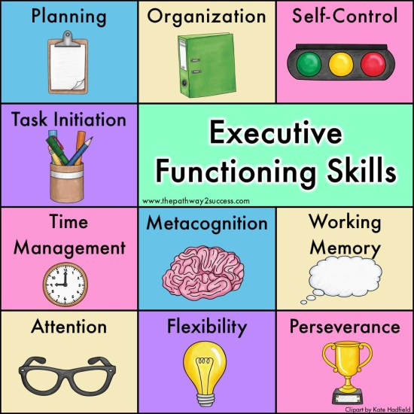

Slide 17
Autistic Inertia
Many autistic people describe a feeling of ‘inertia’ where they are unable to move on from their current state or activity; this was first researched in 2021 - in Manchester! (Buckle et all, 2021)
Thought to be linked to executive dysfunction and monotropism (the autistic brain’s tendency to have narrowed areas of high focus and interest).
Obviously this can have implications in a school day where multiple transitions are required, or in exams working under timed conditions.

Slide 18

Imprecision and ambiguity: communication load, stress, anxiety and inhibition
Flexible thinking is known as a core area of difference in autistic brains.
This goes beyond ‘difficulty with change’ to ‘difficulty with imprecision/ difficulty with being cognitively flexible’ – changing information, adapting it, taking perspective, sorting to create an argument etc.
Also important to understand the idea of communication load – all communication is not equally difficult. Think if you had to ask a colleague to shower more often – this would cause you anxiety, you’d think carefully, rehearse etc.
Communication that is ambiguous or exposing feels more risky to autistic people who are comfortable with categories, precision and accuracy.
Notes:
Tasks which are ‘high communication load’ include any where there is a risk that one could be incorrect, or where the answer is unclear, extended, or exposing of inner thoughts or feelings.
Cognitive inflexibility – About struggling to understand the intent behind what someone else says. But this is actually a two way thing, when autistic people are open/ honest others assume it is rudeness or take it offensively, even if they have good intent. The problem is that autistic people are often in a non-autistic environment.
Low communication load tasks are clear short answers where the person is confident that their answer is correct.
This is why a lot of these students will answer all the one and two point answer questions but leave the longer questions blank.

Slide 19

Continued….
Essay writing, inferring, justifying, creating, extended answers are all ‘riskier’ than memorised answers / maths.
Exposure of the self can also feel risky if you are autistic and inhibited – personal responses, diary, give your opinion on…
Often causes extreme inhibition – slowness or ‘refusal’ - rooted in ANXIETY.
Conversely – the autistic person may have special interest areas where they can write more or engage more fluently. This is NOT evidence that they have been lazy in other tasks. It’s linked to the great comfort and pleasure (= less anxiety) autistic people often derive from their specialist subject knowledge.

Slide 20
Research
Sullivan 2010 – 3 ways students in college cope with academic stress:
- Approach – take active steps to tackle the stress
Avoidance – deny the problem or escape from the task
Social support – seek help from friends/colleagues
Avoidance is the most maladaptive.
‘academic stress impairs a student’s ability to function effectively, may create feelings of emotional exhaustion, and negatively impact academic performance. Coping strategies, therefore, are important resources necessary to ensure the well-being of students. Effective coping strategies help students gain a sense of mastery and independence and allow for adaptation and exploration.’
Notes:
This slide can be skipped over if time is running out – it’s basically here to say that there is research evidence to show that avoidance can be a function of academic stress.
When a CYP is avoiding doing tasks, this is a sign that they are stressed by the task. Avoidance is NOT an effective coping strategy. We need to try to teach our students to tackle their problems using one of the other two methods. Seek help from teachers or friends.
ALSO: Paralkar and Knutson, 2021
Intolerance of ambiguity (in this situation right now) is a separate idea from intolerance of uncertainty (a more general future focused idea)
Intolerance of ambiguity is most closely associated with having an avoidant coping style.

Slide 21
What you may SEE if an autistic young person is struggling
‘Refusal’ to complete longer tasks, or writes very little
May leave ‘longer questions’ in exams blank
May show distress, anxiety, disaffection, school or lesson avoidance
Parents may report stress/distress at home that isn’t shown in school especially when younger
May be more ‘willing’ in maths, computing
May have a reputation as a procrastinator, lazy, or defiant
May occasionally ‘engage’ brilliantly with certain tasks – which is held as evidence that they *can* but choose not to.
See handout
Notes:
If you have been able to do a 2 session trainig, this slide will be a good place to start a more practical and discursive second session

Slide 22
What can we do?
What can we in schools do to make learning more accessible / less stressful for autistic youngsters?
Brainstorm
Writing frames
Be Clear on the PURPOSE of the task
Encourage all clarification and questioning
Use metacognition teaching to support students in planning, carrying out and evaluating
Use worked examples
Teach the meaning of key words in essay prompts (eg compare, discuss, evaluate)
Notes:
- understand – explain – use bloom explicitly - reduce number of qualifications (eg disapply from some gcses) – exam technique support sessions – use writing frames etc
Teach that its always ok to ask and that no question is a foolish question. Never shame those who seek clarification. (these are those showing the APPROACH coping style)
Enable social support for example by getting a group to discuss how to solve a question or how they might tackle something – use group organisation strategies to ensure everyone gets a tur to share (this is the SOCIAL SUPORT approach) – make sure its clear what is plagiarism and what is seeking social support.
Use Oral Language Modifier (OLM) definitions to clarify what academic language means – more precisiely, what they are being asked to do (share OLM definitions as HANDOUT)
At primary school:
Teach the 3 ways to solve a problem

Slide 23
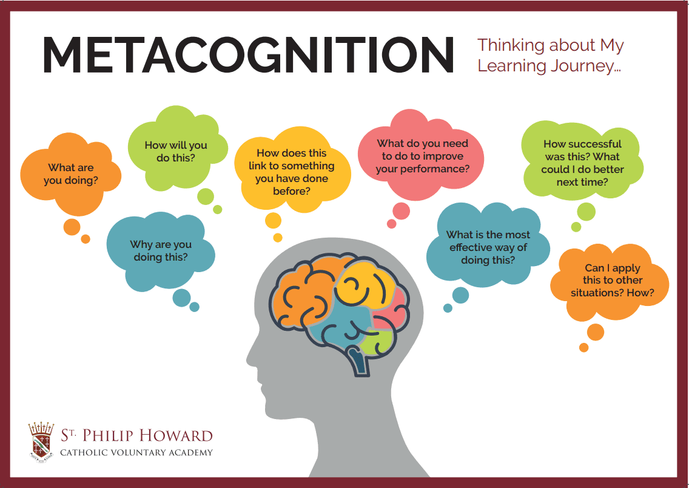
Notes:
One example – I chose this
one because I like the WHY question – what is it the teacher actually wants to find out about me?

Slide 24
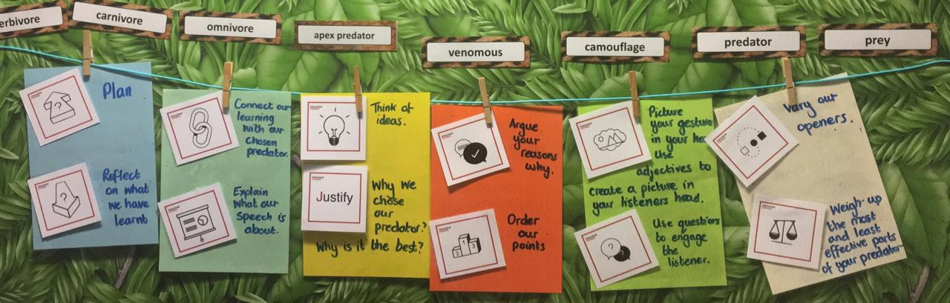
Notes:
This school has used one particular metacognitive approach (Roger Sutcliffe’s ‘Thinking Moves’ ) to create a shared understanding of metacognitive strategies to reduce the ambiguity on how to write a speech about your favourite predator (obviously it can be adapated to any other form of persuasive writing)
Trainers – note how the children’s understanding of required strategies are not assumed. The overarching categories of plan and reflect are highlighted and then the different types of thinking required to write a successful speech are laid out very clearly. Each ‘thinking move’’ has an image associated (and a sign).
(Carla- please don’t reduce the size of this picture to make it pretty – its important its readable!)

Slide 25
Learning isn’t about answers, it’s about process
Some children get the idea very early on that getting answers correct leads to praise and success.
They get overly focused on answers and being right.
They think successful education is about getting as much right as possible.
Can we teach children from the beginning that LEARNING is what is important, not ANSWERS?
Philosophy might help children get used to ambiguity early on.
If we can help children be more comfortable that there isn’t always a correct answer FROM THE BEGINNING this might help.
Teaching children to sit more comfortably with ambiguity…
Notes:
Can skip these two sides for secondary students – this and next

Slide 26
‘Best odds’ chance of facilitating success…
Try to identify barriers for THIS student (see ‘what do you see’ handout).
Start early with modelling errors as a necessary and essential part of learning.
Be as clear and specific as possible (Now, How, Next).
Use writing frames (support ‘How’).
Use worked examples at different levels (support ‘How’).
Teach vocab of exams (describe, explain, contrast, explore etc).
Share PURPOSE of task (what is the core learning aim? The success criteria? What aspects of the task will not be marked?)
Share mark scheme.
Use interests wherever possible for saliency.
Teach exam technique – eg preprepared stories or plot lines for English language creative writing – and how this differs from plagiarism.
Notes:
Purpose: Its often hard for autistic students to understand the core purpose of a task and therefore what aspects the teacher will be judging the work by. For example, if asked to make a poster about a physics topic, the core assessment is on the student’s understanding of the topic and ability to explain to audience clearly; the arrangement of the info on the poster is less crucial. These ‘side issues’ can cause anxiety because of the perceived ‘risk’ of doing the poster ‘wrong’.
Teach students that its ok to pre rehearse or reproduce their own work in an exam – for example they can go into their English language exam with an idea of a couple of stories they have written before which they can potentially adapt to fit the title. This is fine as long as its their own prior work; the examiner won’t know and its not plagiarism.

Slide 27
Being clear and specific: Now How Next
Notes:
This just one suggestion. Useful to bear in mind when planning even where not actually completed for or by the student. Can be filled in by teacher, TA or student depending in age/skills

Slide 28
How to help: Summary
Know your student and their particular autism profile where possible.
Understand that failure to complete written work is rarely purely defiant/ motivational…kids do well when they can.
Try to identify THEIR barriers and work out how to help them.
Work on key principles:
Reduce ambiguity within the task and around the task (now- how-next)
Use writing frames and worked examples where possible
Teach metacognitive strategies – make the thinking explicit
Explore external issues eg noise, lighting with the student when possible
Understand communication load and risk in writing
Be clear on purpose, success criteria and mark scheme
Use special interests where possible

Slide 29


Slide 30
Useful References
‘Mistakes that worked’ – Charlotte Foltz Jones
‘What to do when mistakes make you quake’ – Claire Freeland, Jacqueline Toner (Primary age)
‘Avoiding Anxiety in autistic children’ – Dr Luke Beardon
‘Playing with Anxiety: Casey’s guide for Teens and Kids’ – Reid Wilson and Lynn Lyons
‘I hate to Write’ Boucher and Oehler
Controlaltachieve.com/2016/10/special-needs-extensions.html?m=1 – chrome extensions for struggling students and SEN
Claire.carroll@oneeducation.co.uk

Slide 31


