Slide 1




Autism and Anxiety
Notes:
This module was created alongside young people at SG – 40% of whom are out of school
Feel free to add own activities throughout
Asking schools for real life examples - people that they might be struggling to understand - or include case studies

Slide 2
What is anxiety?
Anxiety is often seen as a negative that the individual must overcome, but anxiety is often a healthy protective mechanism that enables us to identify and avoid harm. To ignore it means we ignore key signals that manage our wellbeing. Sometimes, there are very real causes for the anxiety that need to be addressed or removed for the anxiety to stop.
Notes:
Young people want to thrive
So if they are struggling, there is always a reason why
Being curious and collaboration are key
Dr Ross Grene says "kids do well if they can" so it's our job to find out the underlying cause of a young person's anxiety and help support them with that, rather than focus on just changing surface behaviours.
Importance of being curious and working in collaboration

Slide 3

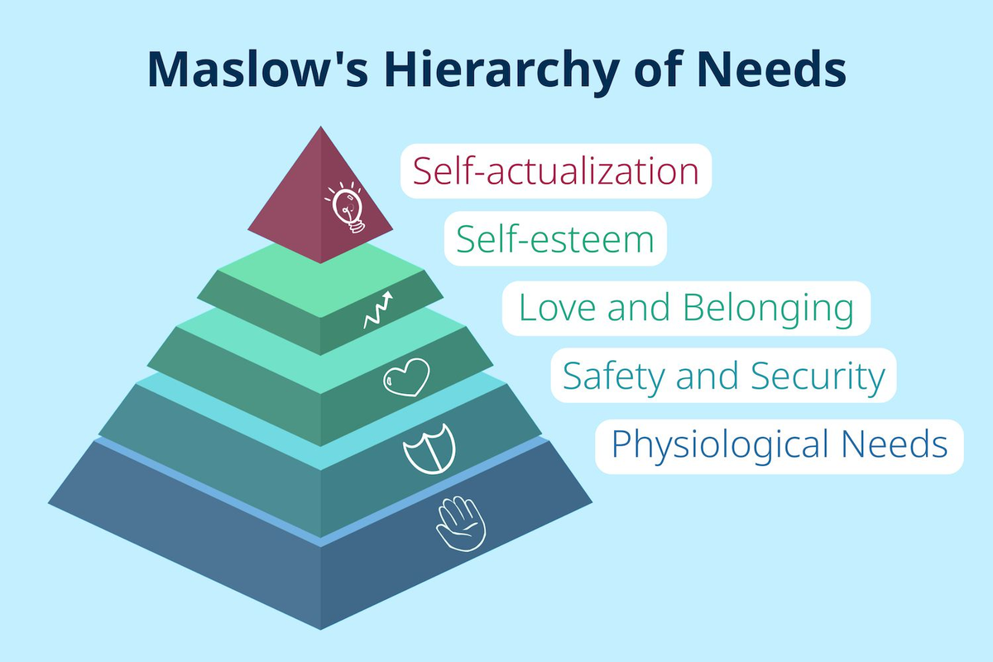
Notes:
Maslow's Hierarchy of needs suggests that all humans need to have their basic needs met – those at the bottom of the pyramid – before being able to seek out and work on meeting the needs higher up the pyramid.
This means that if someone does not feel safe, or their body's basic needs are not met, then they will not be able to focus on learning.
When an autistic person's basic needs are different to others or outside of the caregivers own experience, this can often mean needs go unmet – not through neglect, but through a lack of understanding of the individual. Unmet needs can then be a cause of anxiety. The needs that autistic young people have for safety and security are not changeable, and anxiety relating to those cannot be overcome with 'small steps' or 'graded exposure’.
Lots of young people don't have access to openly autistic people - sharing their expereince
There are reasons why someone is struggling that can be outside of the school environment
Trauma
Lack of acceptance of difference

Slide 4
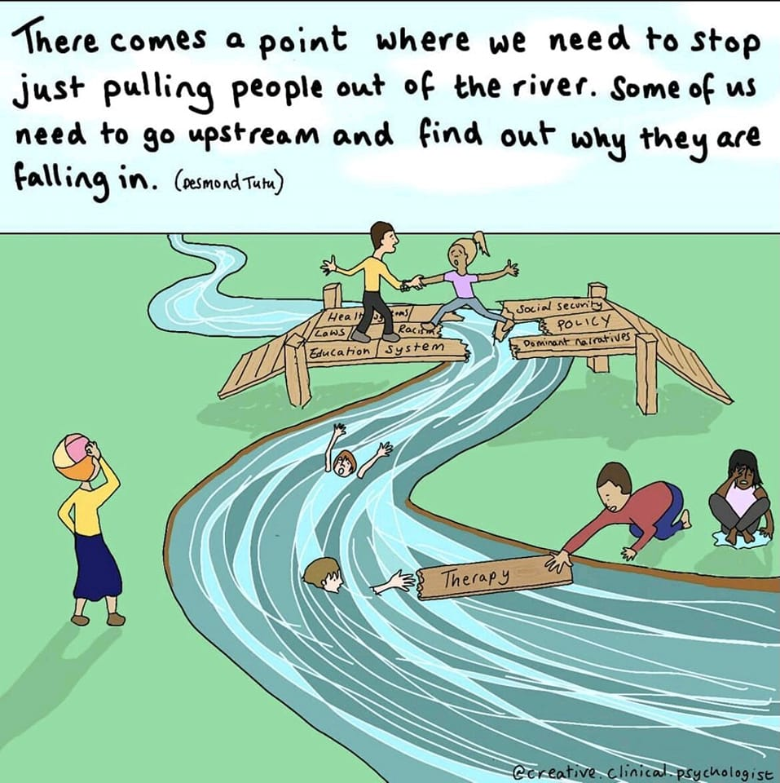
Coping strategies vs. Addressing the root cause
Notes:
Autistic young people may struggle to eat in the dinner hall because it's too loud, or it smells awful, or there are too many people. Their sensory differences could mean that the noise is physically painful for them, or the smells may be so overwhelming that they are unable to eat due to nausea. This is far more than just disliking the hall – when senses are overwhelmed the autistic brain struggles to process the incoming information so means the environment becomes confusing and feels unsafe, as well as smelly or noisy.
Young people speak about support often trying to teach young people to cope rather than advocating for them/fixing the problem
In this environment they may feel anxious because their basic need for safety is not being met.

Slide 5

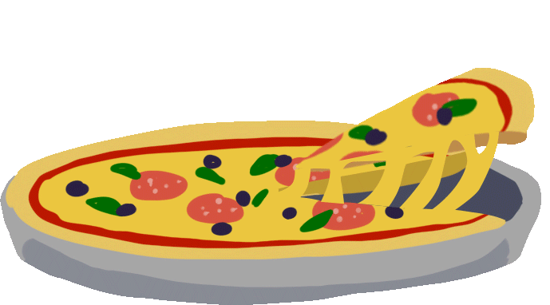
Example: You are struggling to eat in the school dinner hall
The “usual” advice:
"You must get used to sitting in the dinner hall, so we will make you sit in there for 5 minutes, then 10 minutes, then increase the time each time, until you aren't anxious about it anymore"
Notes:
Autistic young people may struggle to eat in the dinner hall because it's too loud, or it smells awful, or there are too many people. Their sensory differences could mean that the noise is physically painful for them, or the smells may be so overwhelming that they are unable to eat due to nausea. This is far more than just disliking the hall – when senses are overwhelmed the autistic brain struggles to process the incoming information so means the environment is becomes confusing and feels unsafe, as well as smelly or noisy.
In this environment they may feel anxious because their basic need for safety is not being met.

Slide 6
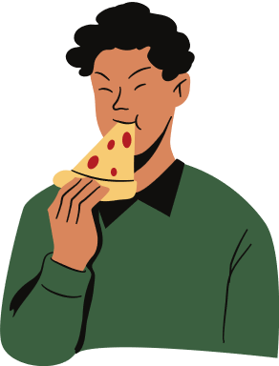
But this often doesn't work...
If it is too loud, the dinner hall will always be difficult when it is loud
If there are too many strong smells, it will always be difficult when there are strong smells
They are putting the blame on you, when it is the dinner hall that is the problem!
Notes:
This strategy does not meet the underlying need for safety. If young people DO manage to ignore their sensory differences and spend an increased amount of time in the dinner hall, then they may be ignoring signals from their bodies (masking their difficulties) instead, which can have a negative impact on their wellbeing.

Slide 7

Instead, work together to understand why it is difficult
If it is too loud, can you wear ear defenders of headphones?
If it is too smelly, can you go at a less busy time of the day?
Do you have to go in the dinner hall at all (adults do not have dinner halls!)?
Notes:
Strategies should address the underlying need for safety and ensure that the young person feels heard, understood and supported.
Encouraging young autistic people to advocate for their needs helps to reduce masking and supports wellbeing as they learn to listen to what their brain/body is telling them they need.
Often higher expectation for children than adults - as an adult if we didn't like a particular place we wouldn't go back, if we needed the toilet we would go

Slide 8

THEN try out some small steps if it is still difficult and if it is something you want to do
e.g. if you want to sit with your friends
Notes:
It is important that any steps taken to overcome anxiety are undertaken because the young person wants to do so themselves.
If NOT sitting in the dining hall is not an issue for the young person, then it makes little sense to set it as a goal for them to achieve.

Slide 9
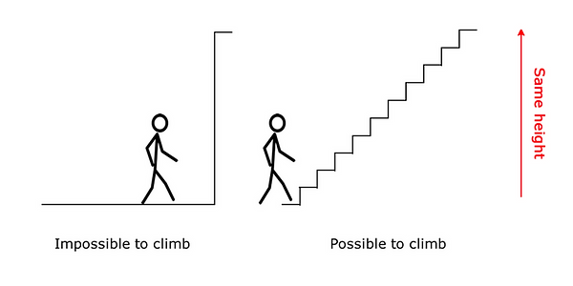
It is better to avoid unsuitable environments, but that isn't reality.
This has to be led by the young person
Notes:
Working in partnership with young people to understand what it is that makes an environment difficult, and supporting them to achieve their own goals with steps decided with them, is more effective in overcoming anxiety than imposing your own goals and steps upon them.
If the young person's desire for going/interests outweigh the fears this may be an approach for them. Can be seen as a set of scales, could draw this out with young people

Slide 10
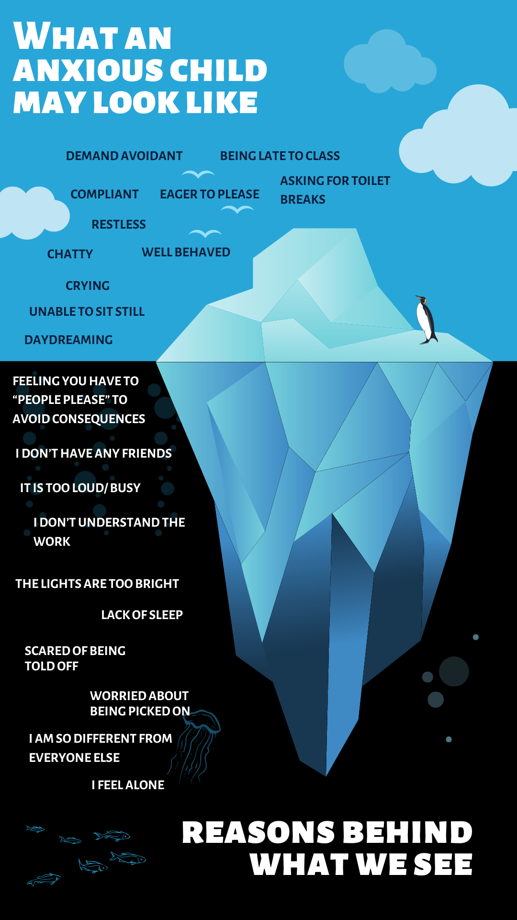
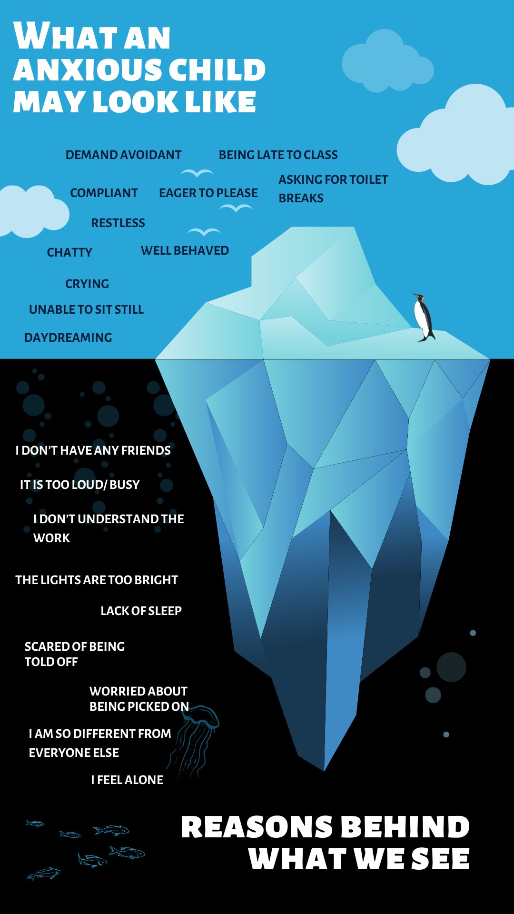
An anxious child might appear “fine” or “naughty”
Notes:
It is important to consider that you may only see the tip of the iceberg when interacting with a young person and that anxiety can look different from one child to another. It might also be that different people see anxious behaviours in young people that others don't – so it is important not to dismiss a parent's, colleagues or other professional's concerns even if they always appear "fine" to you.

Slide 11



There are 3 types of anxiety, that all need a different approach
‘People need to DO better anxiety’
(accommodations)
'People need to BE better' anxiety
Irrational anxiety
With a foundation of understanding your anxiety
Notes:
DO better anxiety = people need to make changes to the support that is offered
BE better anxiety = people need to make changes to how they act towards you

Slide 12
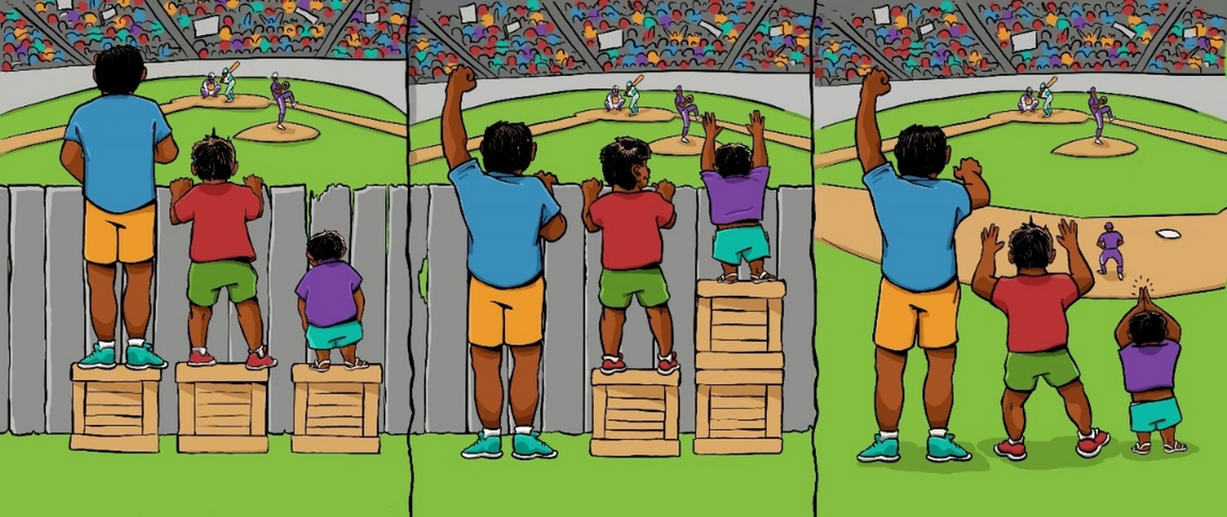
To reduce this, people need to make changes that meet our needs
Anxiety caused by the environment
(people need to DO better)
Notes:
Under the Equality Act 2010, people have a duty to make reasonable adjustments to ensure that disabled people are not placed at a substantial disadvantage and can participate in all aspects of life.
Unfortunately some people do not always embrace difference and therefore autistic young people can be judged for having supports or accommodations. However you can make wider changes so that the environment works for everyone in a way that means people don’t need to be treated differently. This is the premise of inclusion. It might just need a bit of creative thinking or collaborative problem solving to make the wider changers, as you step away things you do or expect, because that's just the way it has always been.

Slide 13
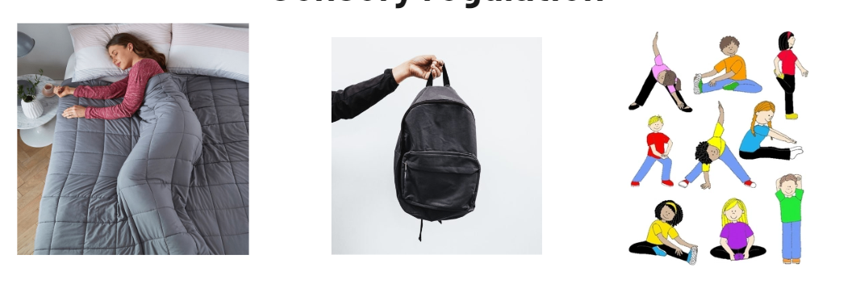
Sensory Regulation
As annoying, but as necessary as brushing your teeth!
Anxiety, stress and sensory differences are all affected by your sensory arousal level
Notes:
Young people who are feeling anxious and stressed may have levels of alertness (arousal) that are too high (hyperarousal) or too low (hypoarousal). This can mean that they are not at the right level for the task and not able to focus and learn. To help with this it is important to support sensory regulation in order to bring their alertness levels up or down to where they may be better able to cope with the environment or activity.
In practice, supporting sensory regulation could include things like:
If a young person needs to be able to move around rather than sitting still, are they able to do this?
If a young person needs a fidget toy, can every young person have access to one?
Rather than having to give eye contact and sit still, can all young people listen in a way that works for them?
Sensory regulation is as annoying but as needed as brushing your teeth!
High levels of arousal/even when really positive emotions with nowhere for it to go can impact arousal levels later

Slide 14

Logical thinking style
Notes:
Uncertainty can cause high levels of anxiety in autistic people, which can be supported by providing as much information about things as possible.
If you don't have enough information it is like having a puzzle with one bit missing – need to complete it but can't!
Infromation in advance (like an agenda) so that can plan and process
Plan B: having an escape plan.
Impact of having consistent use of a sensory room rather than just when in distress
In practice, being inclusive of those with a logical thinking style could include things like:
Can you provide written information about a lesson or activity as well as verbal instructions?
Can you offer opportunities and encouraging young people to ask questions about activities so that they feel they understand what is happening and what is expected of them?
Can you let young people know in advance that they don't have to do something, or can leave an environment if they are finding it distressing?
If we can make the necessary accommodations or adaptations for autistic young people, then this improves/prevents anxiety type 1 – the ‘environmental anxiety.'

Slide 15
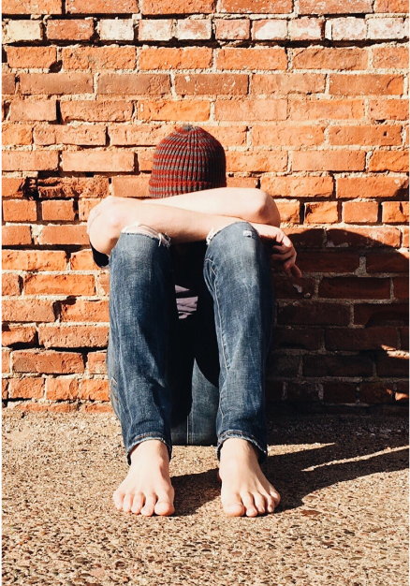
Anxiety caused by a lack of understanding the individual
AKA
Changing your approach and building trust
(People need to BE better)
Notes:
People often do not understand autism and they can therefore treat autistic people in ways that cause distress or dismiss their struggles.
One of the most important things for tackling anxiety caused by this is to help people develop acceptance of difference and therefore acceptance of autistic ways of being.

Slide 16
Neurodiversity Affirming Practice
Authenticity – A feeling of being your genuine self. Being able to act in a way that feels comfortable and happy for you.
Acceptance – A process where you feel validated as the person you are not only by yourself but by others.
Agency – A feeling of control over actions and their consequences in your day to day life.
Autonomy – A state of being self-directed, independent, and free. Being able to act on your ideas and wants.
Advocacy – To speak for yourself, communicate what is important to you and your needs or the needs of others.
Credit: The Autistic Advocate
​
Notes:
A Neurodiversity Affirming approach supports understanding of individuals in relation to their strengths and encourages young people to advocate for their needs and rights.
Instead of encouraging young people to mask their differences and difficulties in the environment, it encourages people to be more understanding and accepting of those differences.
Young person understanding themselves and their needs as a starting point
Could it be helpful to add the barriers to education trusted person here? https://www.barrierstoeducation.co.uk/trusted-person
People are often afraid of things they don’t understand, so proactive understanding is really important to encourage and promote. This doesn’t just reduce bullying, but helps young people feel it is ok to be themselves which is incredibly important for their wellbeing.
'People need to BE better anxiety' isn't just something to address with the other young people. It might be that adults are unintentionally adding to this anxiety.
When an autistic person is anxious and on 'high alert' they may notice every little sigh of frustration, or eye roll, if you are having a stressful day - no matter how hard you try to hide it, adults get overwhelmed too! The key is to admit when you've perhaps not been as patient or understanding as you'd like, and apologise to the young person if you think you may have added to their anxiety. Apologising and admitting our own flaws to a young person goes a long way in building a trusting relationship and helping the young person feel safe.
If you behave differently and others don't know why it can lead to negative interpretation – can we move to a culture of teaching everyone about celebrating difference

Slide 17
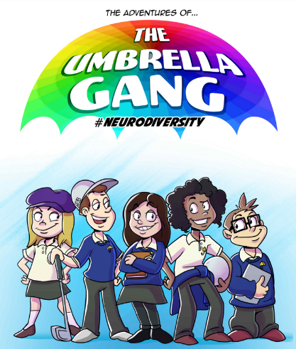
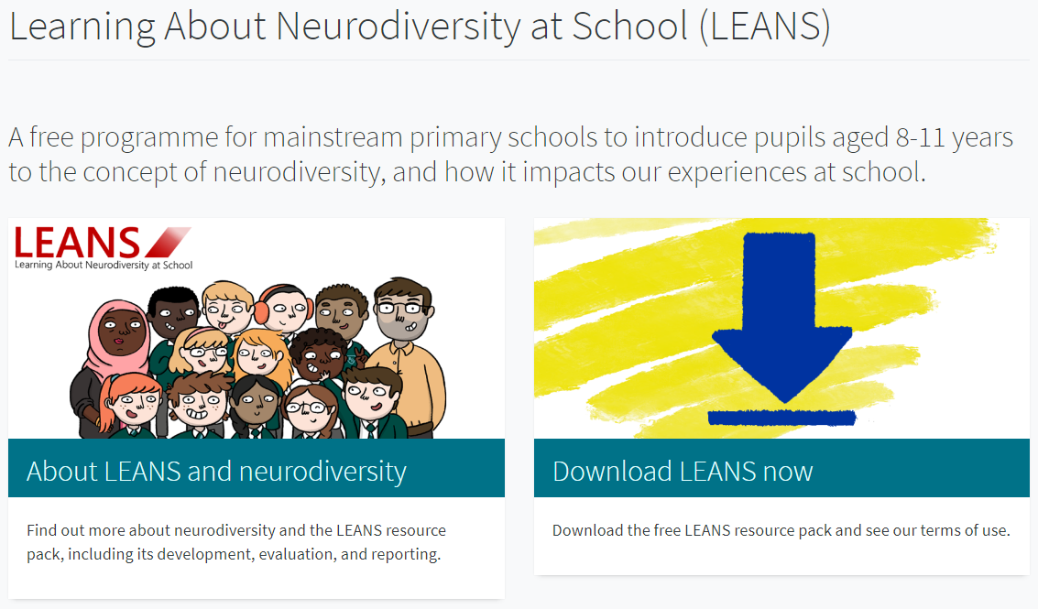
Autism acceptance in schools
Notes:
Here's a couple of ideas you might want to look into to help improve the whole school ethos: The Umbrella Gang is a series of comics by the ADHD Foundation which aims to raise awareness about neurodiversity and celebrate cognitive differences.
LEANS is a multi-session curriculum which aims to increase knowledge about neurodiversity and encourage positive attitudes towards both neurodiversity and neurodivergence for both pupils and staff. Also has posters that you can put around the school . The importance of positive messages
Can we also reference the CYP groups running in AIS schools here?

Slide 18
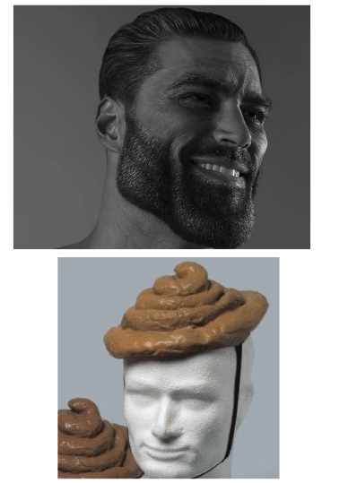
Three types of people (according to young people)
1. People who 'get it'
2. People who try, but need more understanding/ guidance
3. The poo poo heads
Notes:
Everyone you meet in life can fall into one of these 3 categories.
The people who 'get it' are people who either naturally understand you and what you need, or they have learnt a lot about you and are able to now offer you the support that you need.
People who try may not get everything right, but they are reflective and willing to learn. They want to support you, but they just need more guidance.
The poo poo heads don't understand you, or autism, and they don't even try. They are often authoritative, inflexible and may think they know everything already even though they clearly lack understanding.
It is best for autistic young people to try and be surrounded with as many 1's and 2's as possible, and to try to avoid the poo poo heads!
Try not to be one of a young person's poo poo heads – and if you notice yourself being one, then acknowledge that with the young person.

Slide 19
What do young people believe a trusted person should be like?

Slide 20
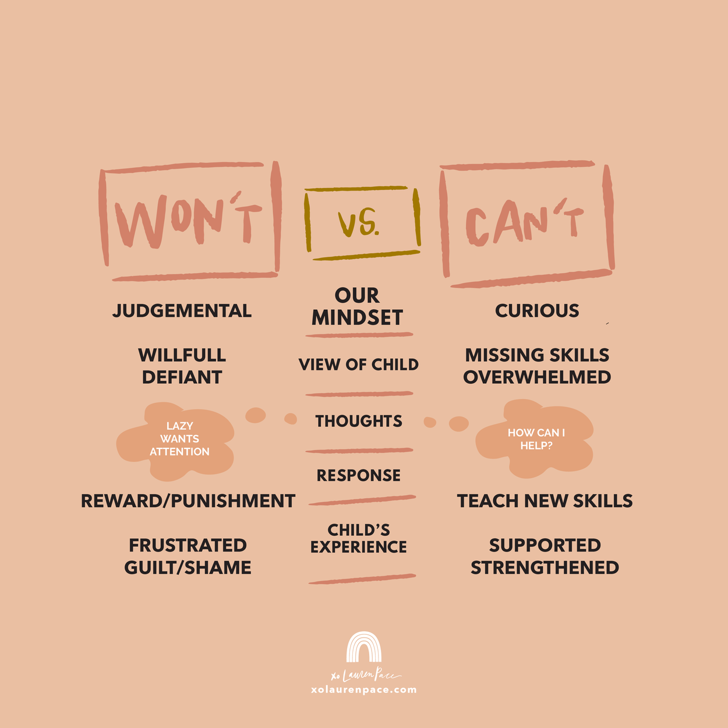
Beliefs and Values
Respectful
Neurodiversity affirming
Be real
Be curious
Understanding of autism and individual’s autism
Committed
Good communicator
Notes:
A trusted person believes in two way respect, focusing on earning it, rather than demanding it because of their position.
Affirming – supporting to be true, authentic selves
Able to admit faults and have a real interest, and proactive in learning more
Don’t take things personally
Young people do well IF THEY CAN: They have belief in a young person. They can meet a young person where they are and allow them to take the lead rather than following their own agenda or expecting too much. They believe that young people can overcome obstacles with the right support and give a seed of belief that things can improve, even if the young person doesn’t believe it themselves just yet.
This includes being able to act as a facilitator: Rather than assuming you know what is best, is it possible to offer young people a wide range of opportunities, but let them take the lead in deciding which ones to pursue (with your support)? You can also offer opportunities by sparking engagement or taking the lead in doing an activity, showing it is ok for young people to try it too, if they would like to. Alternatively, you can mirror them and show you are with them on their journey.

Slide 21
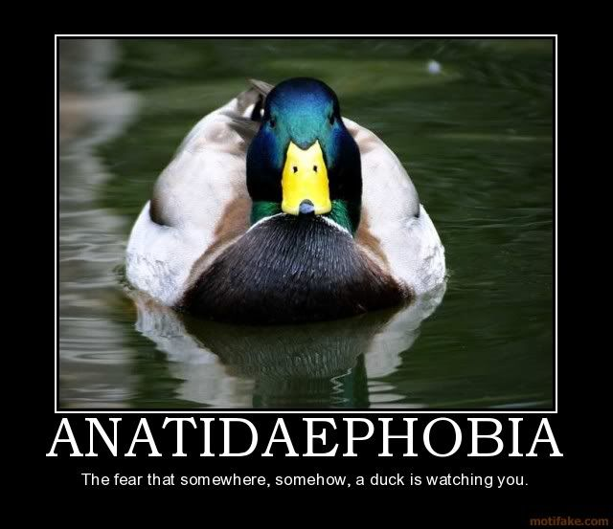
Irrational Anxiety
Notes:
Quack.
Importance in myth busting that all anxiety is irrational
Phobia of ducks watching you – irrational anxiety

Slide 22

If anxiety is irrational (your brain tells you something is threatening when it isn’t), for example a phobia, taking small steps to challenge your anxiety can be helpful. But you still need environmental adaptations put into place, because if your anxiety is too high, small steps will feel much bigger. These steps also need to be under the control of the person experiencing the anxiety. Being pushed by someone else is likely to deepen the anxiety, not reduce it.
Notes:
It's important that any steps taken to overcome irrational anxiety are created in partnership with a young person and that they are feeling motivated and able to begin working on overcoming the anxiety.
If someone is experiencing high levels of stress in other areas of their life, it may not be a good time to work on overcoming this anxiety as it can be incredibly difficult if they are feeling unsafe in other ways too.
Understanding the why is important – e.g. selective mutism - may look the same from the outside but underlying why could be different. Have to unpick what is a result of unmet needs and which is irrational. It can be important to advocate for young people when needs are different e.g. someone might find lights brights sensory – if someone doesn't understand this they may be seen this as irrational.
E.g. fear of the dark, start with lights on and use dimmer switch etc

Slide 23



What can happen when we get things wrong?
Notes:
Let’s say you have a fear of spiders. If someone throws a spider at you, this may increase your fear and then you may become scared of dark corners and crevices IN CASE there is a spider there. Then if it gets worse you could become scared of dark rooms IN CASE there is a spider.
This is why the right support for anxiety is important. Graded exposure for anxiety that is a result of unmet needs or trauma makes things worse.
This what can happen, if anxiety is around school and are pushed back in, anxiety can then be around anything that might feel like school, youth clubs, people, leaving room

Slide 24
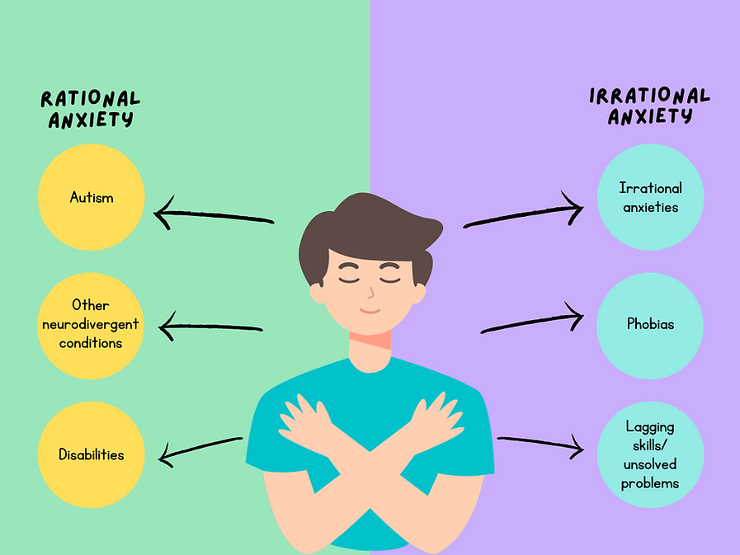
Understanding your anxiety is KEY
Notes:
It is important to know which category the anxiety falls into, as each type requires different strategies in order to support the young person. The small steps strategy for irrational anxieties like phobias will not work for rational anxieties such as autistic sensory sensitivities.
Can have both going on at the same time e.g. phobia of heights - but also hypo vestibular contributing
Having unmet needs can impact/make more likely to have irrational anxiety
Most young people do not understand their own anxiety - it is really important to help them to figure out what the cause of their anxiety is so young people can better understand their needs and what might help.
Without this understanding, anxiety can feel much more scary/ overwhelming. And without this understanding or appropriate support, more severe or longer term struggles develop

Slide 25
There are 3 causes of anxiety, that all need a different approach
'People need to DO better' anxiety
'People need to BE better' anxiety
Irrational Anxiety
Changing the environment
Changing your approach and building trust
Notes:
These three different types or causes of anxiety can help you determine which areas you need to focus on in order to support a young person to overcome their anxiety.

Slide 26
And you can use this as a step by step guide to reducing your own anxiety
Is this something they want to do?
If so, can they take small steps to achieve it?
Is any of this anxiety caused by unmet needs?
This must be fixed first!
Can anything be done to make people more supportive/ understanding?
Notes:
.
You can work through these steps in order, to help identify the root cause of the anxiety so that you can address the underlying issue or need that is not being met.
It can also help you to understand whether this anxiety is something that should be tackled or overcome at this moment in time, or whether it is not the right time or the right area to focus on right now for that individual young person.

Slide 27
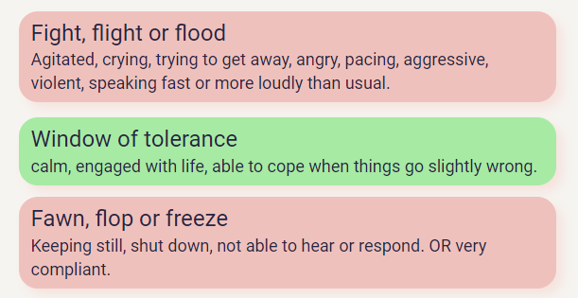
Trauma
One event, lots of events, or a build up of stress
Notes:
Trauma isn’t always from a big and scary event…
When you have a high level of stress, the way that experience is stored in the brain is different – it gets stored in the amygdala rather than the hippocampus.
I
Some autistic young people find school a deeply stressful experience, and this leads to developing school based trauma. Trauma works very differently, as being pushed into something that you find traumatic will only ever make it worse.
Some young people experience "autistic burnout" and reach a point where they are no longer able to attend school.
If someone experiences trauma or burnout, they often need time and space to process and recover from their experiences.
n fight or flight – any memories when in this state can be stored like a trauma

Slide 28

THE HIPPOCAMPUS (HIPPO)
The Hippo places memories into your long term storage when they have been processed. ​It is like a book being placed on a shelf.
The Hippo is a collection of stories that can be accessed whenever you want them.
You may remember the emotions you felt during the memory, but don't feel them as intensely anymore. They are safe to recall.
They have a time tag attached.

Slide 29

THE AMYGDALA (ALARM)
Memories are stored in the amygdala (alarm system) when you have a high level of stress, anxiety or overwhelm.
Less like stories, you feel these memories intensely.
These memories can be triggered by lots of things Including, photos, videos, smells or even thoughts.
The alarm system believes you are better safe than sorry, whether this is helpful to you right now or not.
Notes:
Can use an example here e.g. chased by a dog – scary- stored in the amydala. Brain storing key inform to keep safe, e.g furry, ears. If see dog in the future even if cute and tiny. - furry. Alarm goes off as better safe than sorry

Slide 30
PROCESSING MEMORIES
Over time, many memories move from the Alarm system to the Hippocampus.
​
Everyone has the capacity to process difficult events and we do it all the time. When we talk to people, think about what has happened, get angry and cry, we are often processing what happened to us. We are making sense of the experience and putting the memory in its place in the bookcase.
We all have the capacity to process memories - it’s like healing from a wound - but sometimes it can get stuck and we don’t process the things which have happened to us.
This can happen if you experience too much stress or don’t get the right support to process these memories.

Slide 31
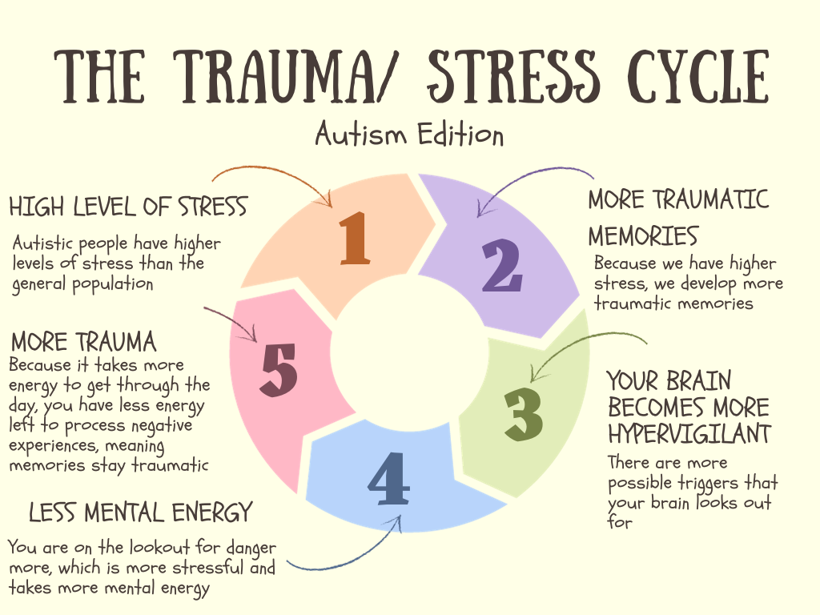
Notes:
Survival mode for so long, don't have energy left

Slide 32
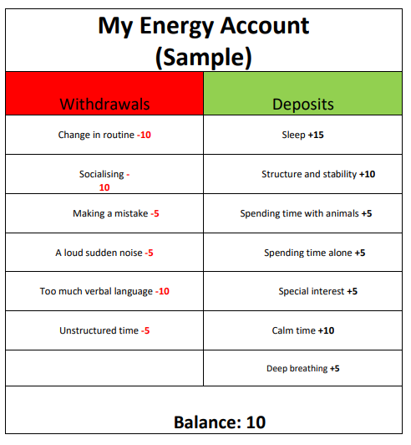
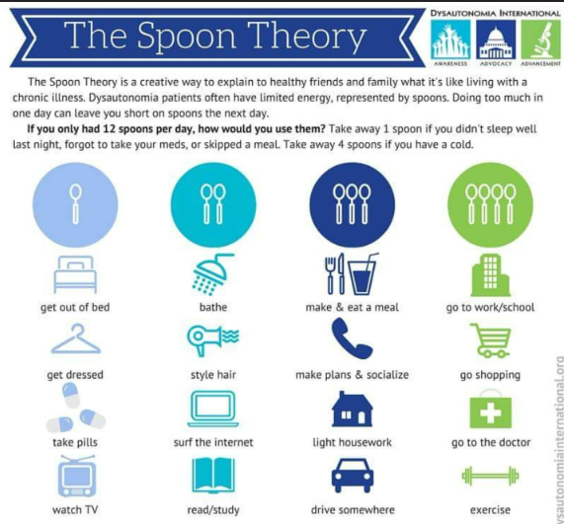
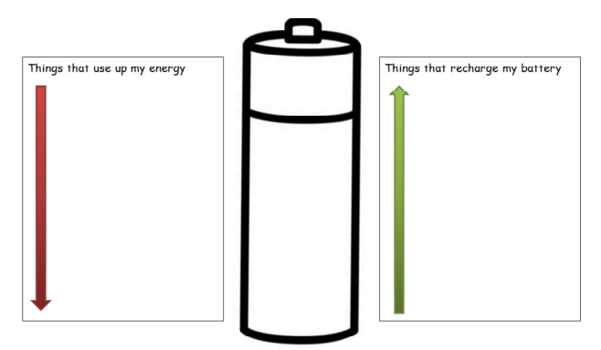
Spoon Theory/ Energy Accounting
Notes:
Burnout
The spoon theory is a metaphor story that provides a visual representation of energy levels and how events tax the energy reserve. (The metaphore can be adapted to the thing that the person loves/makes sense to the person). Also example with forks – do you give a fork about the task?! If so can give more spoons. But other tasks my have the spoons but not the forks. Also important to think about if have the resources to give spoons.
The more anxiety provoking an activity is, the more energy it takes from the person.
Each spoon represents a unit of energy. You start the day with a limited supply of spoons.
Each activity in a person’s day requires giving up one or more spoons, until you are left with no more spoons.
This can be a useful exercise in beginning to understand how to meet an individual person's needs - Important to do this with a pupil not for them.
It is important that we are flexible with what we expect of the pupils.
Lvel of energy can chage day to day. Might be able to do something one day but not another (sleep, overwhelm)
*TASK* - ask staff to think about their own energy accounting.

Slide 33
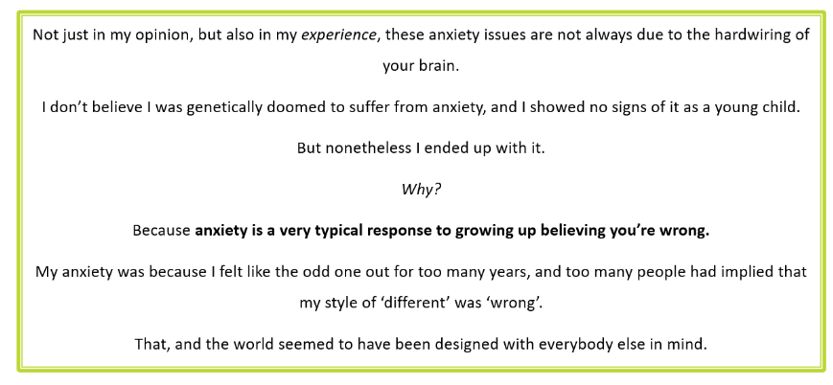
Overall wellbeing
Chris Bonnello - Autistic Not Weird
Notes:
Understanding yourself (Autism Understood)
Peer support
Connection/ a sense of belonging
Peer support: having others who understand, can complain without having to explain and justify the why, the relief of others just getting it
Importance of focusing on the right now - often systems can be focused on what we want to see x no of years from now rather than what we can do right now

Slide 34
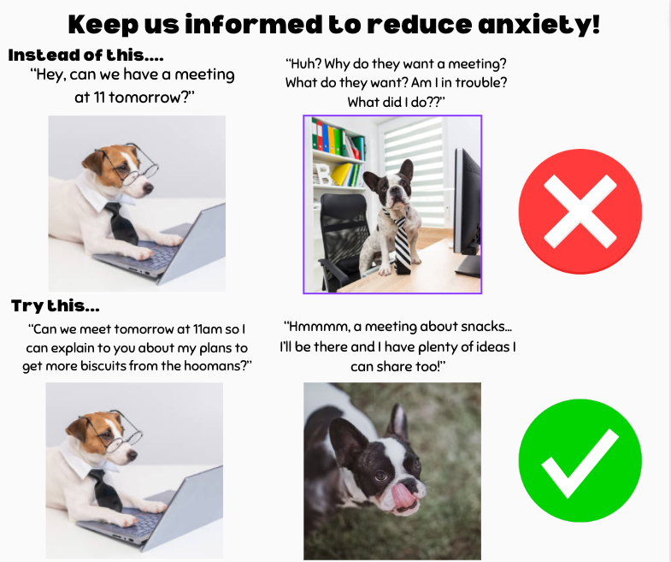
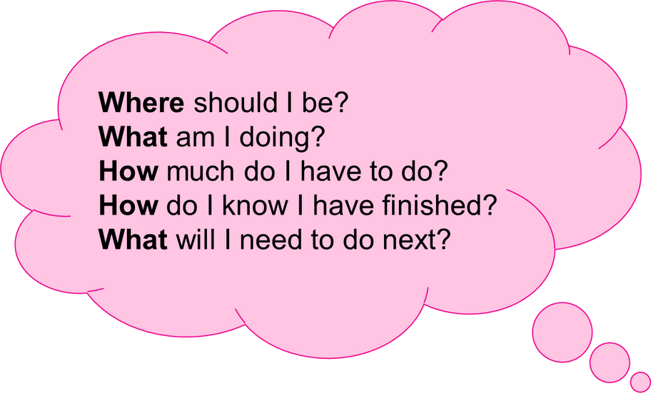
Uncertainty/ anticipatory anxiety
practical ideas - are we thinking about using visuals, preparation e.g. social stories, routines, changes, planning who what where when how

Slide 35
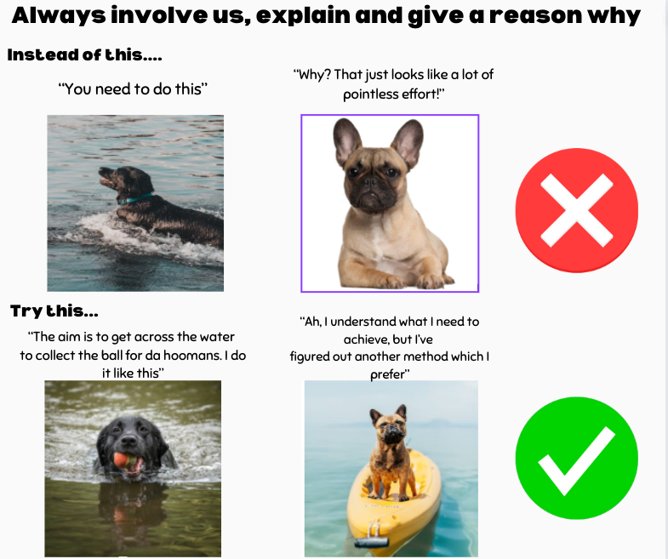
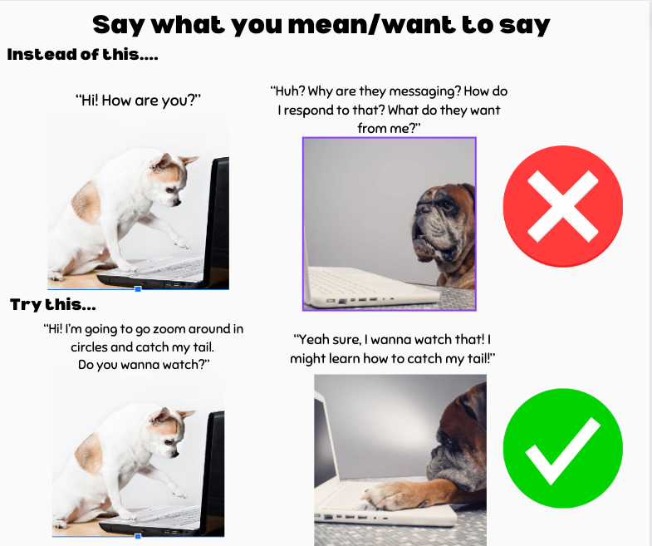

Slide 36
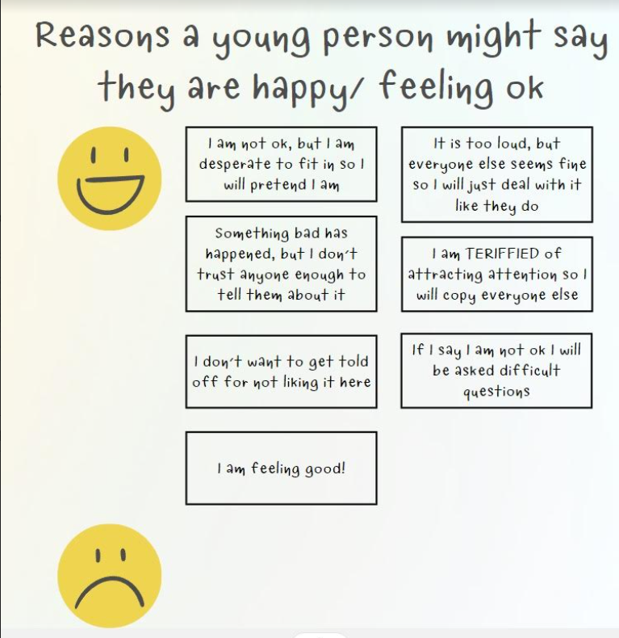
Notes:
Feelings charts: important to recognise just because someone says they ae feeling happy may not always mean that they are
Masking!

