Slide 1

the nest approach
A co-produced approach to supporting young people in crisis, led by Spectrum Gaming

Slide 2
Introducing Our Rules
No talking
Must request permission to drink
Must face the front
Notes:
We are not trying to create any shame or blame – behaviourism is “normal”
Opt out notice

Slide 3
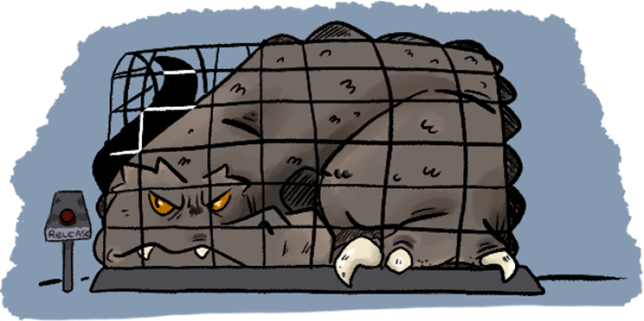
Stress and Wellbeing
No one chooses to display stress-related behaviour.
High arousal levels are linked with high levels of aggression.
When you have a higher arousal level, the logical part of your brain stops working as effectively and survival responses take over.
The young person is not necessarily in full control of their behaviour.
Notes:
Losing control is like a monster breaking free and taking over your brain. Meltdowns feel awful and nobody wants to have one.

Slide 4
​
"Meltdowns feel like I lose all control of what I do and how I do it."
"I feel like my world is crumbling before me and feel as if I've lost control."​
What do meltdowns feel like?
"They feel like an
uncontrollable explosion of emotions. No coping strategy or convincing could be used or work. It makes everything harder and can’t do anything, nothing makes real sense and there is so much anger, confusion and sadness."
"I feel like I’m floating in the void, I cannot control my actions and every object around me feels like it needs to be destroyed. I feel like I could die."
"They feel really overwhelming and like everything goes a bit hot and foggy and I feel really overheated and all my senses feel heightened."

Slide 5

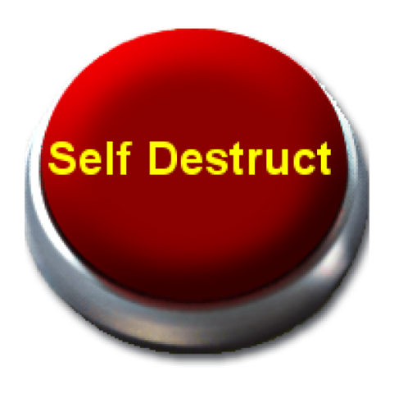
Often after a meltdown or aggression, young people are very apologetic.
By punishing someone for trauma or stress related behaviour, this can cause increased levels of stress and anxiety in the long term.
What they tell you may also be different to how they actually feel.
Notes:
Punishing someone for something they cannot control does not make sense. Punishing someone for something that they already naturally feel really awful and guilty about further adds to their feelings of distress.
Some young people can have suicidal thoughts and feelings after a meltdown as a result of feeling so ashamed of having lost control. Punishments will not help support them with these feelings.
A young person may tell you that they "don't care" but this is most likely an attempt to hide their shame about the situation.

Slide 6
"Embarrassed. Guilty. Sad."
​
"I feel guilty, upset and shameful."
"Sad, I feel like I've let my family and myself down, I have bad thoughts."​
"I feel like a different person and really negative about everything"​
How do you feel after a meltdown?​
​
"Tired and my head hurts from tensing it and under my eyes hurt from crying. Even when I've stopped crying I will then go into shut down and just "go live in another world" for a while."

Slide 7
Rewards and Punishments
“Jeff was given a detention for walking out of the classroom at school. His teacher said he has to stay in class until the lesson ends no matter what. After his detention, Jeff didn’t walk out of the classroom again. But one day, the class was very loud and he had a HUGE meltdown, where he trashed the entire classroom. Jeff was then excluded from the school for his bad behaviour.”
Notes:
In this scenario Jeff was not supported to explore and understand why he felt like he needed to leave the classroom. As he was punished for this behaviour he then learnt to 'mask' any discomfort with the environment he was experiencing.
This resulted in him becoming increasingly dysregulated until his stress levels were so high he was no longer in control of his behaviour. Then, instead of being supported to explore the underlying issue at that point, he was punished further for something he could not control.

Slide 8
ACTIVITY – What could we have done differently and how could we have helped Jeff better?
Allowing Jeff to walk out when needed as a way to prevent further distress – exit pass?
Identifying the reason why Jeff was walking out and working together to create an alternative way of reducing overwhelm, without him leaving the classroom.
Notes:
Do as an activity – ask what they think might help Jeff
Allowing Jeff to walk out when needed as a way to prevent further distress.
Jeff said some options would have been being able to put on ear defenders or asking for a toilet break (and this being accepted every time he asked).

Slide 9
The Impact
As a result of this, Jeff had intense feelings of confusion/ upset. He was punished for trying to meet his needs and was excluded after not being allowed to do this. In the longer term, Jeff struggled to trust any adults. He started to rebuild trust with adults through the Spectrum Gaming community, but it took over a year to gain the confidence to attend a different school.
Jeff now has a one-page profile in his school that ensures he is able to do what is needed to meet his own needs and is feeling much better in a school that is more understanding of him.

Slide 10
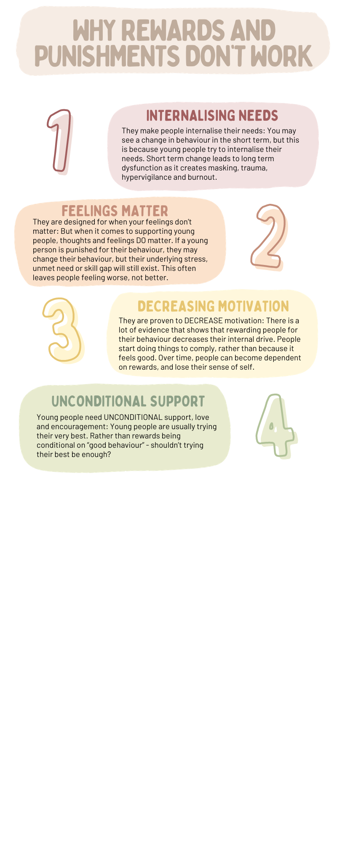
Why rewards and punishments don’t work
Notes:
Some people think rewards are better than punishments, but in addition to the reasons on the previous slide, there is a huge amount of research that suggests they both have the exact same drawbacks
Not receiving a reward can FEEL the same as receiving a punishment.
The locus of control refers to how you feel about events and situations – if you have an 'internal' locus of control then you feel that you MAKE things happen and you have influence on situations.
Rewards shift that locus of control to be 'external' which means young people feel that things happen TO them and they have less influence over situations. This can have a negative impact on both self-esteem and motivation to learn.

Slide 11
Rewards and Punishments
When resolving issues with young people, feelings matter!
If you punish someone for behaving negatively towards someone else, they may behave differently, but still have the same resentment/ negative attitude towards them, and this impacts on how they continue to feel about that person and the environment.
Rather than direct negativity, you may see exclusion, indirect upset and talking behind their back. It doesn't fix the underlying issue.
“When my bullies were told off, they just did it when teachers weren’t looking.” - autistic adult
End rules – What did you think?
Notes:
This shows that the focus should be on addressing the underlying issue and not on short-term fixes to surface behaviour.
Discuss restorative justice – understanding the impact rather than just being punished. Restorative chats in a lot of schools now

Slide 12
Understanding Motivation
When it comes to learning:
  "When we use external consequences to alter someone’s behaviour, we change their relationship to what they are doing (Pink, 2018). They are no longer doing something because they enjoy it; they are doing it because someone else is trying to make them do it – this makes the activity less enjoyable."
  Research directly shows that being rewarded is damaging (Deci et al., 2001). It fundamentally changes how children relate to an activity. People focus on rewards rather than challenge (Pulfrey et al., 2011).
Notes:
Below is an example study – but there is a similar study around painting etc,
Deci conducted a study in three steps. In the first step, he let students solve so-called SOMA cubes. In this part of the study, the students indicated that they really liked the puzzles. In the second part of the study, he let one part of the students just do the puzzles. He told another part of the group that for every puzzle they solved, they would receive a financial reward of a few dollars.
The Free choice period
The third part of the study consisted of a so-called free choice period. Such a free choice period has become an important technique in the investigation of intrinsic motivation. It includes the following. During the research, the researcher leaves the research room with an excuse so that the participants are left alone. He says they can choose for themselves what they would like to do. For example, they could continue with the activity (in this case the SOMA puzzles) or do something else.
While the researcher is away, the participants assume that they are not being observed, nor do they expect to be judged or rewarded. So if they continue with the activity, they are doing it out of interest or enjoyment. The amount of time they spend on the task during this free-choice period is therefore an indication of their intrinsic motivation.
The undermining effect
What Deci found was that the students who had been rewarded for doing the puzzles during the second part, continued to do the puzzles to a lesser extent during the third part than the students who were not rewarded. Also noteworthy: Deci saw that the students who were paid to do the puzzles performed less well. Rewards had undermined their intrinsic motivation and performance.

Slide 13
If punishments don’t work, what's the alternative?
Rather than punishments, we believe in understanding the reasons why someone is struggling, and what can be done to support this.
“I used to struggle at a youth club when it got too loud. If it was too much I would have a meltdown, and I was punished for that. This made NO difference the next time I went, as I would still have a meltdown if the room was too loud. I had no control over that.”
There is always a reason why, we just may not necessarily know what it is just yet.

Slide 14

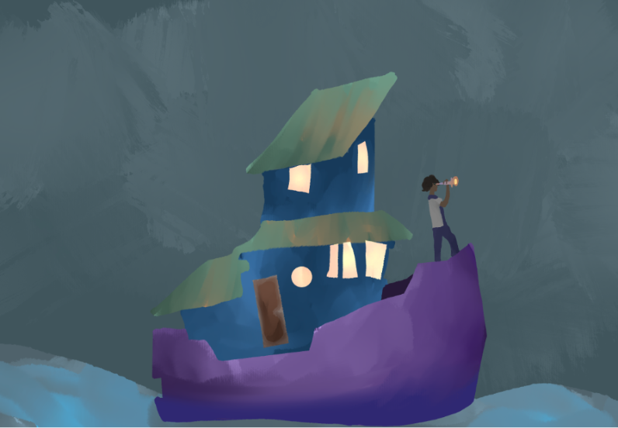
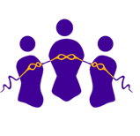

Young People are Driven to Meet 3 Basic Needs
Autonomy
Relatedness
Competence
Having choice and control over your actions.
Feeling connected with and accepted by the people around you
Feeling that you are learning and developing skills
Drawing credit: Wither
Drawing credit: Avari
Notes:
Young people (in fact all people) are innately driven to meet their 3 basic needs:
Autonomy: Having choice and control over their actions
Relatedness: Feeling connected with and accepted by the people around you
Competence: Feeling that you are learning and developing skills.
This means that young people strive to grow, develop and have positive connections. Young people do well IF they can.

Slide 15
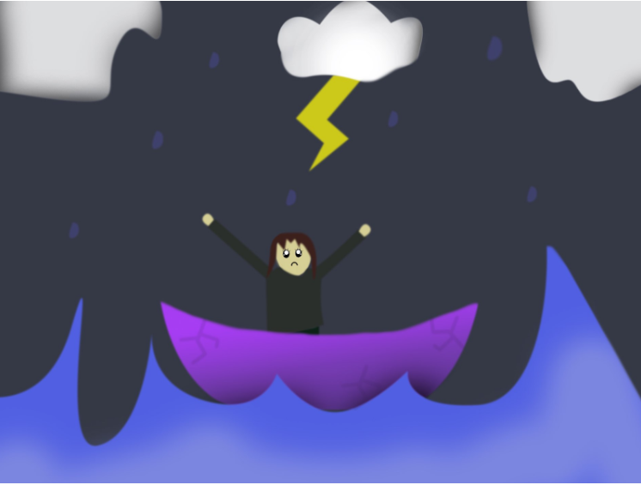
1. Stressors
For example:
What if the space is too loud, too bright, too busy?
What if the people around a young person don’t understand them? Stress caused by the physical and social environment can get in the way.
Drawing credit: Bubbles

Slide 16
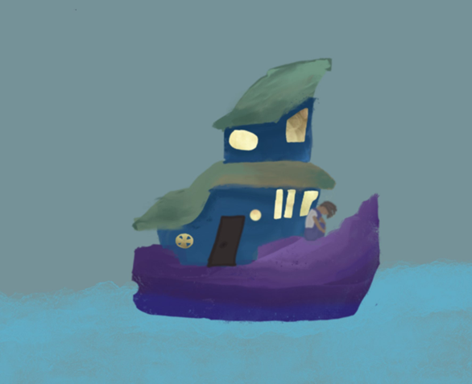
2. Unmet needs
Did they have enough sleep? Are they dysregulated? It is hard for a young person to do well if their physical, emotional, social and sensory needs aren’t met.
But it’s wider than these short-term needs. What if they have a lot of trauma, or feel ashamed of being different? Longer term thoughts, feelings and experiences can make it harder to do well.
Drawing credit: Yuki
Notes:
Importantly, this is wider than just short-term needs. What if they have a lot of trauma, or feel ashamed of being autistic? Longer term thoughts, feelings and experiences can make it harder to do well.

Slide 17
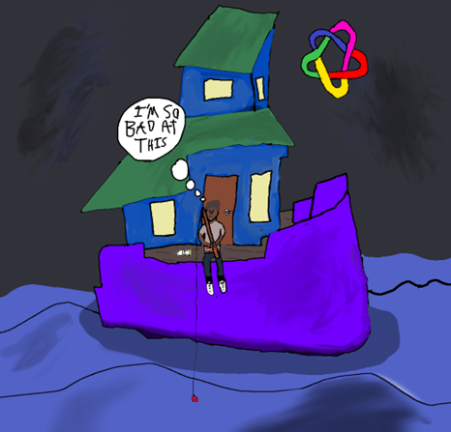
3. Skills Gaps
Everyone on the planet has different strengths and needs - but some people can have quite unique spiky profiles. This means they may thrive in some areas, but find some things that most people find easy, very difficult. If someone has a skill gap, unless the skill is developed, or unless support is put in place to stop it being a barrier, it is hard to do well.
Drawing credit: Zack
Notes:
Everyone on the planet has different strengths and needs - but autistic people can have quite unique spiky profiles. This means they may thrive in some areas, but find some things that most people find easy, very difficult. If someone has a skill gap, unless the skill is developed, or unless support is put in place to stop it being a barrier, it is hard to do well.

Slide 18
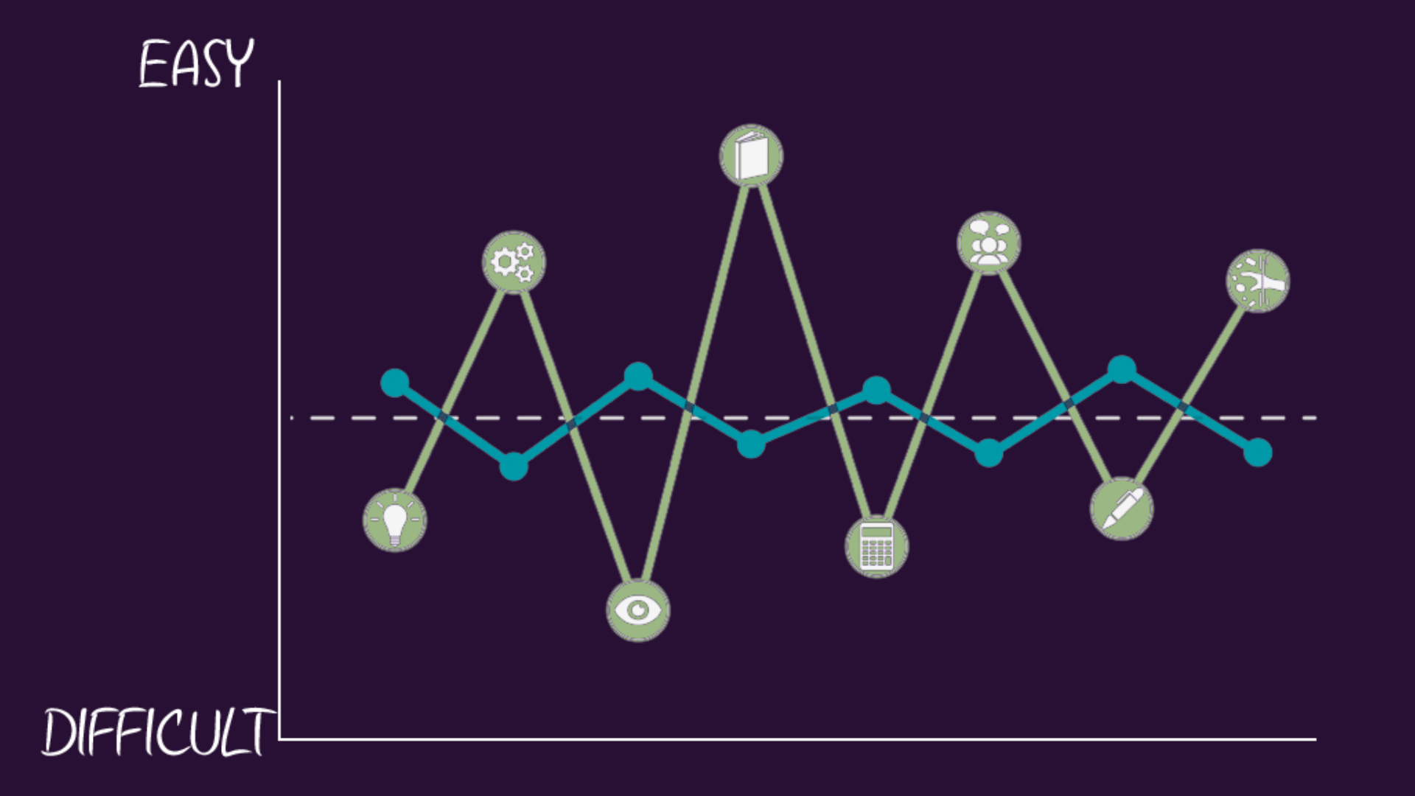
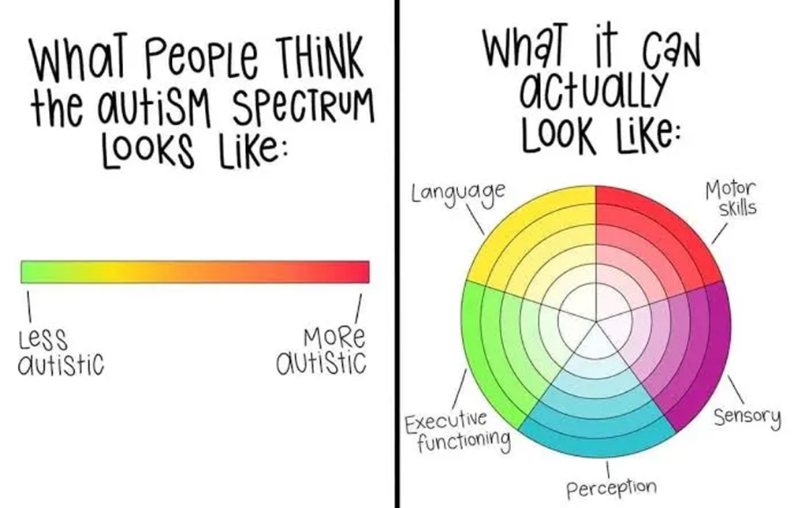
3. Skills Gaps
Notes:
Everyone on the planet has different strengths and needs - but autistic people can have quite unique spiky profiles. This means they may thrive in some areas, but find some things that most people find easy, very difficult. If someone has a skill gap, unless the skill is developed, or unless support is put in place to stop it being a barrier, it is hard to do well.

Slide 19
Some skills can be taught
If a young person is in a new environment, it may be unfamiliar to them so it may take a lot of time for them to ‘learn the ropes’ and understand how the space work. They may not currently understand how to navigate the space in the best possible way, but they can be supported to understand this.
Some skills come with time
Younger children may struggle with empathy towards each other. This isn’t because “autistic people struggle with empathy”, but that empathy is a skill that develops at older ages. In non-autistic children, children start to properly recognise that someone else’s feelings may be different from their own and can navigate complex moral decisions from the age of 8.

Slide 20
Some gaps are part of an individual's skill profile
As adults, autistic people still have varying skill profiles, where they may excel in some things but struggle in others. These spiky profiles are an innate part of them, so some of these skills will not ‘develop’ - they are a natural part of human variation. When this is the case, it is really important to focus on someone’s strengths, rather than trying to ‘fix’ weaknesses.
Notes:
Can you share an example of how punishing or rewarding behaviour has not had an impact on a young person, because it was part of a skill gap?

Slide 21



Building a "toolbox"
This approach is not about saying behaviour is "acceptable".
It is understanding that young people do not want to struggle. So why don't we try and meet the underlying needs behind behaviour, rather than punishing them for something they don't actually want to do to begin with?
Notes:
There will still always be times where someone becomes so dysregulated that they feel completely overwhelmed. The aim should not be to stop someone having any meltdowns at all, as young people often feel incredibly ashamed about losing control, so implying that they should be able to regulate in all situations will only make that feeling worse.
Just because we understand WHY someone is doing something, doesn't mean that they can continue to behave that way if it is having a negative impact on themselves or others.
Supporting young people to understand their needs, and then giving them positive ways to meet those, can help reduce their stress levels and therefore the negative behaviours.
The examples of strategies in this toolbox here are:
Physical activity, like running – which is shown to reduce levels of stress hormones like adrenaline and cortisol in the body.
Gaming – which can be a distraction from distressing thoughts or help boost feelings of accomplishment and useful for emotional regulation
Music – Angry music like metal can help to channel feelings of rage in a less destructive way, but other types of music can be used to support emotional regulation too

Slide 22
What is the nest approach?
Notes:
Now we move onto the NEST approach, which has been coproduced with autistic young people as a way to best support them when they are distressed and overwhelmed. It is important to go through the steps in order, as skipping parts can make resolving situations less effective.
N – Nurture
E – Empathise
S – Sharing Context
T - Teamwork

Slide 23

Nurture
Notes:
The first step is Nurture – this is about helping a young person to feel safe and is an important first step when supporting someone in distress.

Slide 24
Be Calm
Emotional Contagion Effect.
Take time to calm yourself.
Coregulation.
Things will be ok eventually, but the young person may not recognise this right now.
Notes:
The Emotional Contagion Effect is where someone's emotions and behaviours influence those of other people nearby. In this situation if you are highly stressed or dysregulated yourself, this will escalate the situation, which is not what you want to happen. Therefore it can be helpful to take a moment to calm yourself before engaging with the young person.
Co-regulation happens when we meet the young person's distress and dysregulation with our calm, connecting with them and bringing down their distress to a more manageable level.
When a young person is not in control, the logical part of their brain will not be working, and so they may not be able to understand that that they will feel better eventually and the distressing feelings will pass.

Slide 25
What Can You Do?
  Using a relaxed, comforting posture rather than appearing stiff/ rigid.
  Using a calming, caring tone. Speak slowly and softly.
  Keep your language simple and clear.
  Try not to show stress on your face.
  Speak in the affirmative rather than the negative.
  A stressed person is usually trying to communicate something, so show active listening and acknowledge.
  Make sure to not be ‘too’ relaxed by joking/ not paying attention.
  The aim is to look confident that things will be ok.
  Use distractions – special interest?
Notes:
The idea is to avoid triggering further threat responses in the young person and to convey your feelings of calmness in order to co-regulate with them and help them feel safe.
Distractions are not a ‘reward for negative behaviour’

Slide 26
Be Wary of Your Physical Presence
It is helpful to avoid touch wherever possible, though sometimes a young person requests it (this happens the minority of the time).
Slow down and be as predictable as possible to show a sense of calmness. If you feel approaching a young person is needed, let them know in advance and approach them in a calm and slow manner.
Try and stay at least 2m away if someone is struggling. Sometimes if someone cannot tolerate you being in the same room, waiting outside and calmly reminding them that you are there could help them feel safer.
Avoid direct eye contact (eye contact can be distressing even when they are calm).
Notes:
n you are in survival mode, your brain is looking for danger and is more likely to perceive things as a threat.
Touch can be a sign of affection, warmth and security but it also can be a sign of threat and hostility, even if you are trying to comfort someone.
Everyone has a ‘comfort zone’ of how close they are comfortable with people being to them. This changes depending on the person, the environment and level of stress.
Laughing can feel like someone is laughing at you. A friendly wave can feel like a taunt. Eye contact can be really overwhelming.

Slide 27
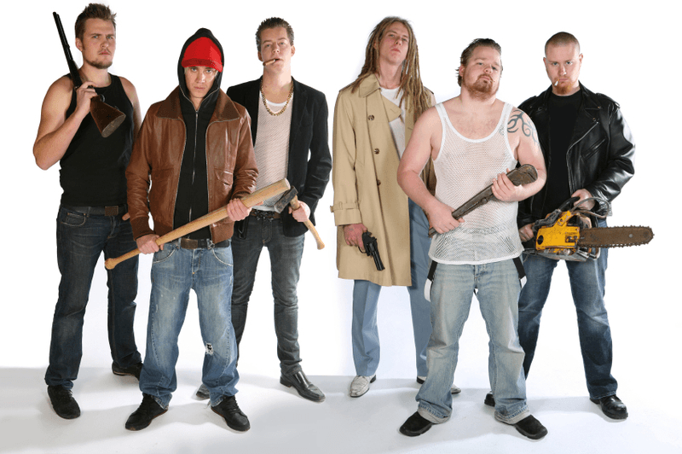
Avoid Gathering Staff
The ‘audience effect’ (Strauss, 2016) - being watched by others whilst in a stressful situation feels like a form of coercive control.
Notes:
If someone is feeling highly stressed, most people are going to look like a threat.
The audience effect makes even the right support feel threatening at times.
It is much easier to remove other people than to remove the distressed person - so try and remove them so you can focus on helping the distressed person become calm/ relaxed.
Trying to remove the stressed person is likely to escalate the situation and is often what leads to physical restraint.
The pied piper effect.

Slide 28
Tactically Withdraw from the Person
Sometimes withdrawing from a situation can lead to a decrease in stress. We can often get into arguments, disputes or ‘stand-offs’ with young people.
When a young person’s brain is telling them they are unsafe, they may not be able to back down, even if they desperately want to.
If you stand down, try not to view this as ‘giving in’ - it is really important for avoiding distress/ crisis.
"When someone is drowning, that is not the best time to teach them how to swim" - David Pitonyak.
Notes:
Standing down now doesn't mean that you cannot address something another time when everyone is calmer. When someone is already feeling out of control, further attempts to control them can escalate their feelings of being unsafe and therefore their distress. Letting a young person feel more in control of a situation can help increase their feelings of safety.

Slide 29
Reduce Demands
Research showed that nearly two thirds of stress related behaviours were preceded by staff demands/requests (McDonnell, 2010).
If someone is unable to meet our demands, can we remove the demand completely, or at least reduce it for now?
How you word things is also important in whether it is perceived as a demand.
Autistic young people in general can struggle with being told “what to do”, and instead thrive when given a reason “why” something needs to be done. This allows them to come to their own conclusion, and so reduces external demands.

Slide 30
Remove Environmental Triggers
People who are highly stressed become more sensitive to their environment. It is really helpful to remove any potential triggers in the environment:
Turning down lights or turning them off completely.
Reducing sounds.
Removing ourselves from sight/ the room.
Having a safe/ quiet space to go to is often incredibly helpful - though it is easier to access this if a safe space is agreed in advance.
This also works better as a proactive tool, where young people can go there freely and use it to pre-emptively avoid stress.
Notes:
Young people need to view a safe space as somewhere that they actually feel safe themselves – being TOLD somewhere is a safe space, and being MADE to go there when they are overwhelmed often does not help a situation. If a young person does not feel safe somewhere, and they do not want to go there, demanding that they do is likely to add to their distress.

Slide 31
Important Note
While the Nurture step is for when someone is visibly struggling, assume young people who do not show they are struggling may need input too.
Notes:
Some young people may not show outward signs of overwhelming distress. Meltdowns are the outward signs of distress, but some autistic young people have 'shutdowns' instead, where the distress is internalised. These young people may look calm externally, but on the inside they may be incredibly dysregulated and feel unsafe too.
This is why it is important to know and understand the individual presentations of the young people that you work with, so that you can identify their signs of distress.

Slide 32
The Young Person is Now Calmer/ More Relaxed, What Next?
When a young person is out of crisis, they may be feeling shame, guilt and embarrassment, but may also have feelings of anger/ resentment about the situation and what happened. Although they were unable to control their emotions during the incident, some of their actions whilst in meltdown may have been dangerous, frightening to others, or had a negative impact on themselves and others.
Therefore, it is very important to work with the young person to fully understand the situation, and to identify actions that can be taken to reduce the chance of this happening again. This can be done in a three-step process that we are hoping to go through.
Notes:
It is important to not work on understanding the situation too soon.
It is usually ok to wait until the next day to start this process with a young person.
As the experience was difficult for the young person, they also may not be able to talk through this all at once. This debrief may be done over a long period of time, and it is really helpful to not push discussion with a young person around this.
Use your judgement to consider when they may feel ready to talk about it, or they may let you know when they are ready.

Slide 33

Empathise
Notes:
The next step is Empathise – this step aims to understand how the young person is feeling about the situation or problem so that you can effectively problem solve together later.

Slide 34
Empathise
If someone is struggling or has reached crisis point, it is important to assume there is a good reason why and to try to understand their perspective.
One of the main reasons autistic young people say they are failed by services is that they don't feel listened to.
Young people have also said that feeling listened to and valued is much more important than all of their needs being met. We will never be able to solve everything (though we do aim to solve as much as we can), but we can always listen, work together and try our best.
Notes:
Young people need to know that you are 'on their side' and that you want to work WITH them and that you care about their wellbeing.

Slide 35
Understanding the individual is key
If we just focus on what we want and what we deem to be acceptable behaviour without looking at a young person's perspective/ needs, we are never going to be able to truly meet their needs. Everyone is different and needs different things in order to thrive, so taking the time to understand an individual person’s needs is incredibly important.
Notes:
As mentioned previously, if you just focus on surface behaviours this can results in young people feeling dismissed and that you care more about 'rules' than you do about them.

Slide 36
No matter what the person has done and how you may perceive this, the first step is showing you care about them and would like to understand their thoughts and feelings at the moment.
Allow the young person to be heard, and make sure you fully understand their perspective.
Try to understand their perspective, and show you are trying by asking the right questions.
Stay impartial and show no signs of judgement.

Slide 37

sharing context
Notes:
The next step is Sharing Context – this step aims to share the wider context of the situation with the young person and help them reflect on how it may be affecting not only themselves but others too.

Slide 38
Sharing Context
Why do we want to problem solve with the young person?
How the problem is affecting them.
How the problem is affecting others.
Do not start talking about solutions yet or judge/ lecture them. We want to let young people know we are here for them and want to work together.
Sharing other people's perspectives, when done in the right way, can be really helpful.
Notes:
The idea is not to make the young person feel even more guilty for anything they have done, so sharing the impact on others may need to be done quite gently. It is important to let the young person know that you care about their wellbeing – so you can see the negative impact that the behaviour is having on them and you don't want to see them struggle.

Slide 39

Teamwork
Notes:
The next step is Teamwork – this step is where you will work collaboratively with the young person to come up with some strategies to help resolve the situation, or reduce the chances of it happening again in the future.

Slide 40
Teamwork
Most services and settings focus on a system of rewards and punishments for changing behaviour. We understand that when young people are struggling, we need to address the root cause. The best way to do this is by working together.
Let the young person have the first opportunity to propose a solution, but remember this is a team effort so you should work it out together (sometimes just having a break is enough if they are struggling due to a short-term situation rather than a need)
Notes:
Young people may suggest things that you know will not work, or will not help the situation. Rather than just telling them this directly, it can be more helpful to ask them questions about their proposed solution, so that they may come to the same conclusion by themselves.

Slide 41
Don't just put the onus on the young person.
Work out the probability of the solution being successful.
Remember you should focus on solutions that focus on meeting needs/ fixing underlying reasons .
You don't have to come-up-with solutions straight away.
Make sure the proposed solutions are possible from both sides, and address everyone's concerns.
The teamwork step always ends with agreeing to start this process from the beginning if your proposed solution does not stand the test of time.
Notes:
Young people often feel shame around what happened, so they may say they need a punishment to rectify what happened or to stop it from happening again. But we know that this doesn’t address underlying reasons behind behaviour so we shouldn’t accept this, and instead work together to try and work out a more meaningful solution.

Slide 42
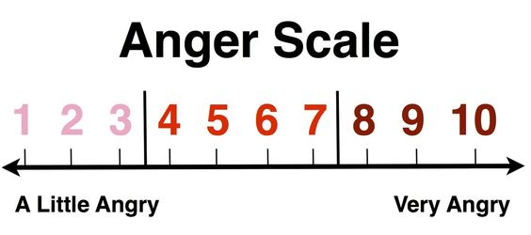
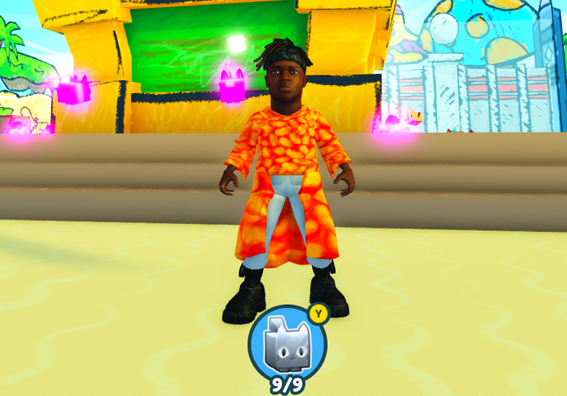



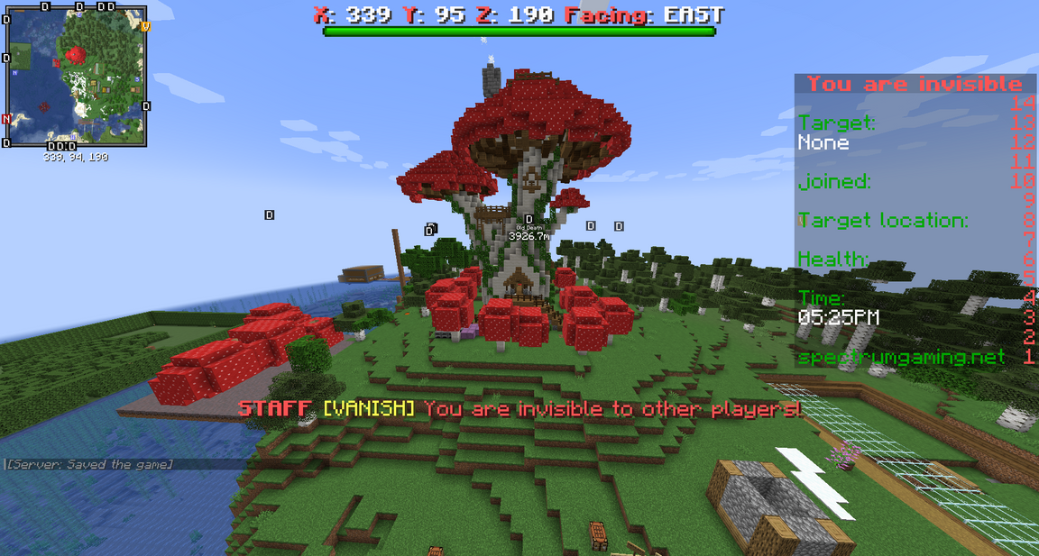
Building a Toolbox
Notes:
Depending on the situation, it may be helpful to develop a toolbox of strategies that the young person can use to help them when they feel stressed. It is important that anything that goes in the toolbox is something that is actually possible and that the young person finds genuinely helpful. What helps one young person, may not be the same for another.
These could be tools such as 'anger scales' and breathing exercises, certain games, music or activities, fidgets, creative outlets, comfort foods or access to safe spaces or changes of environment.

