Slide 1

Welcome Meeting September 2025
Welcome

Slide 2

The year ahead…

Slide 3
1. PERSONAL DEVELOPMENT
To continue to improve our offer for personal development for pupils
To continue to support the wellbeing of our community
a. Write anti-racist policy to share with parents.
b. Monitor teaching of Protected characteristics
c. Offer parent workshop in Computer Safety
d. Offer parent workshops in ‘Supporting Children’s Wellbeing’
-Anxiety
-Emotion Coaching
-Managing Worry
-Setting limits and boundaries
-Transitions

Slide 4
Parent workshops (dates TBC)
Date | Theme
10th October 9am | Anxiety
12th December 9am | Emotion Coaching
6th February 9am | Managing worry
27th March 9am | Setting limits and boundaries
24th May 9am | Preparing for transition
28th January 7pm (confirmed) | Cyber safety (Tanya Cross)

Slide 5
2. BEHAVIOUR AND ATTITUDES
To continue to promote positive behaviour and attitudes
To re-introduce Restorative Ambassadors in support of our restorative practice
3. LEADERSHIP AND MANAGEMENT
a. To establish the new leadership team
b. To continue to strengthen subject leadership

Slide 6
QUALITY OF EDUCATION AND OUTCOMES
To continue to improve our ambitious curriculum for all children
a. Breakdown knowledge progression and rebuild modules of learning in writing
b. Monitor History, Geography, Science and Computing for impact of curriculum approach. Moderate changes to writing.
c. Revise strategies to promote active engagement in lessons for all learners and therefore retention of knowledge
d. Ensure continuity of vocabulary acquisition via planned lesson checks.
e. To introduce adaptive technologies in all classrooms to support all children.
f. To refresh and update our reading scheme.
g. To introduce and embed sensory classroom approaches through staff training and development, ensuring inclusive, engaging environments that support all learners.

Slide 7
Paperwork
Local visits permission slip – if new to school
Medical Conditions form – Mrs Bristow if any changes
Change of address, telephone numbers etc – please inform office
Ladybrook - Learning without Limits

Slide 8
Help please!
Please label all uniform (shoes/coat)
Coat needed EVERY DAY
Pump bags – draw string
No huge bags – no space!
No jewellery – earrings must be plain, small studs (children to bring own tape to cover for PE)
NB SWIMMING TERM AND NEW PIERCED EARS
No nail varnish / make-up
Long hair – tied back – its own colour please
Ladybrook - Learning without Limits

Slide 9
Make Reading a daily pleasure and routine
Ensure your child is getting enough sleep
Arrive / collect on time.
Absence for planned medical / dental reasons should take place out of school time if possible. The office requires appointment card / medical letter to allow us to authorise the absence
Please don’t book holidays in term time
Ladybrook - Learning without Limits

Slide 10

Communication
NO NUT RELATED PRODUCTS OR CEREAL BARS in lunch boxes
School lunches – order on time
Choose lunches with your child
Please: (Years 3-6) keep your lunch account in credit – or lunch choices are lost
Ladybrook - Learning without Limits

Slide 11
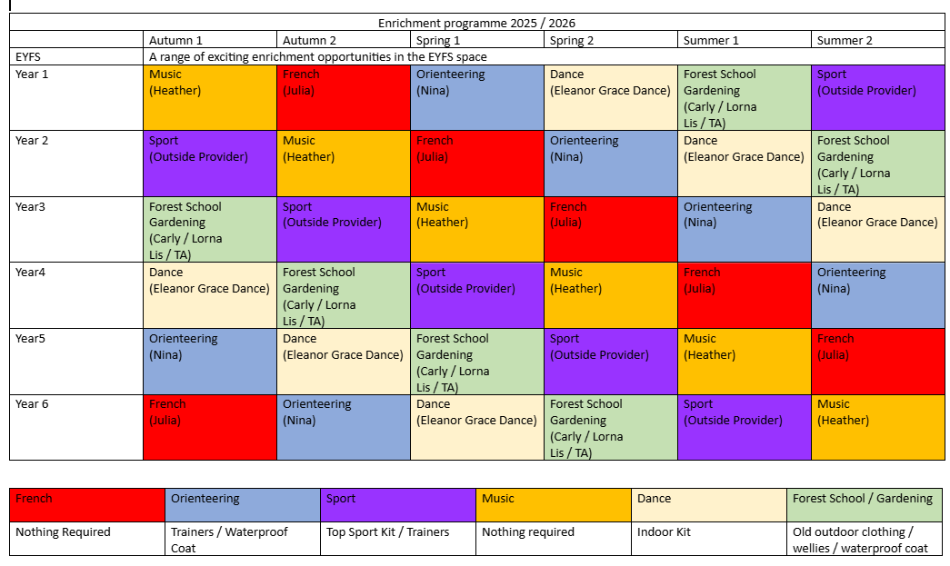
Enrichment

Slide 12
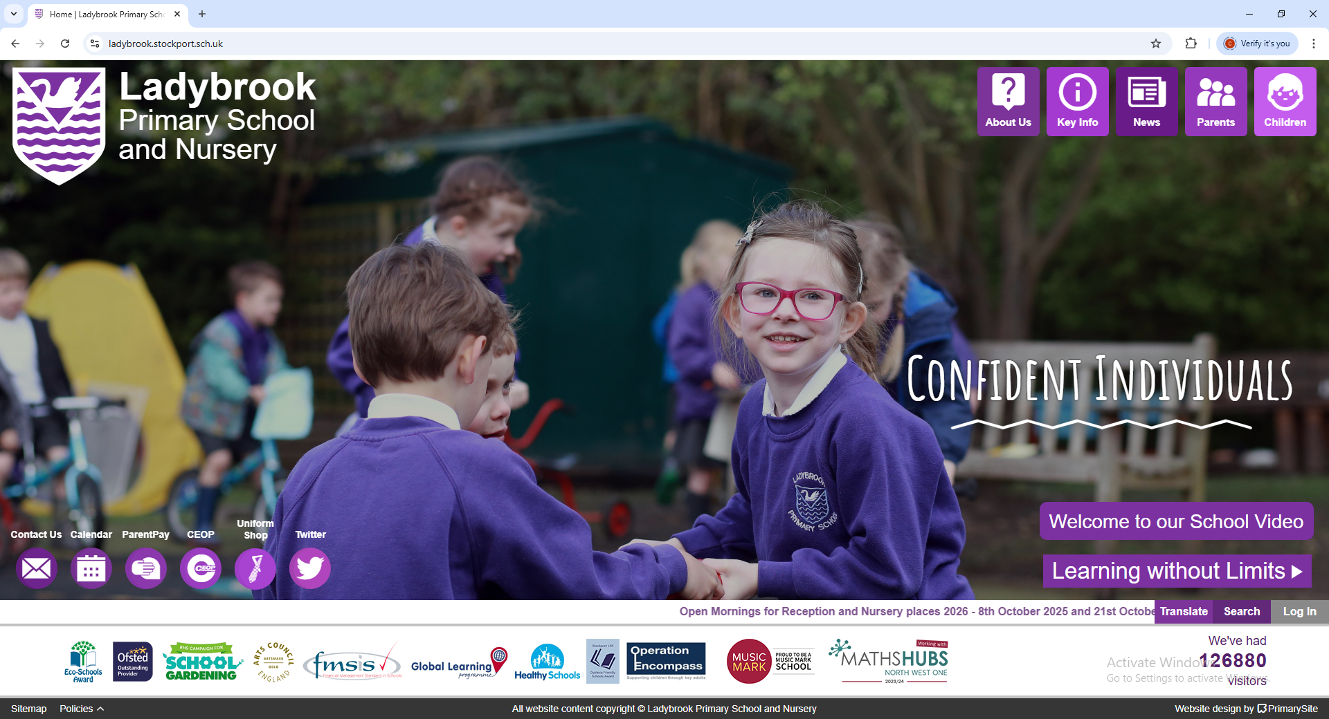
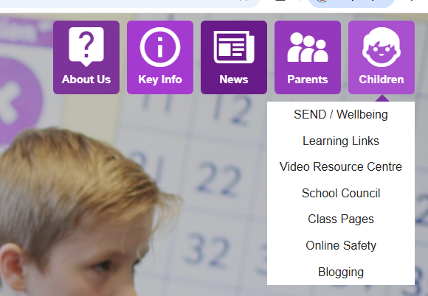
Sharing your child’s learning ….

Slide 13


Ladybrook PTA
Please join!
17th September … more info to follow from PTA

