Slide 1
Ladybrook Primary School
Restorative Ambassadors

Slide 2
Introductions – Who are we?
We rae volunteers who help other children restore relationships when something happens in the playground. Sometimes we do this by ourselves but sometimes adults work with us if the problem is big.

Slide 3
Our training
2 days training with Stockport’s RA team
In this training, we developed the skills needed to be an ambassador:
We learned about reading body language and facial expressions
We learned about empathy
We learned how to be good listeners
We learned all about different emotions
We learned about having different perspectives, that there isn’t always one story and that if stories are different it doesn’t mean one is wrong!

Slide 4
Our role in the playground… we play until we are needed! Other children come to us for help.

Slide 5
What is in the restorative bag?
Our talking toy
Our emotions chart
Our notebook
Our jackets
Our questions

Slide 6
Different perspectives and jumping to conclusions
Sometimes we see something happening and we want to jump straight in, we mustn’t do that because we don’t always know the reasons for what is happening….we have to listen to what may have already happened or what may be about to happen. Our restorative circles allow us to get the full picture.
Watch this short video. At each pause, decide what you think is happening.
https://www.youtube.com/watch?v=_SsccRkLLzU
At the end, were you surprised?
Often, we can jump to conclusions!

Slide 7
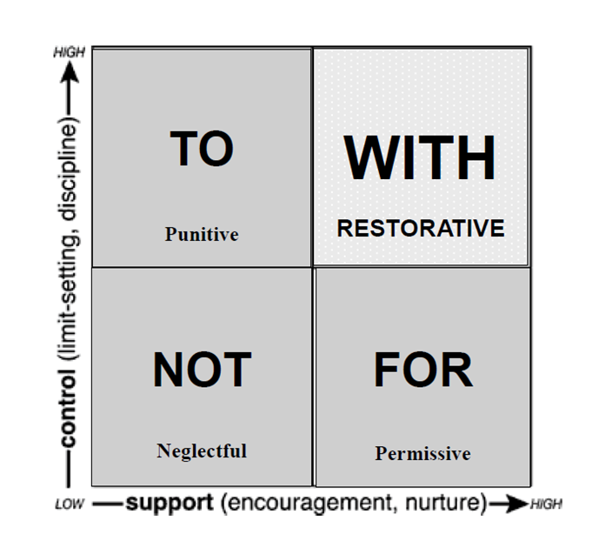
How we try to help solve problems WITH people in our circles… the social window
Problem:
Two children in Year 1 keep falling out over the football. They both want it.
If we are in the ‘for box’ – we get them both a football – they don’t learn to share.
If we are in the ‘not box’, we ignore them and they don’t learn to share.
If we are in the ‘to box’, we punish them by taking the ball off them – they don’t learn to share.
If we are in the ‘with box’, we talk to them about the problem, find solutions together and model what should happen – they learn to share!

Slide 8
Thank you for listening. To finish ….
How much do you now know about Restorative Ambassadors?
0 is nothing, 10 is everything!

