Slide 1
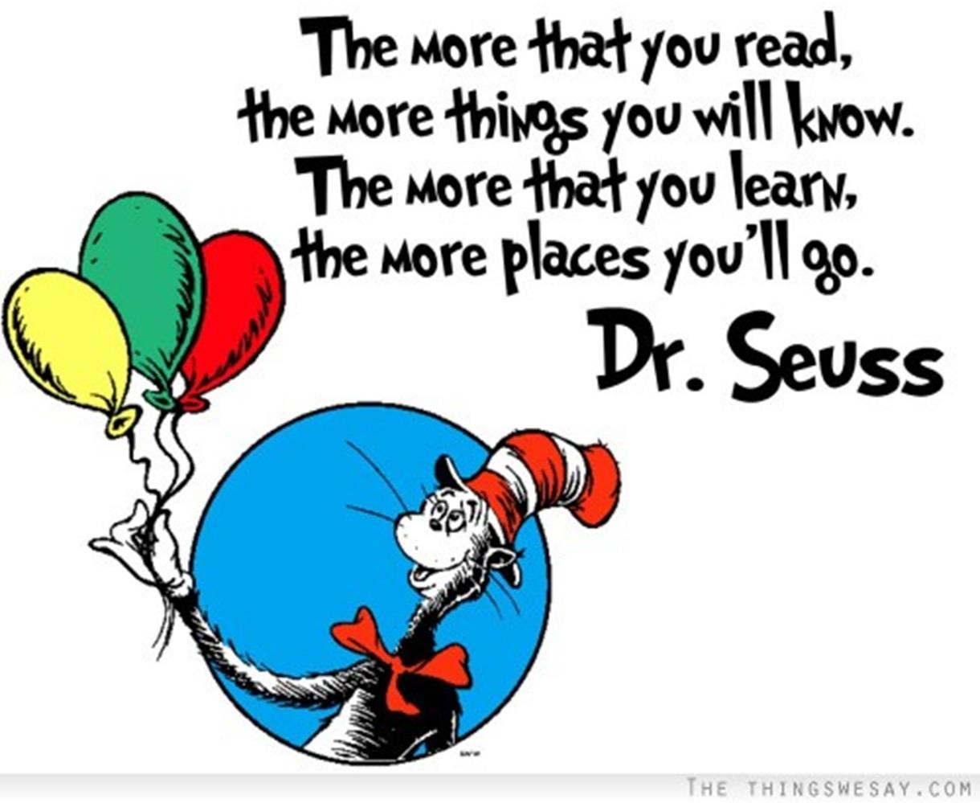

Slide 2

Is our attention span shrinking? Do books even have a future? Many people believe that the Internet represents the end of the book as we know it!
The Literacy Book Trust Annual Survey shows a downward trend in reading.

Slide 3
Key findings
Reading enjoyment:
Just 2 in 5 (43.4%) children and young people aged 8 to 18 said they enjoyed reading in their free time in 2023. This is the lowest level since the question was first asked in 2005.
  Fewer boys than girls said they enjoyed reading (40.5% vs. 45.3%). While the gender gap in reading enjoyment has halved for those aged 8 to 18 between 2005 and 2023 (decreasing from a 10.7 to a 4.8 percentage-point difference in favour of girls), this drop is largely because of a greater drop in reading enjoyment in girls than in boys.

Slide 4
Reading frequency:
Fewer than 3 in 10 (28.0%) children and young people aged 8 to 18 said that they read daily in 2023.
  There has been a 26% decrease in the number of children and young people aged 8 to 18 who read daily in their free time since 2005 (decreasing from 38.1% to 28.0%).
  More girls than boys aged 8 to 18 said they read daily (30.4% vs 24.9%). However, daily reading levels increased for boys and decreased for girls between 2022 and 2023.

Slide 5

The end of "deep reading”?
In the age of social media, audiences are becoming increasingly accustomed to short-form content. Popular social network apps allow users to scroll through endless videos in seconds, each one offering something new to stimulate the senses.
Does this matter – is it just a new and different world?

Slide 6
Yes it does matter!
Several studies show that these scrolling habits can become problematic as we get more used to reading on a superficial level and therefore we think less about the information we receive. This in turn can mean we remember less of the content we are consuming, and as a result, the habit of "deep" or thorough reading is getting lost.

Slide 7
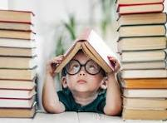
Why Read?
Reading improves vocabulary
Even as adults, when we read, we come across many new words we never really heard of. And we learn from this. As you read, you come across new words, phrases and writing styles.
This is even more so for young people. Children sometimes stumble over their words, do not know how to pronounce them or what they mean. By reading, young people encounter new words more frequently and sometimes repetitively and therefore can see them better in their context. If you then pay attention to the pronunciation as a parent, these children will be better prepared for school.

Slide 8
Better comprehension
Children who are encouraged to read at an early age have better comprehension of things around them. They develop smart thinking abilities and are more receptive to creativity and ideas that others their age lack.
The more you read, the more imaginative you become. Whenever you read a fiction book, it takes you another world. In the new world, your imagination works at its best as you try to see things in your own mind.

Slide 9
Develops critical thinking skills
One of the primary benefits of reading books is its ability to develop critical thinking skills. For example, reading a mystery novel sharpens your mind. What elements are there in a story to make this or that conclusion. If a book is non-fiction you will sometimes ask yourself if the author is right. Critical thinking skills are crucial when it comes to making important day to day decisions. Reading requires an individual to think and process information in a way that watching television can’t. The more you read, the deeper your understanding becomes about what you’re reading and its application.

Slide 10

Improves memory
Every time you read a book, you have to remember the setting of the book, the characters, their backgrounds, their history, their personalities, the sub-plots and so much more. As your brain learns to remember all this, your memory becomes better. With every new memory you create, you create new pathways and this strengthens the existing ones.

Slide 11
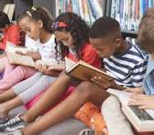
Broadens horizons
By reading books, you get a glimpse of other cultures and places. Books expand your horizons, letting you see other countries, other people and so many other things you have never seen or imagined. It’s the perfect way to visit a new country in your mind.
When we open a book while sitting in the comfort of our rooms, it can be like time travelling: we transport our imaginations to a world purely based on the imaginations of the author. We learn about everything they want you to know, see the world through their eyes and their perspective, learn about new people, discover their traditions, cultures and all that makes them unique and unforgettable.

Slide 12
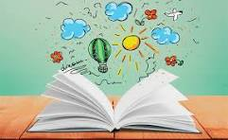
Improves writing skills
Reading a well-written book affects your ability to become a better writer. Just like artists influence others, so do writers. Many successful authors gained their expertise by reading the works of others.
Children who learn to read also tend to develop better writing skills. The reason: they have been introduced to a world where they experience different text types, understand the organisation and purpose of texts, have a wider vocabulary, have developed a wider imagination

Slide 13
Improves focus and concentration
In our internet-focussed world, attention is drawn in a million different directions at once as we multi-task through every day. This type of behaviour causes stress levels to rise, and actually lowers productivity.
When you read a book, all of your attention is focused on the story—the rest of the world just falls away, and you can immerse yourself in every fine detail you’re absorbing.

Slide 14
Makes you more empathetic
According to studies, losing yourself in books, especially fiction, can increase your empathy. In a study conducted in the Netherlands, researchers showed that people who were “emotionally transported” by a work of fiction experienced a boost in empathy. By reading a book, you become part of the story and feel the pain and other emotions of the characters. This in turn allows your mind to become more aware of how different things affect other people. Eventually, this improves your ability to emphasise with other people.

Slide 15
Developing reading in Key Stage 2:
Reciprocal Reading
Reading conferences
1:1 reading
Active research techniques
A love of reading

Slide 16
Key reading skills:
Summarise
Predict
Clarify – expanding vocabulary
Comprehend – literal, deduction, inference – quality questioning reference handout

Slide 17


