Slide 1
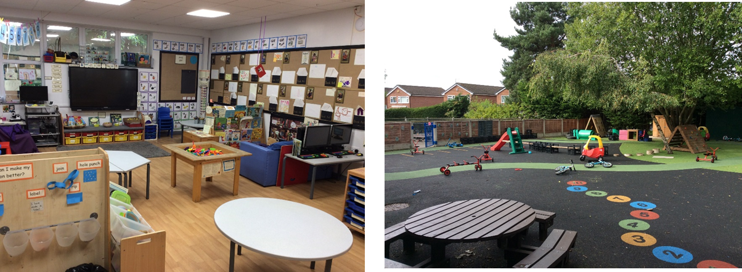
Welcome to Reception 2025/2026

Slide 2
Staff
Teachers – Miss Woodward (Mon, Tue, Wed am)
Miss Ridgway (Wed pm, Thurs, Fri)
Teaching assistants – Mrs Robinson

Slide 3
Uniform
Please label all uniform (inc shoes/coat). Anything named should find it’s way back to you eventually.
Coat needed EVERY DAY
Wellies - please bring in if you haven’t already
PE will start after Christmas- PE bags – drawstring bag, a plain white t shirt and black shorts. No huge bags please; we have no space!
No jewellery – earrings must be plain, small studs (children to bring own tape to cover for PE)
No nail varnish
All long hair – tied back

Slide 4
Early reading
Reading sessions will be on Monday and Tuesday Your child will have 2 books to read throughout the week at home. Please leave them in their book bags everyday. Book change will be Thursday
Oxford Reading Tree Scheme will be starting next week including the character matching game- No books will be sent home the week of 6th October
Children will read to an adult once a week and they will have a book change once a week.
Stories with no words to begin with once the children recognise the characters they will move onto books with words.
Talk about the pictures, feelings, predictions, initial sounds.
All children will choose a library book once a week, this is for grown ups to share with your child and for your child to enjoy listening to stories.
Please sign your child’s diary when they have read their reading books so we know if they need a book change or if there is something that they have found tricky.

Slide 5
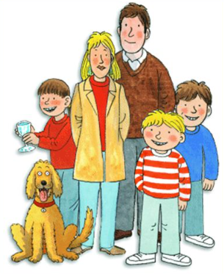
Phonics
Floppy's Phonics – links to Oxford reading tree. Phonics sessions 4 times a week.
Listening games, finding objects with the same initial sound, rhyming words – you can play these at home too.
Teaching the sound and the letter name e.g letter A sound a.
Once we start a few letters we then start blending e.g c-a-t.
Then when doing reading with your child they will start to blend. Some words will be recognisable eg mum, dad.
Tricky words- to, the, I , no, go.

Slide 6
Early writing
Children will come into school making marks, some writing their name.
We will be working on writing their names from now on – please also practise this at home.
First we will see lines, then shapes, then letter like shapes and then letters, then words and sentences.

Slide 7
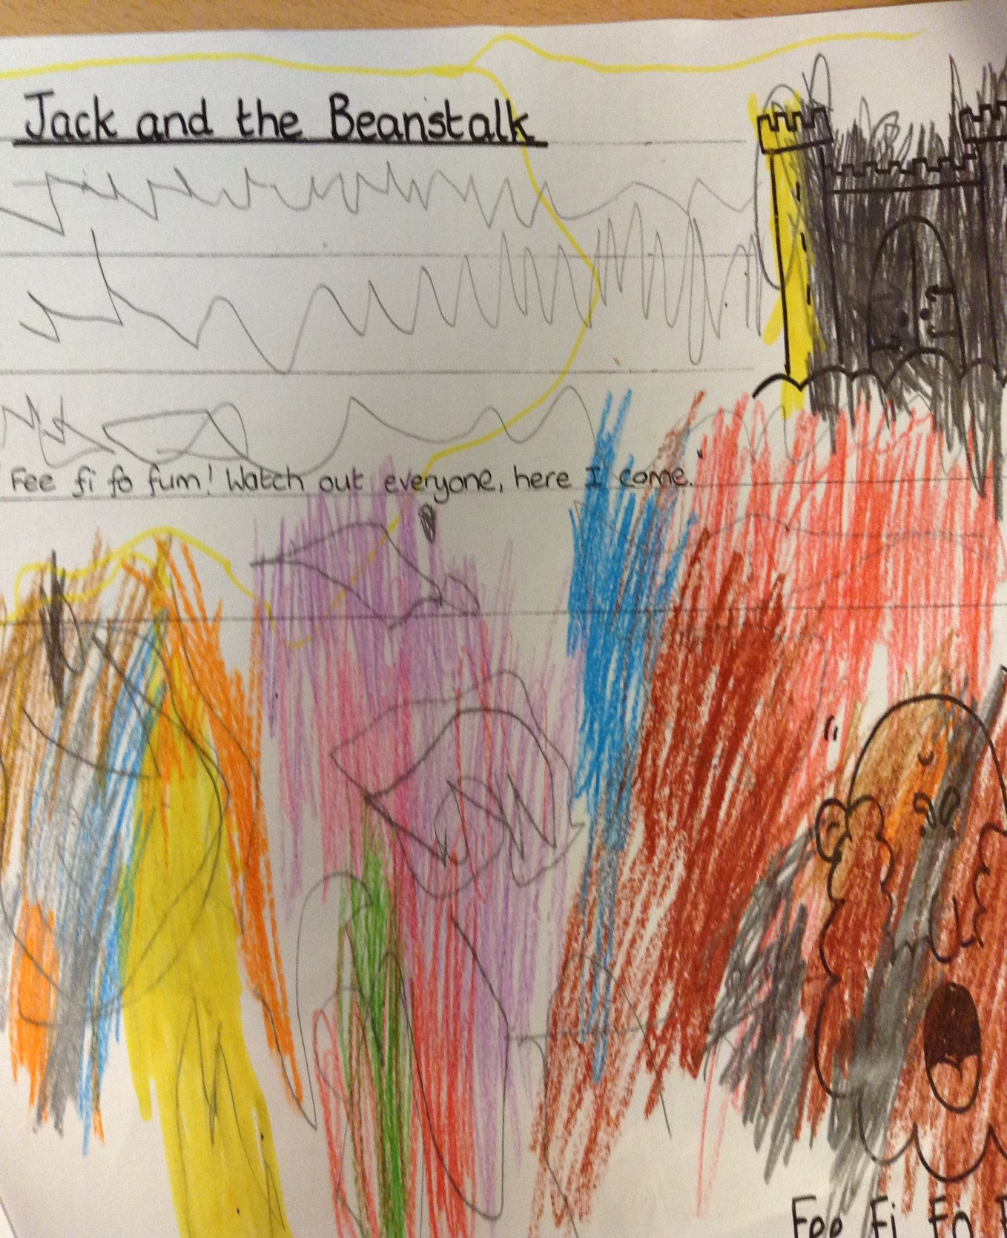
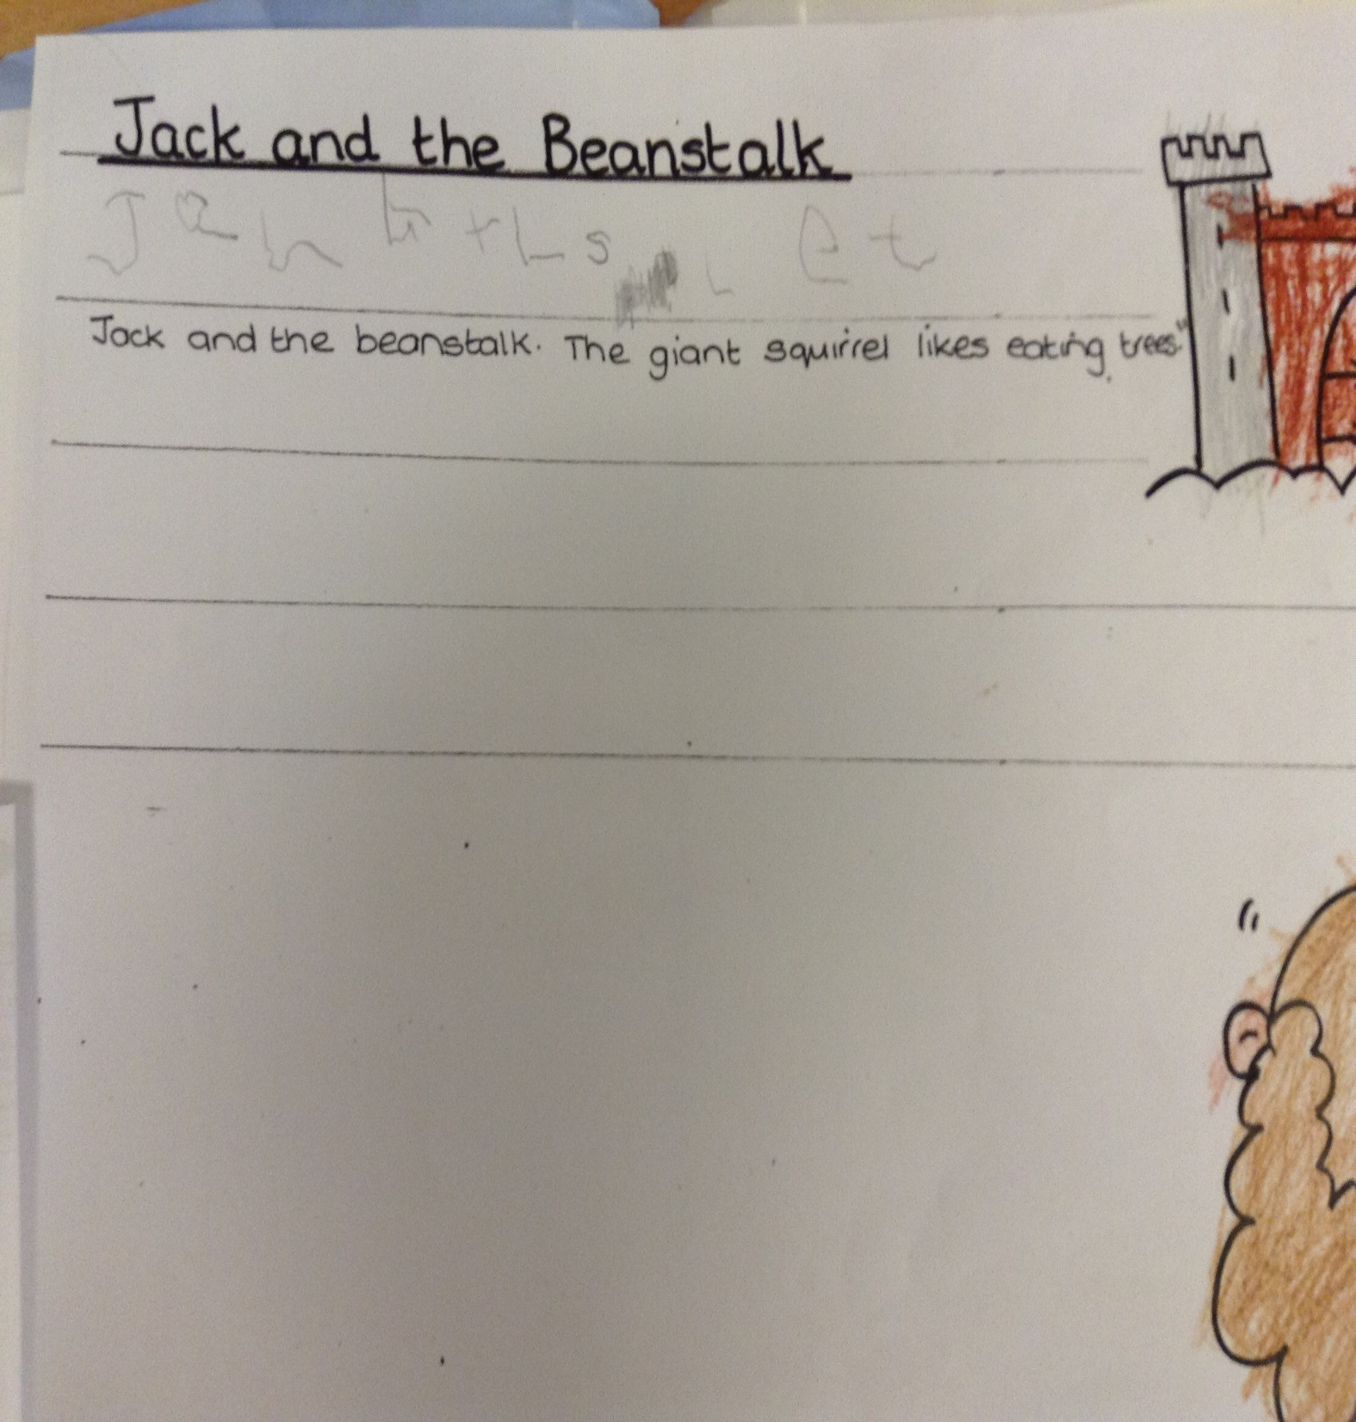

Slide 8
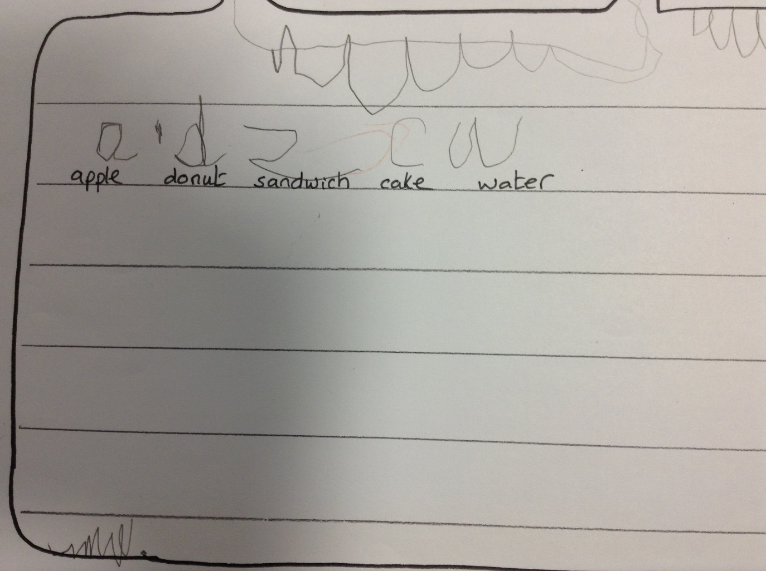
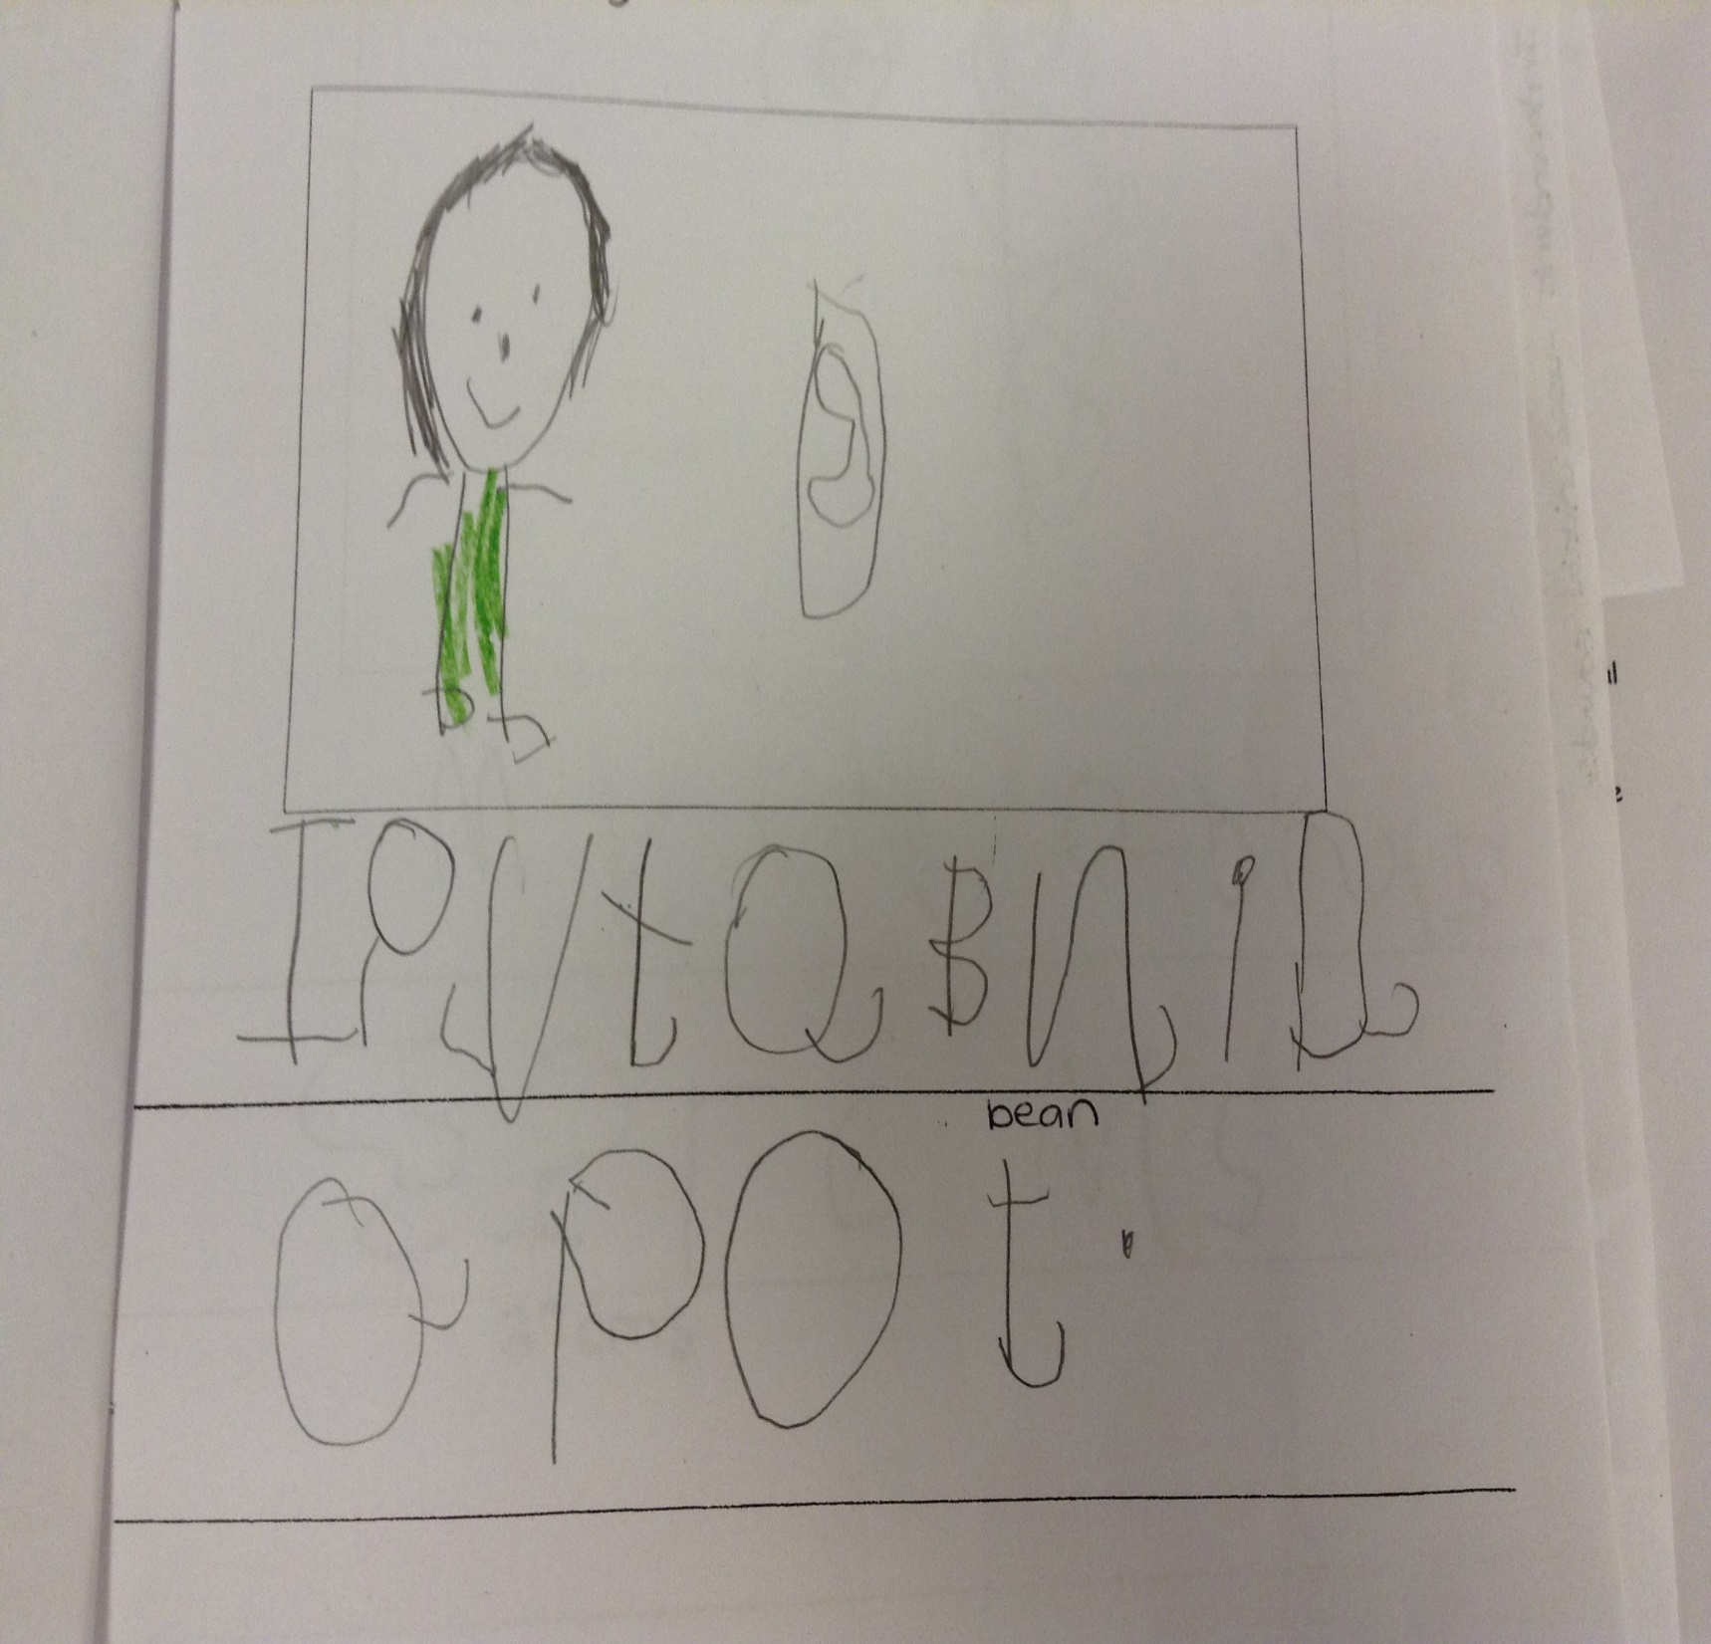

Slide 9
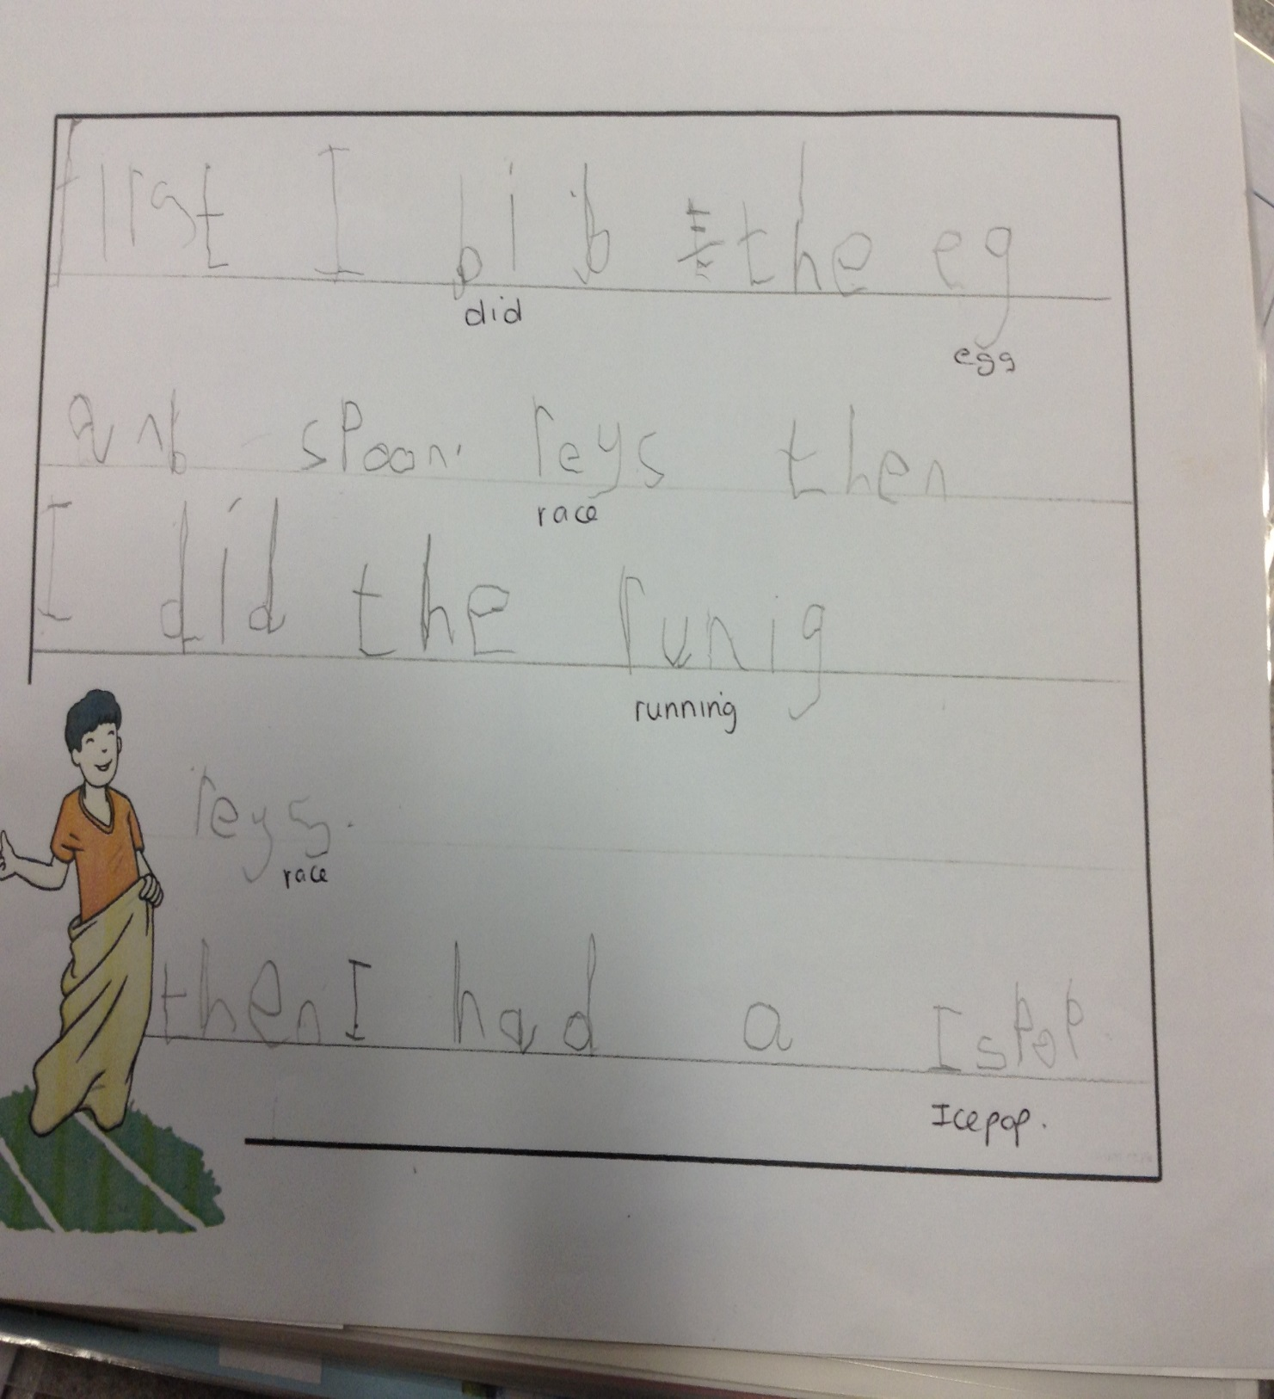
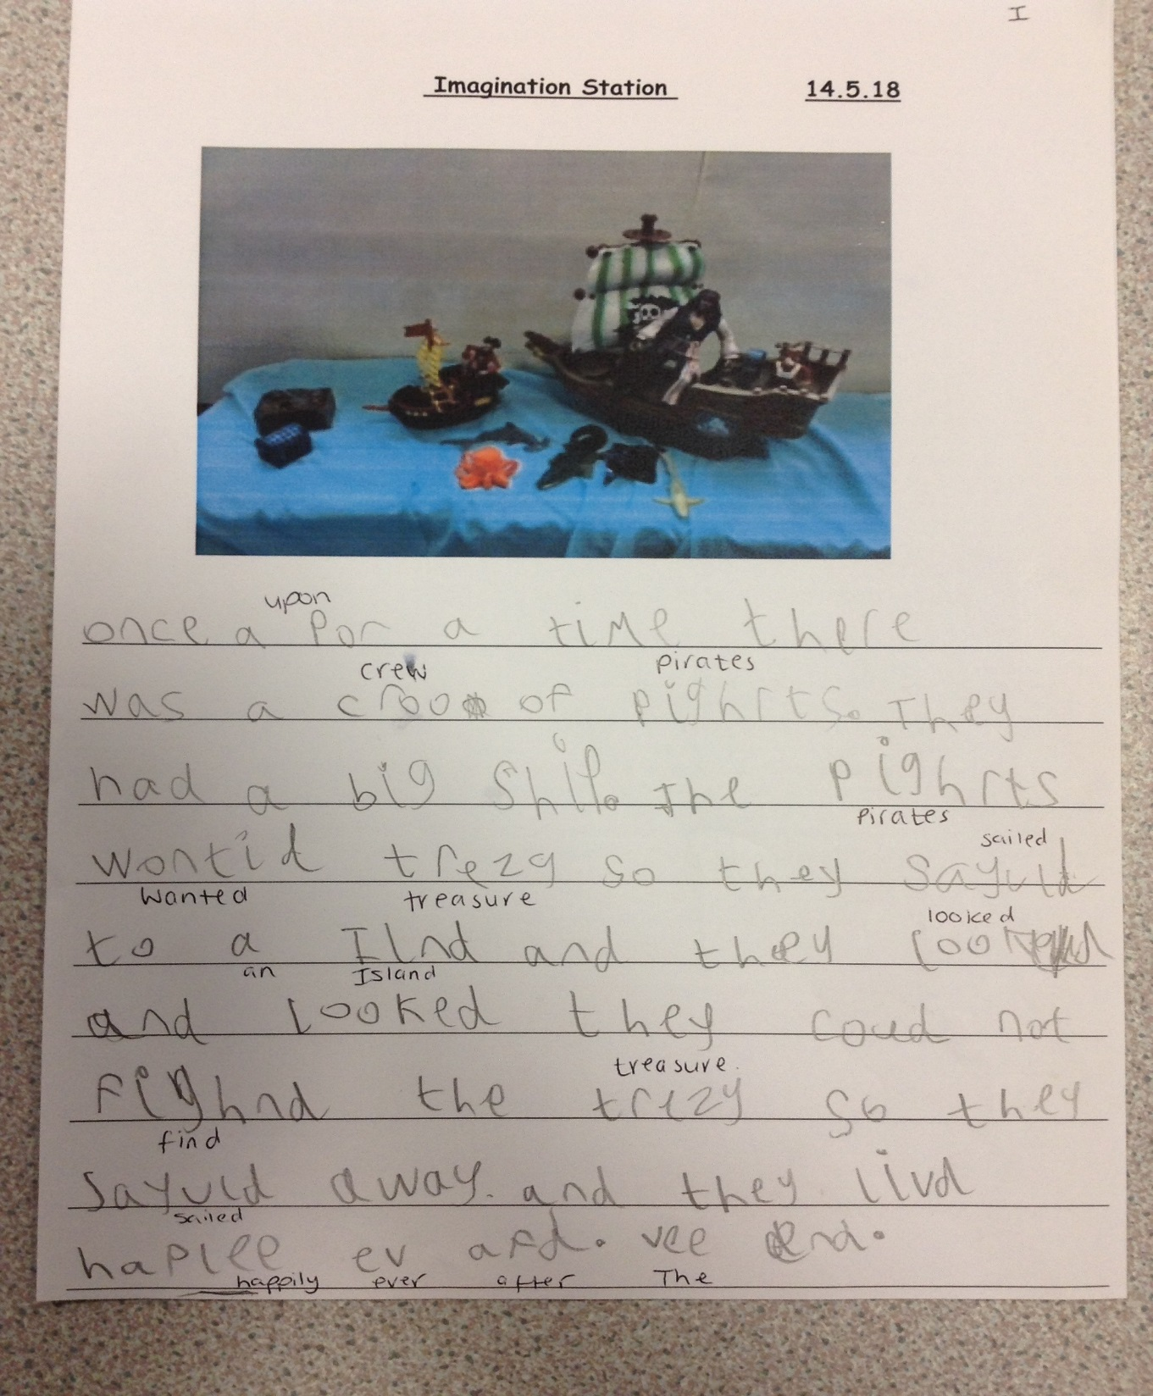

Slide 10
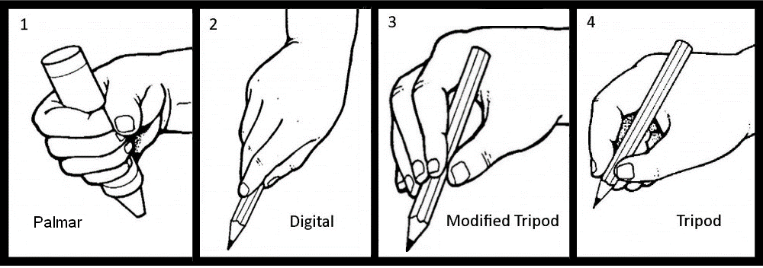
Pencil grip- we do fine motor activities to develop this through continuous provision, inside and outside. Dough gym and funky fingers, name writing, which will lead to handwriting in books later on in the year. We are aiming for number 4 the tripod grip. Please position your child's hand correctly if they are doing any mark making at home. We do lots of practise at school.

Slide 11
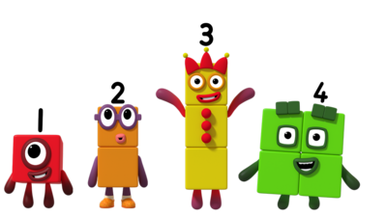
Maths
Maths is mostly practical. We do begin to record this as and when but seeing it visually and playing games helps them retain the information – please practise counting, number recognition and ordering numbers at home.
In school we do lots of finding numbers, ordering, counting objects which will lead into addition and subtraction.
Our Maths scheme also relates to the Number block series which children are familiar with. We do watch Number block episodes/clips in our sessions.

Slide 12
Tapestry
Your child's learning journey is now all on Tapestry we no longer have paper copies. Please check this weekly. You will get an email if we have sent a message or observation on your child. These could be important.
There will be a weekly round up, some weeks will have photos and others might not. This will not be on a set day.
There will be observations of your child throughout the year.
Please don’t share any photos as it may have other children in.
We will use this as a tool for communication from us to you, however please can you only use their diaries to communicate with us (or speak to us) as Tapestry will not be checked daily.

Slide 13


Sometimes, we have lots of grownups that we need to speak to at the end of the day. If your child comes out with one of these cards —->, please hang back so we can have a quick chat. Please don’t be alarmed, it may be something like they have just tripped whilst getting their coat, or they didn’t like their lunch that day.
Children need to get changed throughout the day for a variety of reasons, toileting, playing in the water, slipping in mud. The oops slip will be put in a plastic bag with your child's clothes so that you have some information about why they have had a change of clothes.

Slide 14
Other Information
Baseline assessments / Wellcomm assessments
All about me sheet - please return if not done so already.
School lunches- please choose with your child each week by Thursday- NO NUT PRODUCTS OR CEREAL BARS in lunchboxes. Please do not send in snack for your child. We provide snack for the children.
If your child is on school dinners, please do not send in a packed lunch as well.
Water bottles - please bring in every day, water only please!
Support from home with writing and maths is much appreciated and will make a difference
Home/School diary is checked everyday please add any notes in there if needed.
School starts at 8.50am-9am. Children should be in school learning by 9am.
School finishes at 3.20pm- book bags and water bottles will be outside the door for grownups to collect before the children come out.
PE will be on a Thursday from Spring. PE kit will stay at school and we will send it home at half term to be washed.
Yearly Snack money £25 please pay this on Parentpay
Family photo for their learning wall - please send in a 6x4 (or smaller) photo of your family so we can put it onto your child’s space on our learning wall.
Check emails and notices around school for PTA events. E.g Discos and fairs.
Phonics Workshop- If you have not signed up and you would like to attend, please come and see us.

Slide 15
Date for diaries
Reception class assembly- Wednesday 1st July 9.30am
Harvest assembly- 16th October (time to be confirmed)
Phonics Workshop- Tuesday 7th October 9-9.30 OR Monday 13th 9-9.30am - If you have not signed up and you would like to attend, please come and see us.
Children in Need Stay and Play-
Tuesday 11th November 2.30-3.20pm and Friday 14th November 9-10am

