Slide 1
Welcome to Year 5
Miss Hobbs
Mrs Ainslie

Slide 2
Timetable
Monday – indoor PE
Tuesday
Wednesday
Thursday – outdoor PE
Friday – Spelling test / new spellings and homework set
Enrichment – Orienteering (trainers and water proof coat needed)
Notes:
PE kits including trainers to be in school all the time please.
Bookbags – only one keyring please.
Water bottle in school each day please.

Slide 3
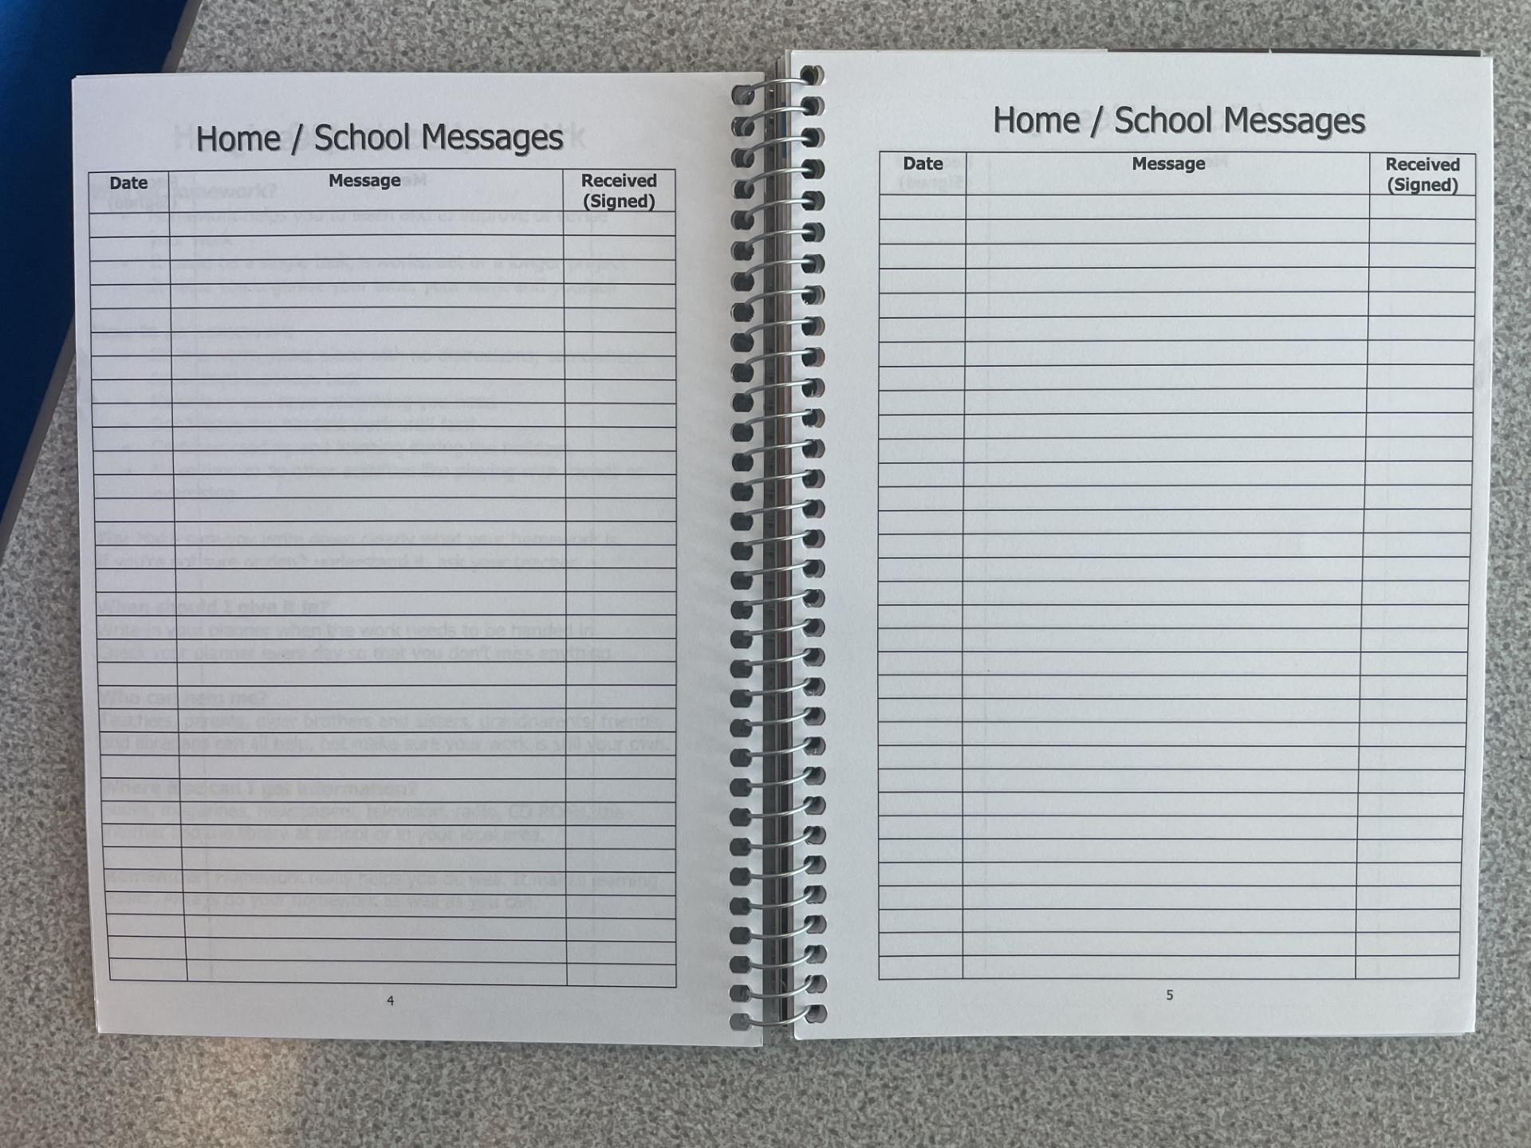
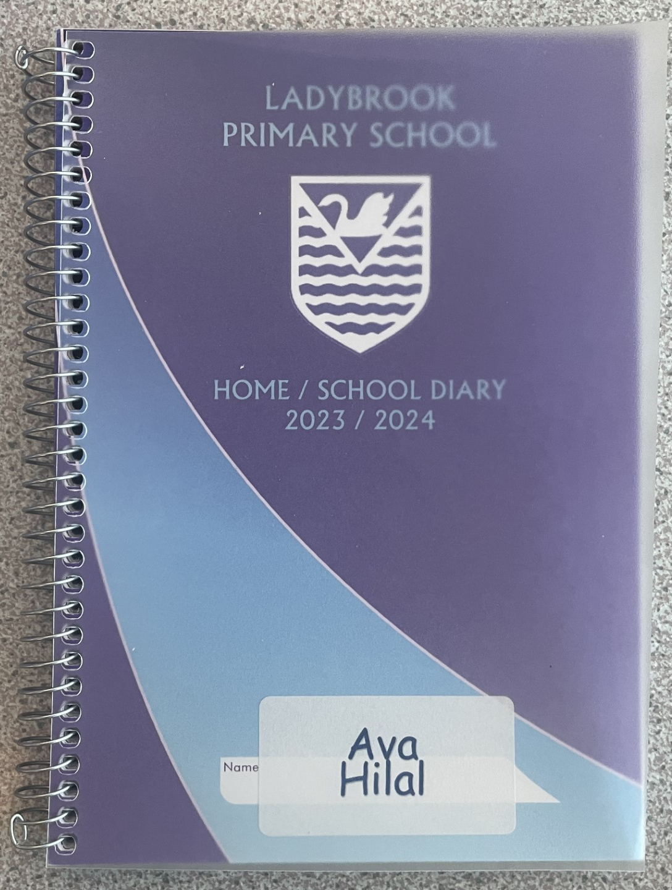
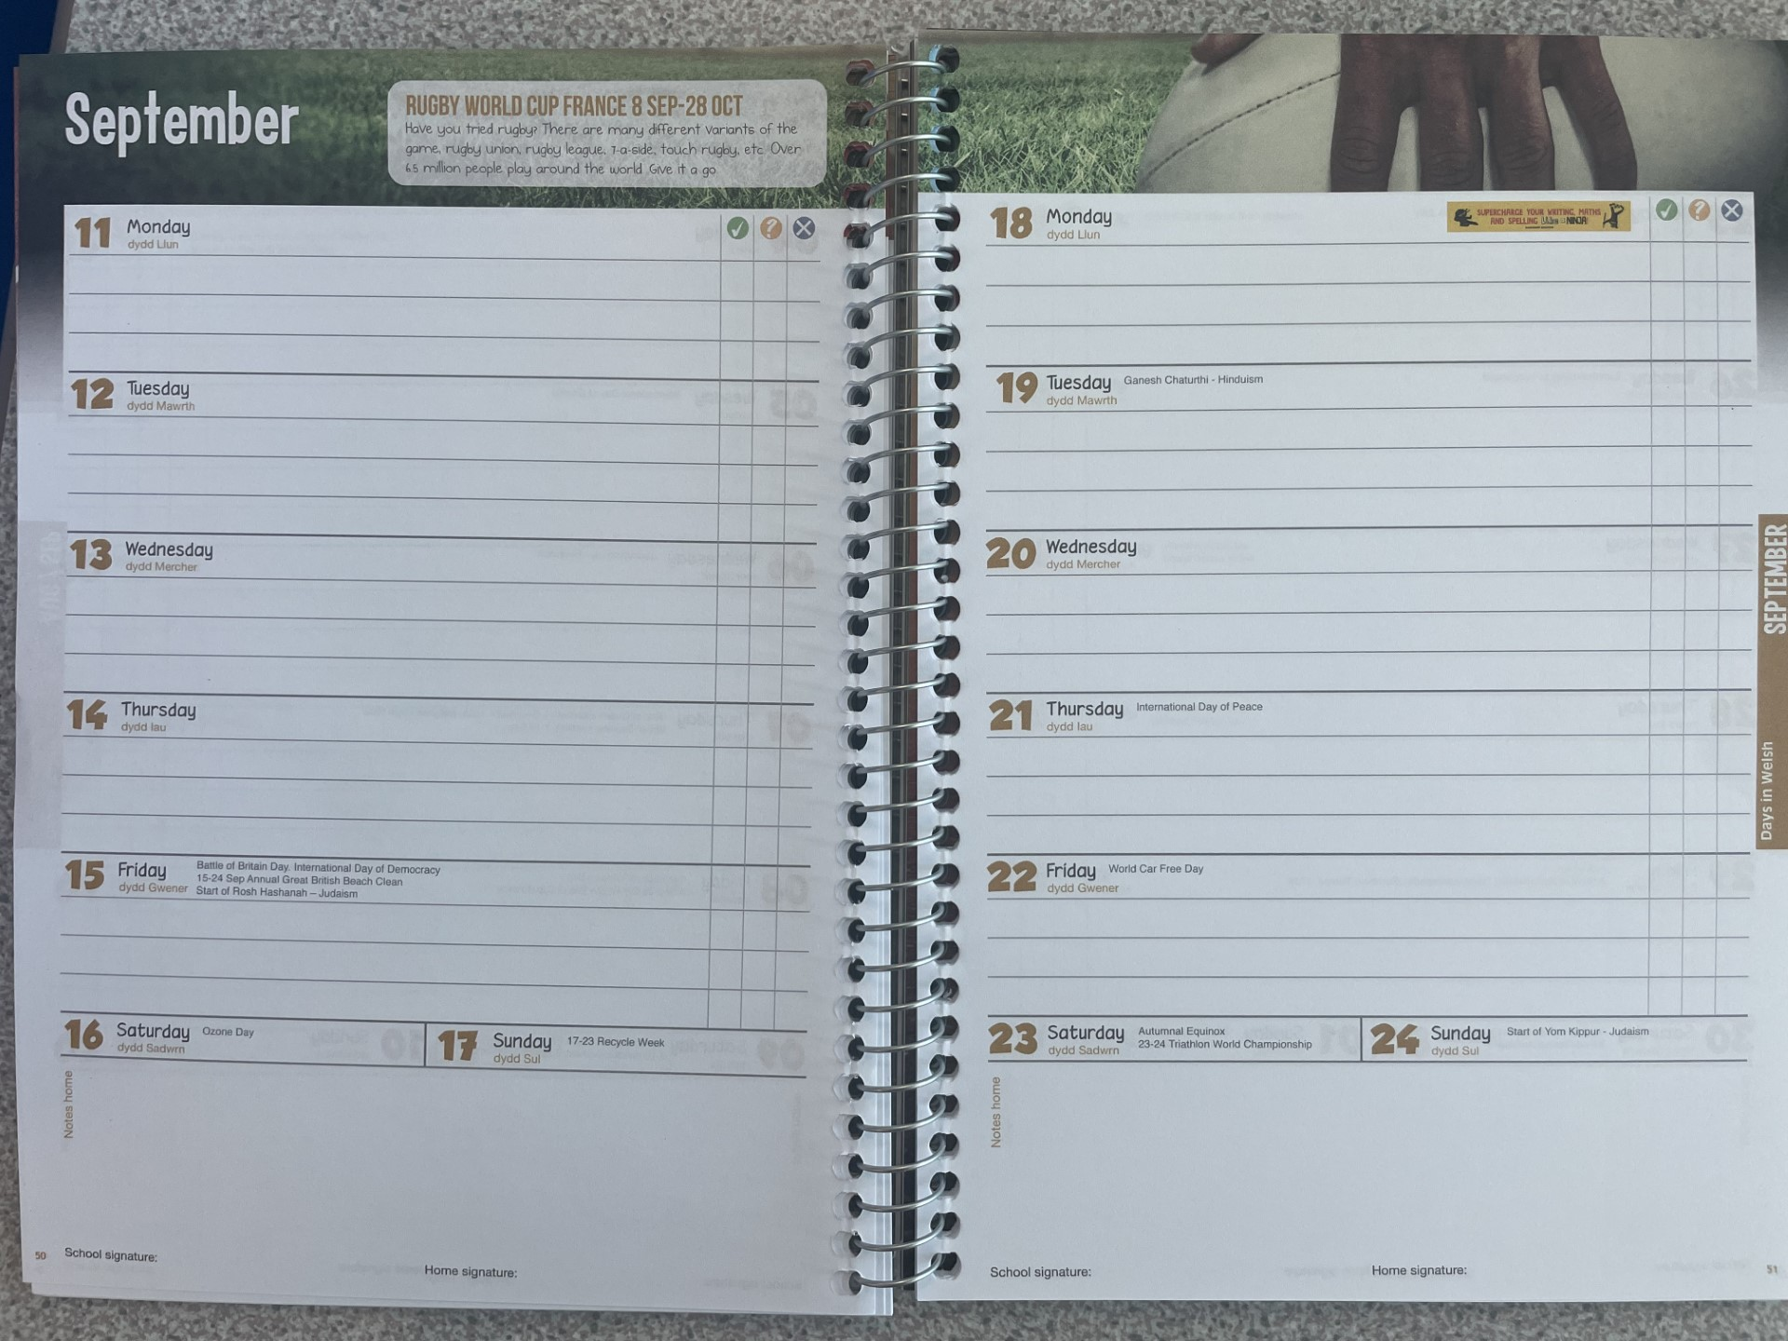
Home/School Diary
Any messages from me regarding your child will go here so please check regularly.
You can also write a message for me regarding your child if necessary.
It is then the children’s responsibility to show me any messages.
This year, all home/school communication will be done in diaries.
Reading is to be recorded in these sections.

Slide 4
Recording Reading
- Reading books can be changed any day through access to the class library.
- Children can read a book from school or from home as their reading book as long as it is an appropriate level.
- Record reading in their new reading diaries in the diary part. Use the dated section for that day, write the name of the home book and the pages read.
Diary and reading book in school EVERYDAY please ☺
- Parents to still hear children read at home and sign/comment please.
- Group reading and whole class reading of class novel (linked to our topic) in school.

Slide 5
Classroom
Children are seated in groups.
Frequently used resources are kept on tables/grey boxes – an emphasis on responsibility in Y5.
Book bags stored in trays/backpacks on pegs.
Named uniform and PE kit.
**Indoor PE: children must be barefoot. If for any reason they cannot be, they must have trampoline socks/socks with grips on the bottom.
Tuck shop/ healthy snacks from home – absolutely no nuts please.

Slide 6
Uniform reminders- summary
Please label all uniform (shoes/coat)
Pump bags – drawstring
A plain white t-shirt and black shorts
No huge bags please; we have no space!
No jewellery – earrings must be plain, small studs (children to bring own tape to cover for PE)
Swimming begins in Spring so no new ear piercings please.
No nail varnish / make-up
All long hair tied back – its own colour please.

Slide 7
Outside
Please bring coats every day – we will try to go out to play in all weathers!
Wellies must be in school.
Children MUST have their trainers for PE during the week and orienteering every Friday.

Slide 8
Times tables
- We will continue to test times tables most days.
Children will keep track of where they are up to in school.
All times facts for each times table first, then go back and do division facts for each table, then go back and do mixed multiplication and division facts for each table.
Please learn tables as much as possible at home using:
*Times Tables Rockstars
*Hit the Button
*Mathletics
*Multiplication.com etc.

Slide 9
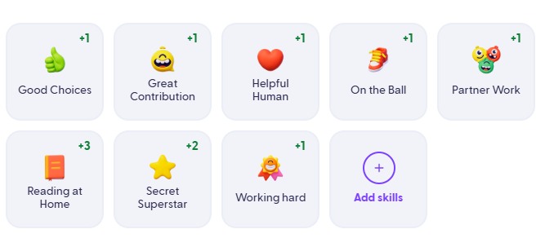
Rewards
- This year, I will be running class dojo!
At the end of a half-term, I crown Dojo King and Queen (the boy and girl with the most dojo points) and they receive a special prize.
The bubbles are then reset to zero so it is an even playing field for the next half-term!
Dojo produces a report of points given to each child, which I will share with you the end of a half-term.

Slide 10
Homework: Monday to Monday
- Homework will be a mixture of paper copies and set on Mathletics.
I will be setting up a new Google Classroom for Year 5.
Spellings will be sent home along with spelling books: ‘Look, Say, Cover, Write, Check’
Weekly jobs for home:
*Spellings practice and the accompanying task sheet.
*Times tables practice (TTRS)
*Reading a minimum of 3 times per week.
*Mathletics or paper maths homework

Slide 11
Year 5 Topics
Autumn – World War II
Later in the year:
Vikings & Forces, Space & North America

Slide 12
Dates for your diary:
Tuesday 4th November: School trip to Stockport Air Raid shelters!
Thursday 12th March: Class Assembly

Slide 13
I hope that this information has been useful.
Please speak to me at the gate or jot a message in the diary.
Please take any handouts you might have missed as you leave and make sure you signed in – thank you ☺

