Slide 1
Year 6: KS2 SATs meeting
2025-2026

Slide 2
Our approach – to prepare and to aim high but to maintain the whole curriculum
We believe that every child matters - they are all individuals– their achievements, attainment and progress must be a cause for celebration;
We believe we are preparing children for learning beyond school – learning for life;
Projects leading to events such as Christmas performances develop children socially and emotionally;
Educational trips and whole school projects help children to make connections in their learning and create lasting memories that can shape a future;
Learning how to learn with others and independently is central to our ethos.

Slide 3
How will we be supporting in school?
Delivering the whole curriculum as usual – revising through curriculum
Homework and homework feedback / discussion sessions
Booster sessions – two teachers and TA Wednesday afternoons:
Focused reading tasks using previous papers – differentiated according to need
Additional skills based and reasoning based maths work
Flashback 4s and times tables/5-a-days
Individual reading sessions
Practice tests x 3 batches (one of which will be in the hall)
Notes:
Explain booster type materials eg skill based approach and SAT type questions

Slide 4
How can you help at home?
Homework is focussed revision activities; the focus now is on ‘being correct’ - if children don’t know, they need to find out! Using grammar and maths mats.
Regular reading –at least 15 minutes minute blocks of sustained concentration- and discussion.
Mathletics Monday
Spellings
Times-tables!!
Sleep
Calm weekend before SATS week!!
Please don’t use any SATS papers from 2018 and beyond
Notes:
Explain how homework will be changing
1 reading task
Maths task
SPAG task
Explain the need to spread the revision – little and oftern – all children have been asked to produce a timetable – also good practise for high school
Remind parents about links on the website to help

Slide 5
Additional support during the tests…
A very small number of children qualify for a different approach based on need e.g. brain-breaks, a reader OR additional time OR a scribe OR a transcription
We will notify you if this involves your child
We need to seek permission, from the DFE, for most but not all of these strategies
Notes:
Explain the process of additional time / reader / scribe / breaks
Explain how strict this is and and how it sould not be misused

Slide 6
Observers
Independent Governor
Local Authority Representative

Slide 7
Timetable and the tests – wk beg
Day | Test
Date | Activity
Monday 11th May | English grammar, punctuation and spelling paper 1 – 45 mins, 50 marks approx. 50 questions paper 2 – 20 words, 20 marks
Tuesday 12th May | English reading 1 hour, 3 texts, 3 sets questions 50 marks
Wednesday 13th May | Mathematics Paper 1 – arithmetic 30 mins approx. 40 questions, 40 marks Paper 2 – reasoning 40 mins, 30 marks
Thursday 14th May | Mathematics paper 3 – reasoning 40 mins, 30 marks
Notes:
Look at sample of each paper
Explain where the tests take place
Explain timings to allow for a warm up
Explain how tests are collected and opened

Slide 8
What information will I receive about my child after the SATs?
Results returned to school in early July to check / remark
(around the third / fourth week of July deadline for marking reviews)
Results will be sent home in July reports.
A table of information alongside written report which will include test scores and Teacher Assessment.
Notes:
Explain reasons for delay i.e. checking and remarking papers

Slide 9
Test Results
Each pupil registered for the tests will receive:
a raw score (the number of marks awarded)
a scaled score*
confirmation of whether they are at standard (AS) or didn’t meet standard (NS) in maths, reading, GPS
Notes:
* Next slide explains this

Slide 10
What is a scale score?
Raw scores are converted to scale scores
100 is the scale score which reflects ‘expectation for Year 6’
The raw score required to achieve 100 may vary slightly on year – year depending on the difficulty of the test and how children do nationally
80 is the lowest scale score; 120 is the highest scale score.
100 is expected standard; 110 can be considered working at depth
Notes:
Scaled scores allow test results to be reported consistently from one year to the next. National curriculum tests are developed each year to the same specification. However, because the questions are different, the difficulty of tests may vary slightly each year. Scaled scores maintain their meaning over time so that 2 pupils achieving the same scaled score in different years will have demonstrated a similar level of attainment.
A pupil’s scaled score is based on their raw score. The raw score is the total number of marks a pupil receives in a test, based on the number of questions they answer correctly. The pupil’s raw score is translated into a scaled score using a conversion table. A scaled score of 100 will always represent the expected standard on the KS2 tests.

Slide 11
Progress Measures
School will also receive a progress measure for each child and a progress measure for the cohort.
This is based on KS1 data
Progress measures are based on a child’s starting point
They are used to measure the impact of the curriculum in KS2 and intended to challenge.

Slide 12
Teacher Assessment
Schools are no longer required to make statutory teacher assessment (TA) judgements in reading and mathematics. Test results in reading and mathematics will continue to be used in school performance measures.
Teacher assessment will be given for writing – within this cohort the range will be WTS (Working towards standard), EXS (Expected standard) or GDS (Greater depth standard).
Teacher assessment will be given for Science – this will either be HNM (has not met standard) or EXS (working at expected standard)

Slide 13
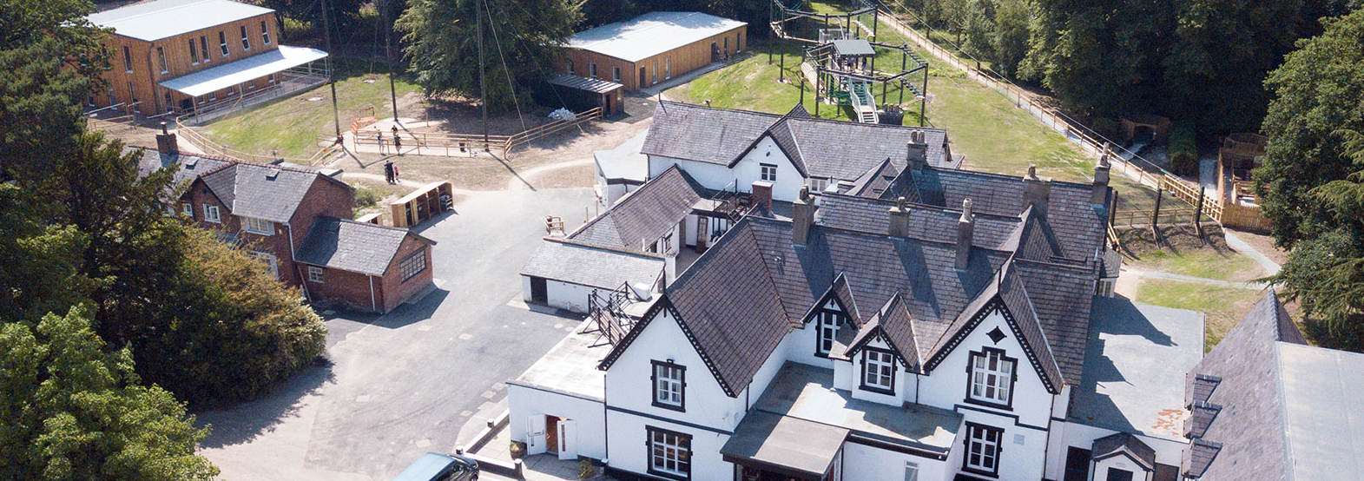
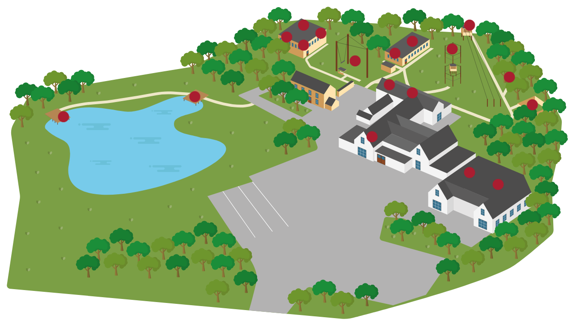
Robinwood
Wednesday 15th
to Friday 17th July 2026

Slide 14
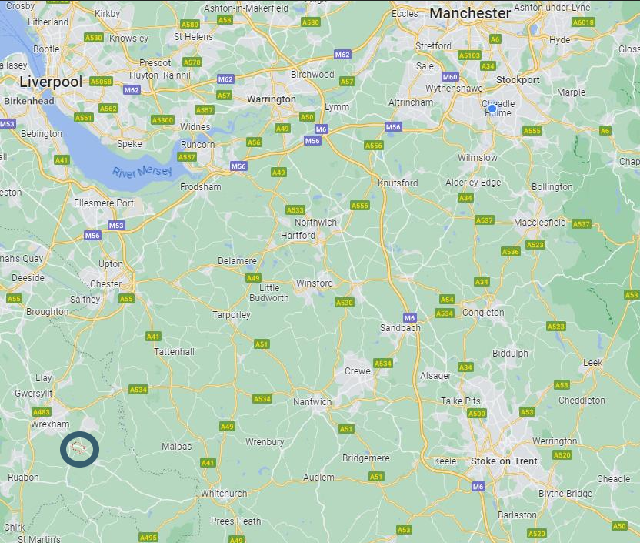
Where is it?
• Maes-y-Nant, Cross Lanes, Wrexham.
• Maes-y-Nant activity centre is the newest centre and is set in the beautiful Welsh countryside just outside of Wrexham. Maes-y-Nant dates back to the late Victorian era when it was built as a private house in around 1870. Its name Maes-y-Nant when translated means ‘house by a stream’. In 1959 the house was sold and converted to a hotel with many of its original features being preserved to this day.

Slide 15
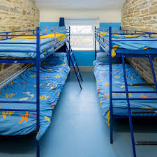

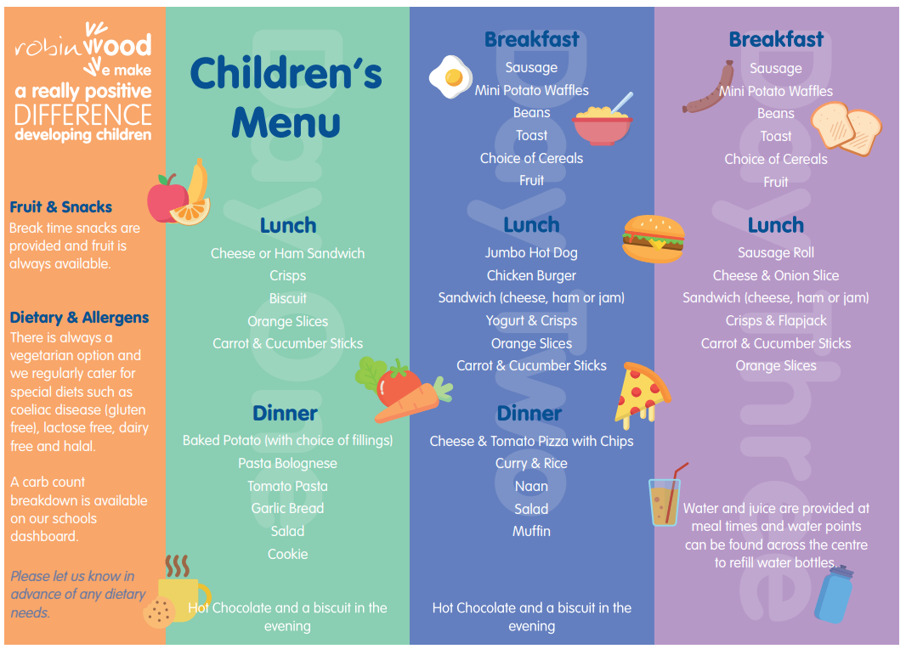
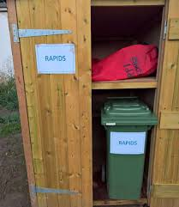
On arrival…

Slide 16


Activities

Slide 17
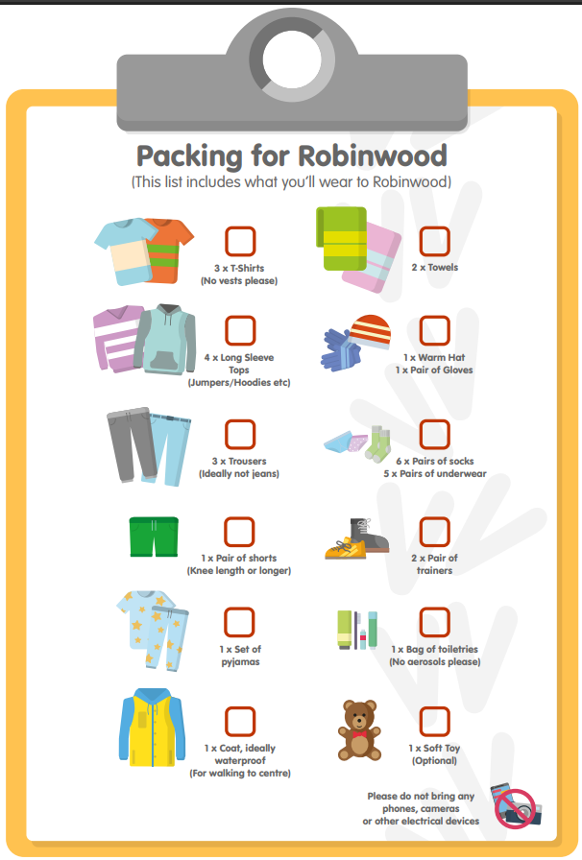
What to bring

Slide 18

What not to bring
Cameras – don’t worry the teachers will take lots of photos and we will keep you posted on Twitter!
Valuable items – mobile phones, tablets or expensive watches.
Aerosol sprays – they set off the fire alarms.
No snacks – all the food is provided.

Slide 19
What you need to do:
Please check payment dates.
Look out for kit lists and medical forms nearer to the time.

