Slide 1
Year 3 welcome meeting.
2025

Slide 2
Meet the staff
Miss Sinnott – teacher
Mrs Lockett – teaching assistant (Monday, Wednesday, Friday AM (alternate)

Slide 3
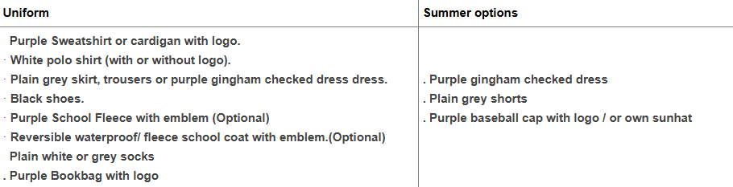
Bookbags should only have 1 keyring on them as we do not have the space.

Slide 4
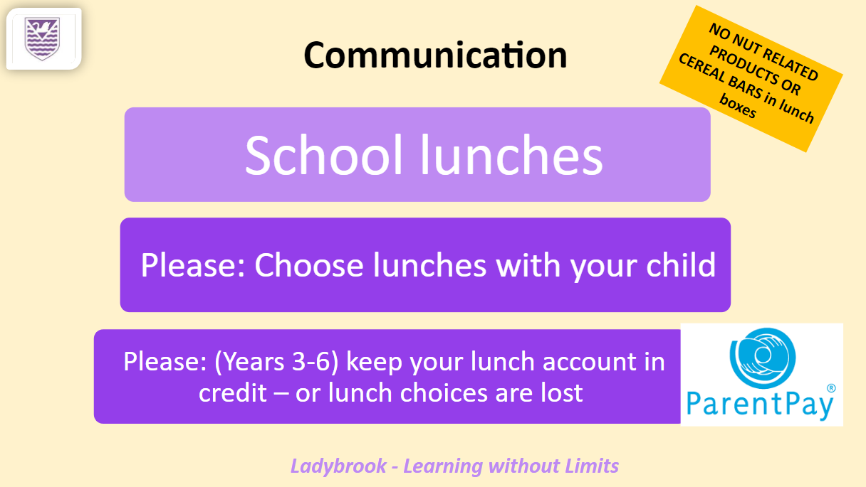

Slide 5


Slide 6
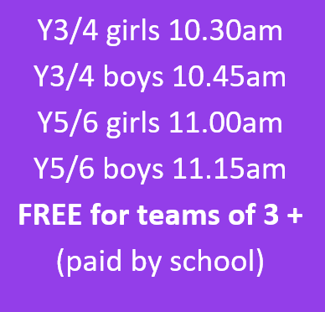
Cross country
Year 3-6
Girls ¾ Boys ¾ Girls 5/6 Boys 5/6
Starts Saturday 20th September 2025
Woodbank park
More information to follow

Slide 7
Communication
Home / School Diaries
Parents evening – Autumn and Spring
Open door
Reports – Autumn, Spring targets, Summer
Updates/photos on Google classroom
Classroom / webpage

Slide 8
Reading
Reading book & diary in school daily – ERIC
Scheme – 2 books – a key read/supporting title.
Children change books independently when their diary has been signed to say they have completed the books.
Diary is not checked daily (once a week). It is the child’s responsibility to let somebody know if there is a note.
We buddy up with year 6.

Slide 9
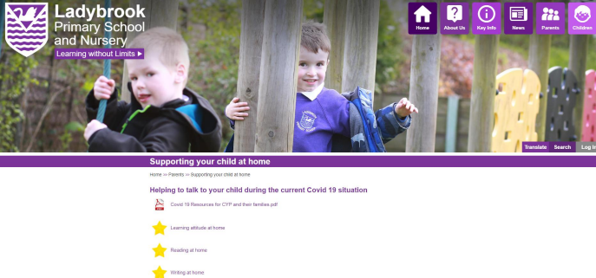
Reading guidance is on the website

Slide 10
Spellings
Spelling Shed programme – stage 3
Spelling test every Wednesday and new spellings given the same day.
Everyone will have the same spellings but some children may have 5 instead of 10.

Slide 11
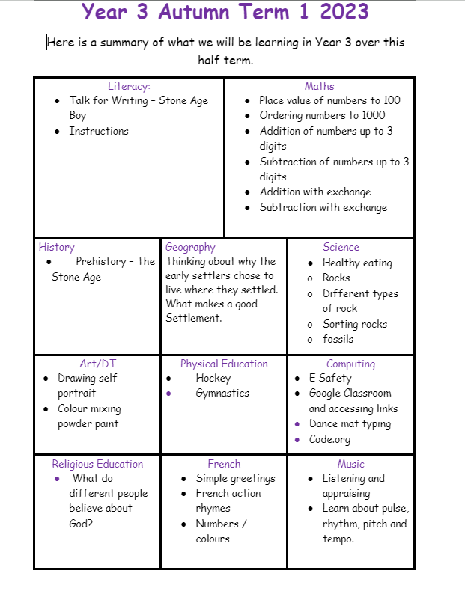
Fundamentals

Slide 12
Maths
Mathletics / TTRocks
Daily times tables/number bonds challenge.
Other ways to help at home :
Telling the time / Money

Slide 13
Google Classroom
Homework tasks/useful websites
Online learning – if needed
Photo uploads

Slide 14
Trips/visits
Autumn = Forest School Morning - Den building
Visitor – Stone Age
Spring = History field Trip - Roman related
Summer = Geography – field trip – recycling centre

Slide 15
Homework
Mathletics – set weekly
Reading – daily
Spellings – set weekly but need to be practised daily.
TTRS/Numbots - daily
Any additional homework tasks will be uploaded via Google classroom.

Slide 16
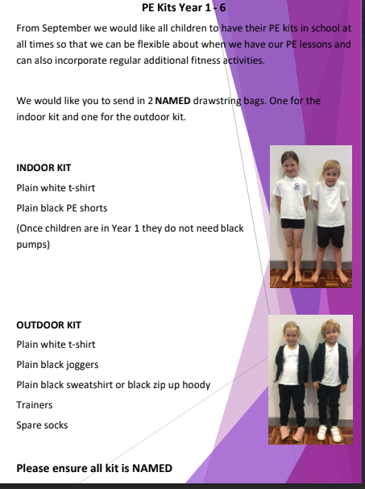
Indoor PE – Tuesday
Outdoor PE – Wednesday
Swimming – Summer term
- Please take your child swimming before the
Summer term.

Slide 17
Tables
Team tables
Happy rocks – reward system

Slide 18
Playtime
Tuck shop available morning play only – 25p
Healthy snack:
Piece of fruit/vegetable sticks/ breadsticks/raisins/bread roll
No nuts/ chocolate/ crisps/ yogurts/ cakes/ fruit winders/ sugary cereal bars/ yogurt covered snacks

Slide 19
Enrichment
Forest school and gardening – Autumn 1
Please have wellies in school at all times – labelled.

Slide 20
Any question?

