Slide 1

Welcome to Year 4!

Slide 2
Meet the team…
Mrs Draper
Class teacher – Monday, Tuesday, Wednesday am

Slide 3
Meet the team…
Mrs Gadd
Class teacher - Wednesday pm, Thursday, Friday

Slide 4
Meet the team…
Mrs Lockett
Teaching assistant
Mrs Lewis
Teaching assistant

Slide 5
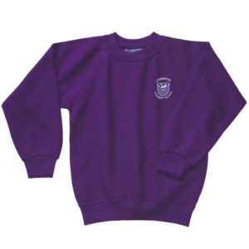
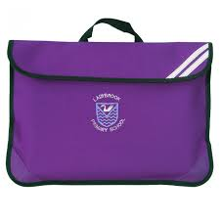

Reminders
* All uniform, PE kit and wellies should be labelled.
* Coats, filled water bottles and book bags should be in school everyday.
* Children may bring money for the tuck shop or bring a healthy snack from home for playtimes- no nuts please.

Slide 6

Weekly timetable
Monday- Mrs Draper
Tuesday- Mrs Draper and Mrs Lockett
Swimming – Autumn Term
Outdoor PE – Spring/Summer Term
Wednesday- Mrs Draper am
Mrs Gadd pm
Thursday- Mrs Gadd and Mrs Lockett
Indoor PE (not Autumn 1)
Friday- Mrs Gadd
Homework set, Enrichment afternoon

Slide 7
Curriculum overview
Autumn | Spring | Summer
Going for Gold! The Ancient Greeks and how their achievements influenced the Western World. | Angry Planet! We will be looking at Natural Disasters - earthquakes, volcanic eruptions, flooding etc | Survivors! We will be looking at many aspects of Ancient Egypt, particularly how the River Nile helped the people survive.
Updates throughout the year will be posted in Google Classroom.
Photographs will be added to Google Classroom and the Year 4 section of the school webpage.

Slide 8
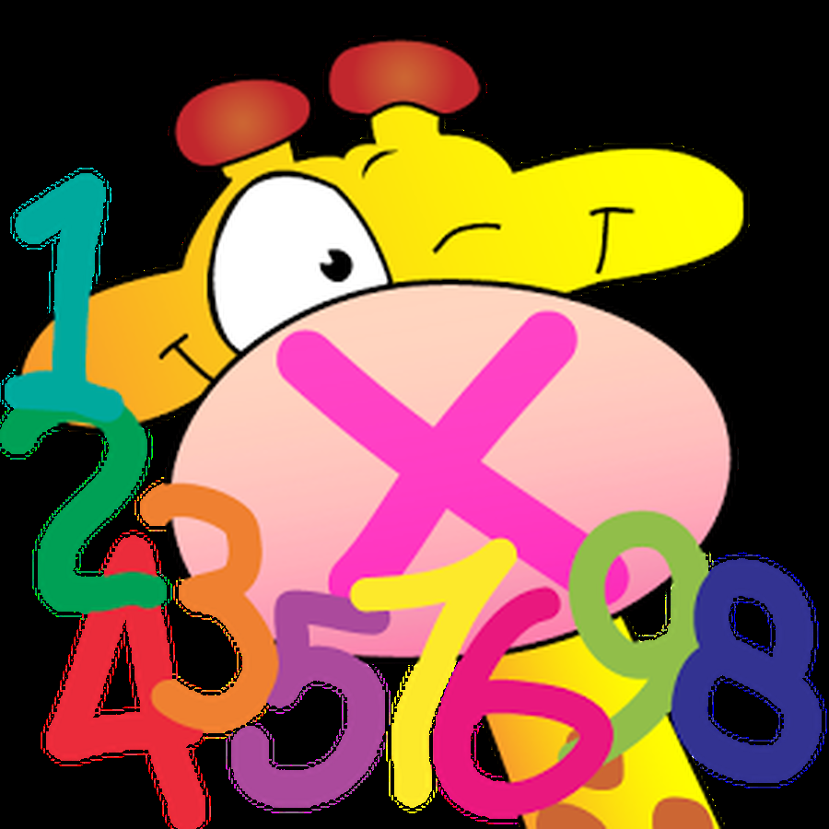


Times Tables
All primary school-aged children are expected to know their times tables up to 12 x 12 by heart by the end of Year 4.
Times tables will be taught and practised throughout the year in a variety of ways.
To monitor children's recall they will continue to complete short tests each morning in school. Children are expected to answer 30 questions in 2 minutes. Children will complete multiplication tests for all times tables before progressing to divisions and then mastery questions.
We will continue to use Times Tables Rockstars alongside these tests this year.

Slide 9



Multiplication Tables Check (MTC)
- During the summer term, Year 4 will take part in the Year 4 times tables check (MTC).
- The times tables test will be timed, with the entire assessment lasting approximately 5 minutes in total.
The children will be set a handful of practice questions to begin with.
Following the practice questions, the test itself will comprise of 25 questions, for example, 2 x 5 = with the child required to input the answer.
- Children will be given six seconds to answer each of the questions, with a three second blank gap between each question.
The questions will be randomly selected ranging from 2 x 2 up to 12 x 12.
There will be more questions from the 6, 7, 8, 9 and 12 times tables, as these are focused on more in Years 3 and 4.
- We will provide plenty of opportunities for children to practise in this way. Please support your child by helping them to practise their times tables at home.
SOUND CHECK game on TTRS is very similar to the actual test.

Slide 10

Supporting your child’s learning at home
Reading Books
Children change their own book once they have completed it - either from the scheme or from the free choice reading book shelves outside our classroom. This will be monitored daily during ERIC time. Please sign diaries at home.
Mathletics
Tasks will be set regularly. Children can also select and complete their own tasks.
Google Classroom
Google Classroom will be used as a hub for homework this year.
Spellings
We will continue to follow Spelling Shed. New spelling lists will be sent home each week and will be tested in school the following Tuesday. After Christmas children will be expected to write 2 of the spellings in sentences.
Any other homework will also be set on Google Classroom on Fridays and children will have one week to complete it unless stated otherwise.
LOOK OUT FOR THE WEEKLY HOMEWORK NOTE POSTED IN GOOGLE CLASSROOM EVERY FRIDAY AFTERNOON.

Slide 11

PE
Tuesday
Swimming (Autumn term only)
Children need their swimming costume, towel and swimming cap for children with long hair please.
Thursday
Indoor PE (not Autumn 1 - Dance on Fri afternoons instead)
Children need white t-shirt and black shorts. No trainers
Indoors. (Special socks if necessary)
Children need trainers in school all the time please.

Slide 12



Enrichment
Autumn 1 - Dance

Slide 13
Buttons!
- reward system
- earn as a team
- team with most buttons is the VIP table the following week
- cushions and VIP pencil pot!

Slide 14
Information from Mrs. Presswood

Slide 15

Uniform
Please label all uniform (shoes/coat)
Coat needed EVERY DAY
Pump bags – drawstring fo a plain white t shirt and black shorts
No huge bags please; we have no space!
No jewellery – earrings must be plain, small studs (children to bring own tape to cover for PE) NB SWIMMING TERM AND NEW PIERCED EARS
No nail varnish / make-up
All long hair – tied back – its own colour please
Ladybrook - Learning without Limits

Slide 16

Communication
NO NUT RELATED PRODUCTS OR CEREAL BARS in lunch boxes
School lunches
Please: Choose lunches with your child
Please: (Years 3-6) keep your lunch account in credit – or lunch choices are lost
Ladybrook - Learning without Limits

Slide 17
Communication: Class Assemblies
DATE | TIME | YEAR GROUP
Wednesday 26th March | 2.30pm | Year 4
Thursday 28th November | 2.30pm | Year 5
Thursday 30th January | 2.30pm | Year 2
Thursday 22nd May | 2.30pm | Year 1
Thursday 26th June | 2.30pm | Year 3
Wednesday 2nd July | 2.30pm | Reception
Thursday 24th July | 9.30am + coffee / Open morning | Year 6
Ladybrook - Learning without Limits

Slide 18
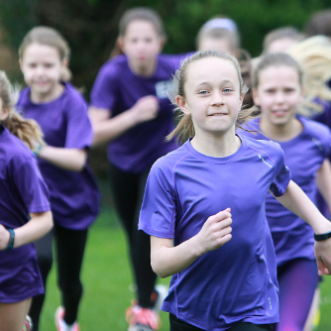
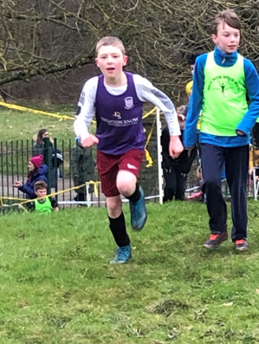
Additional Opportunities for juniors
Cross Country
Woodbank Park
Monthly (Sept – March)
Starts Saturday 21st September
Y3/4 girls 10.30am
Y3/4 boys 10.45am
Y5/6 girls 11.00am
Y5/6 boys 11.15am
FREE for teams of 3 +
(paid by school)
Ladybrook - Learning without Limits

Slide 19
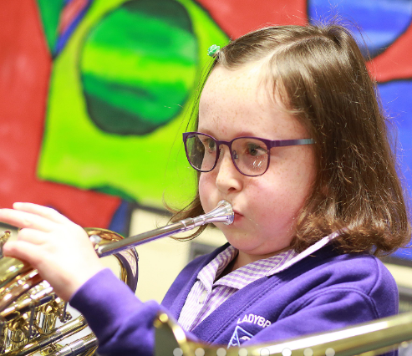
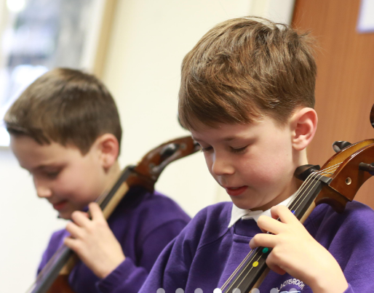
Additional Opportunities for juniors
Learn to play a musical instrument:
Try outs are still available for children interested in brass and wind (flutes, clarinet, saxophone)
Ladybrook - Learning without Limits

Slide 20

Don’t forget…
We are always around in the mornings and at home time as the children arrive and leave school.
If you have any quick messages you may pass them on during this time.
Alternatively you may write messages in your child’s diary.
We do ask that you let us know if your child is being collected by someone other than who they normally go home with.
For any other messages please email renate.bristow@ladybrook-primary.co.uk and she will pass them on.

Slide 21
Thank you!

