Slide 1
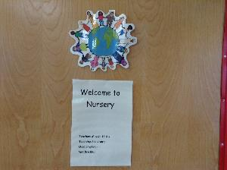
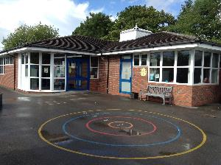
Nursery 2025-26
Year Group Meeting

Slide 2
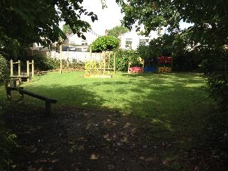
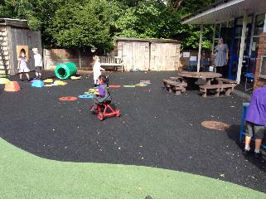
Routines and Expectations…
Whole class teaching sessions
Continuous provision
Outdoor and indoor learning
Independence skills
Expectations in the Nursery group

Slide 3
How can you help?
Please can you…
Make sure everything is named
Put bookbags in the boxes and lunch bags on the trolley in the morning
Please cut grapes in half and no nuts in lunches, sorry no peanut butter/chocolate spread
Make sure your child has a spare clothes bag in their locker
Come to school on time but if you are late please go to the main school front door

Slide 4
How can you help?
Please can you…
Encourage children to recognise their name (lower case letters please)
Practise putting on their coats and hats - encouraging children to become more independent
Encourage correct hand washing
Practise pouring drinks and help with tidying up at home

Slide 5
Tapestry
Observations of your child’s learning and development
Weekly round up - might not always be photographs
Please don’t share any group images
Communication book used for questions and comments

Slide 6
EYFS Principles
The unique child
Positive Relationships
Enabling environment
Learning and Development

Slide 7
The Prime Areas
Communication and Language
Physical Development
Personal, Social and Emotional Development

Slide 8
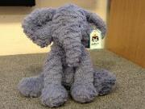
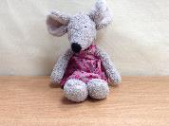
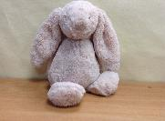
Getting Ready to Learn…
Learning Power Heroes- puppets and toys.
Resilience-trying to do
something.
Being independent- finding
things, putting shoes on,
going to the toilet.
Teamwork- sharing and
taking turns.
Good looking and listening in
whole class teaching sessions.

Slide 9
Specific Areas of Learning
Literacy
Maths
Understanding the World
Expressive Arts and design

Slide 10

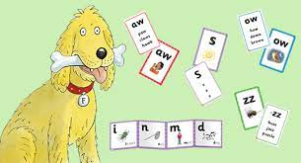
Floppy’s Phonics
Phase 1 phonics games played in whole class sessions in the Autumn term
Floppy’s phonics scheme started when the children are ready
Phonics workshop Phase 1 - please sign up today

Slide 11
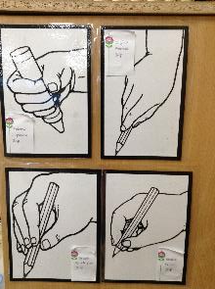
Writing
Pencil grip
Mark making opportunities in Nursery
Emergent writing
Praise children for their efforts

Slide 12
Theme: Marvellous Me…
Please send in one, small family photo to put on your child’s learning wall, approx. 10 x 15 cm
Please use your child’s home school diary to let us know any important information

Slide 13
Thank you
any questions?

