Slide 1

Welcome Meeting September 2026
Welcome

Slide 2
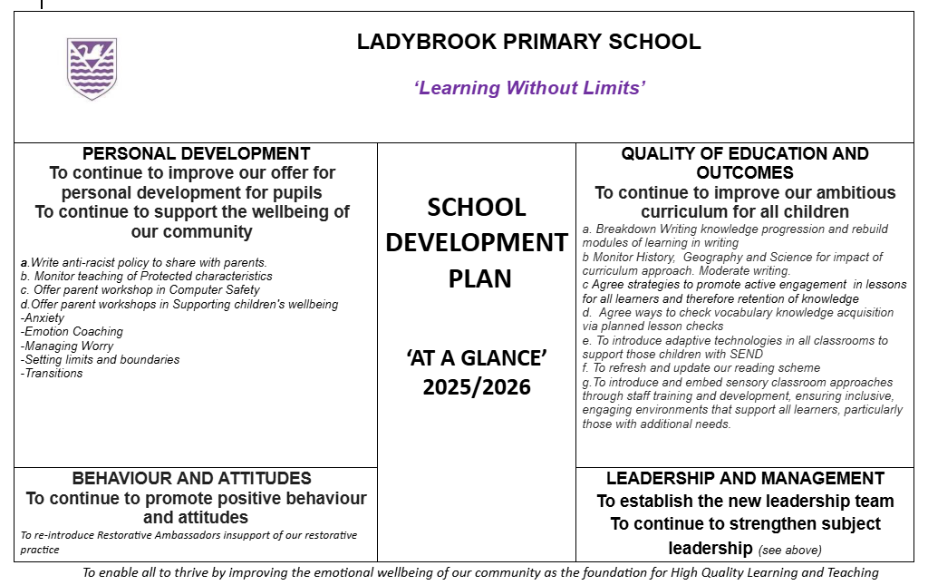
Last year …
Review of last year – all completed except finalising anti-racism policy. To complete this year.

Slide 3

School Development Plan 2026-28
Safeguarding and Vigilance
Inclusion
Curriculum and Teaching
Achievement
Attendance and Behaviour
Personal Development and Wellbeing
Early Years Foundation Stage (EYFS – nursery and reception)
Leadership and Governance
The plan is written under the 8 OFSTED headings. All 8 areas are shared on the website in whole school news.

Slide 4

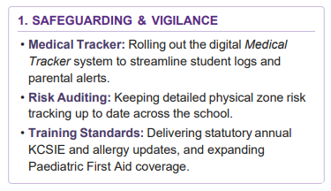
This year …

Slide 5
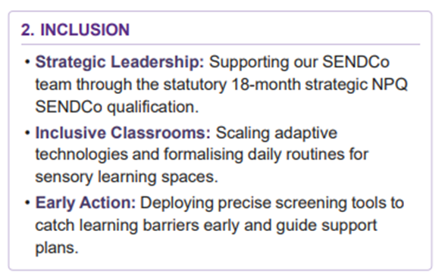


Slide 6
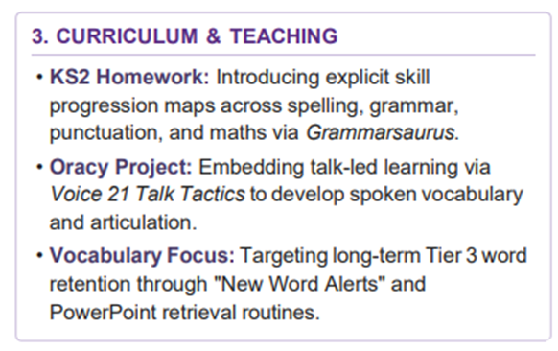

Slide 7
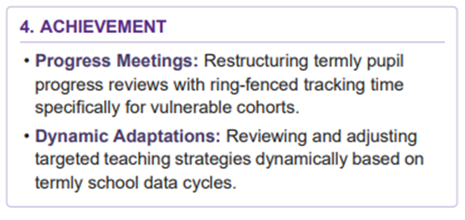

Slide 8
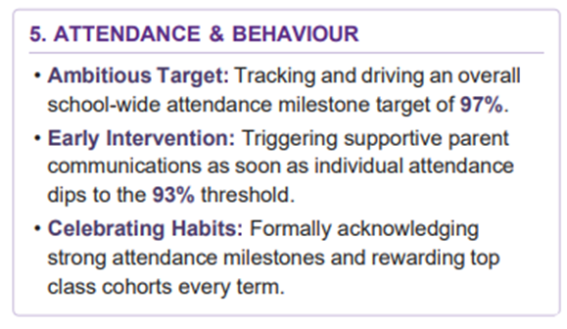

Slide 9
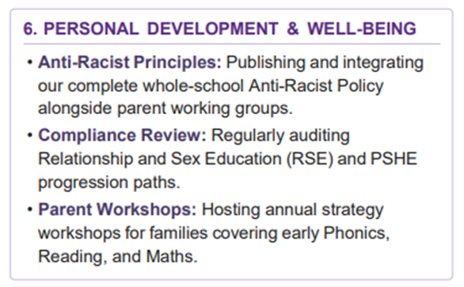

Slide 10
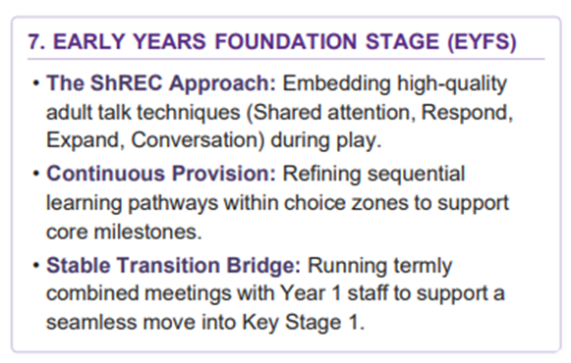

Slide 11
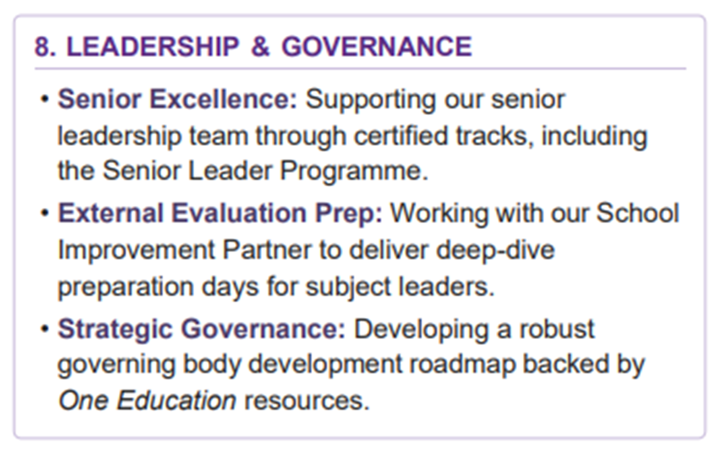

Slide 12
Some key changes this year…
Our Christmas Production – the KS2 performance willnow be one afternoon matinee and one evening performance to support our younger children in KS2
Class Assemblies and audiences – Fire regs mean we are restricted to the number of people in the hall. Our class assemblies will still welcome parents but we will need to limit to 2 adults per child
Harvest Festival – Linked to the above, harvest will now be for the children only. Lots of photos will be shared on our website
Phones on the playground / school building – linked to the government’s initiative to have mobile phone free schools, we would like adults to lead by example and not use them on our school grounds

Slide 13
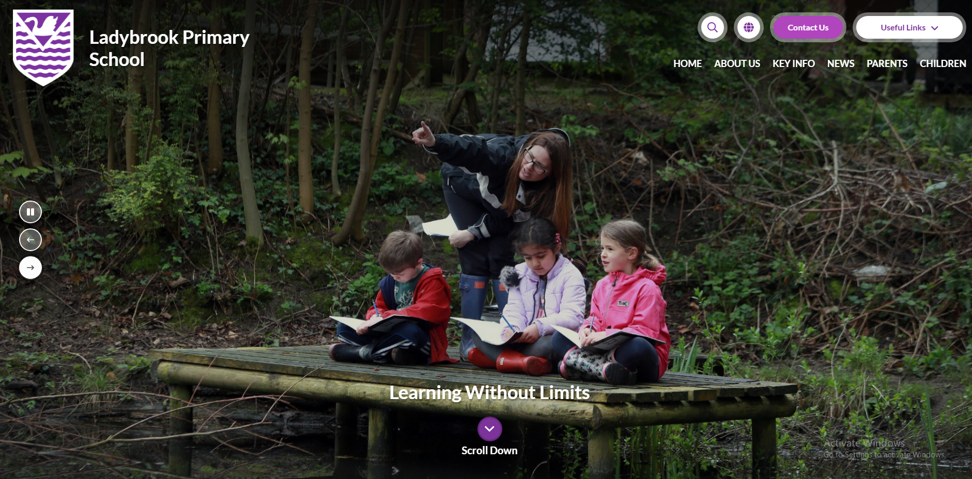
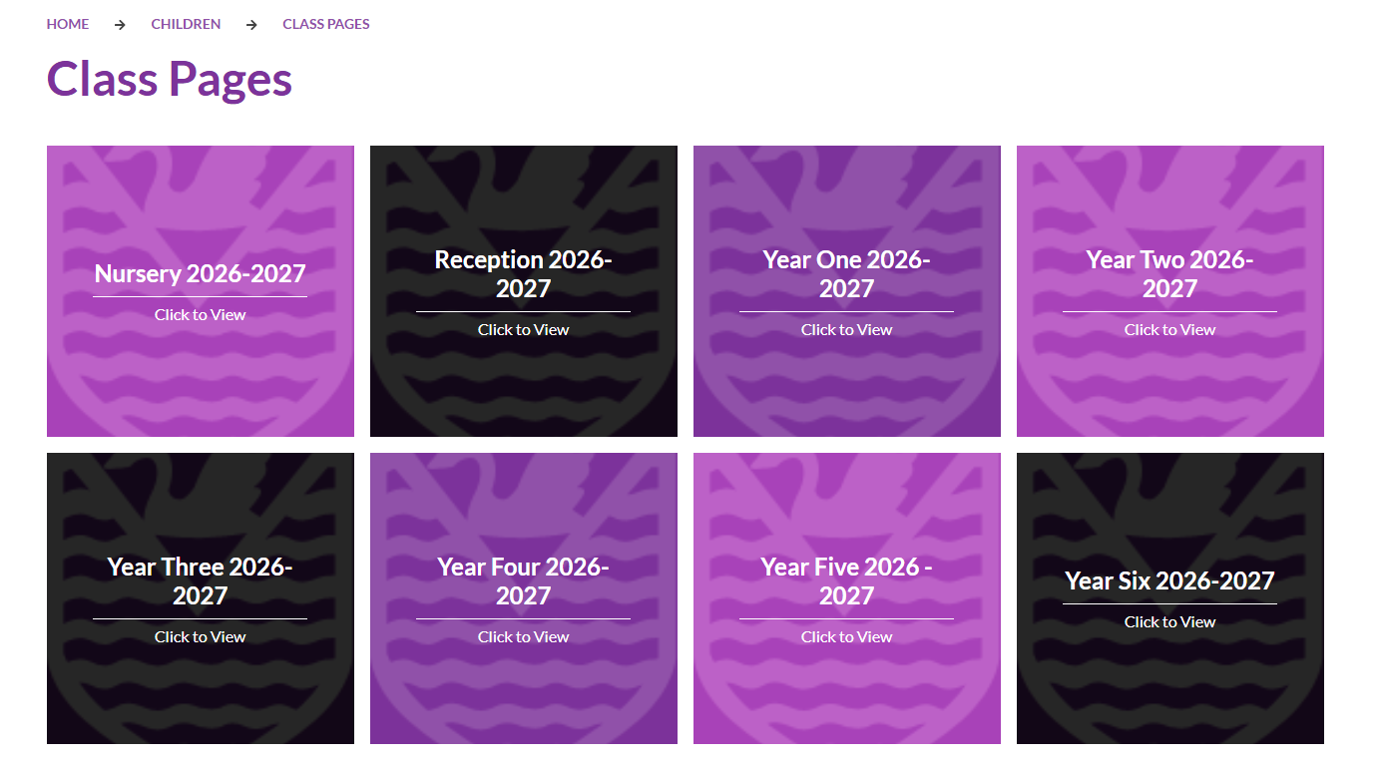
Sharing your child’s learning ….

Slide 14
Paperwork
Local visits permission slip – if new to school
Medical Conditions form – Mrs Bristow if any changes
Change of address, telephone numbers etc – please inform office
Ladybrook - Learning without Limits

Slide 15
Absence for planned medical / dental reasons should take place out of school time if possible. The office requires appointment card / medical letter to allow us to authorise the absence
Please don’t book holidays in term time
Ladybrook - Learning without Limits

Slide 16

Communication
NO NUT RELATED PRODUCTS OR CEREAL BARS in lunch boxes
School lunches – order on time
Choose lunches with your child
Please: (Years 3-6) keep your lunch account in credit – or lunch choices are lost
Ladybrook - Learning without Limits

Slide 17

HELP!!

Slide 18
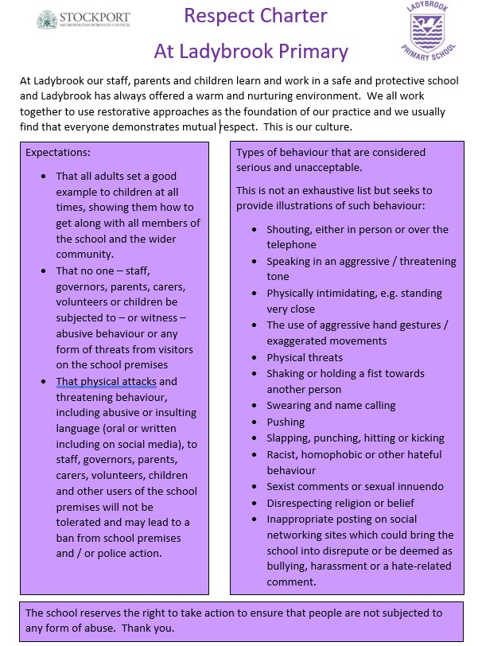
Respect Policy and Charter ….

Slide 19

Ladybrook PTA
With your help we raised £5356 in the Summer Term of 2026 - THANKYOU!
Our first meeting for 2026/27 – 7pm, Tuesday 22nd September in the Ladybrook Pub
Come to our Cheese and Wine Night on Thursday 8th October - book on Parent Pay

Slide 20
Core functions of Ladybrook PTA
We are a registered charity raising vital funds for resources, equipment, and extra-curricular activities that fall outside the standard school budget.
We foster a strong sense of community through the organisation of inclusive events that bring families, pupils, and school staff together.
The Trustees and Class representatives provide a structured channel for parents to share feedback, propose new ideas, and stay informed about school initiatives.
Our enthusiastic and committed parent and carer volunteers ensure our events are enjoyable and successful.
Our Trustees ensure all funds raised are used to benefit the best interests of the children, advancing education and enhancing the school environment.
Notes:
Explain that due to deficits in government funding the PTA funds are increasingly being used to purchase items and upgrade the school environment in ways many would expect the school budget to cover. This is why it is essential to have the support of our parents to maximise potential for fun and fundraising.
In recent years, PTA funds have paid for… the running track, the MUGA and its resurfacing, the Chrome books used in classrooms, playground markings and play equipment, staging and audiovisual equipment and the largest project to date – the beautiful library and computer suite behind us
Our trustees meet once every half term and we hold a PTA meeting discussing plans for upcoming events in the Ladybrook pub every 4-6 weeks
Our class representatives send out PTA communications via the class whatsapp groups we also produce a monthly newsletter accompanying the school newsletter to allow advance planning for you and keep you informed
We need your help - we would like to appeal to all of you to get involved in volunteering to help at events or even help coordinate. E have a robust core group of long standing parents but to ensure longevity we are seeking new parents, particularly from the younger year groups to become involved. Likewise, Parents from the older year groups – if you haven’t had the chance to volunteer already in your time at Ladybrook…please help us at one of our events this year if you can.

Slide 21
Calendar of Events 2026/27
50/50 Lottery Entries - by 30th September
Junior Movie Night (1 of 2) - Wednesday 23rd September
Cheese and Wine Night - Thursday 8th October
Spooky Disco* - Thursday 22nd October
Wreath Making Night - Tuesday 24th November
Christmas Fair - Friday 4th December
Rotary Club Santa Float - December - date tbc
Quiz Night (Adults Only) and AGM - Friday 22nd January
Junior Movie Night (2 of 2) - Wednesday 3rd February
Infant Movie Night (1 of 1)* - Wednesday 19th May
Summer Disco* - Friday 2nd July
Summer Fair - Saturday 10th July
*Sadly, the Discos and Infant Movie night are not available to Nursery children, but can be enjoyed from Reception onwards
Notes:
List not exhaustive…the PTA arrange and organise additional events such as second hand uniform sales too

Slide 22
Current Fundraising Priorities
Ladybrook’s 50/50 lottery is raising money for playground toys and equipment - please sign up before the end of September on Parent Pay.
Amongst other things, the PTA funds an annual visiting Christmas Pantomime, Christmas gifts from Santa for EYFS and the Year 6 leavers party.
This year’s big project: preparing for future heatwaves and striving for sustainability
  The recurrent heatwaves and climatic forecast necessitate that we strive to future proof the school to ensure optimal wellbeing for the children's’ attendance, learning and play.
  School maintenance and Health and Safety budgets are small and have multiple priorities.
  The Trustees have therefore committed PTA funds to projects such as air conditioning the remaining classrooms, hopefully offset by playground shelters with embedded solar panels.

Slide 23
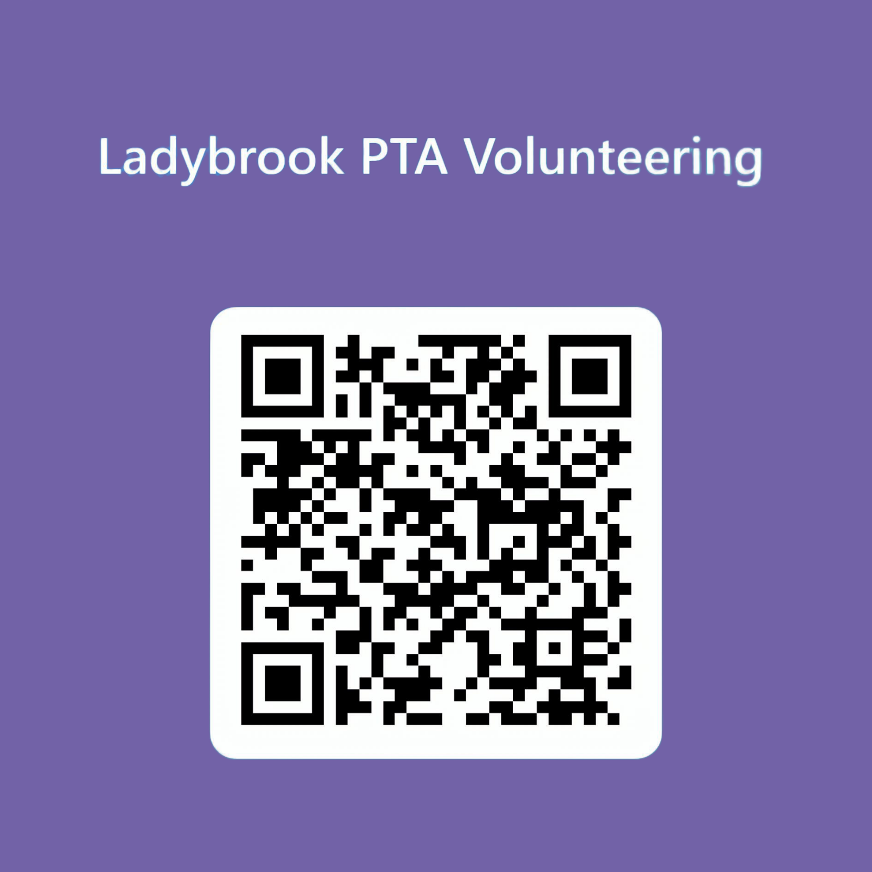
How do I volunteer?
contactus@ladybrookpta.onmicrosoft.com
Trustees: Caroline Doney, Louise Abedin, Chrissy Bennett, Philip Slater, Caroline Woosnam and Catherine Morrison
Class Reps & support team: Alanna Miejluk, Christy Wheatley, Holly Roberts, Jo Shatwell, Nic Crane, Liam Morrin, Natalie Freegard, Ruth Ingram
Currently seeking a class rep for Nursery and Year 1

