Slide 1
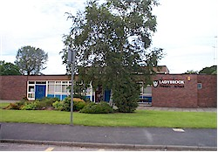

Ladybrook Foundation Stage
Teachers:
Miss Woodward and Miss Ridgway-Reception

Slide 2
Welcome to Ladybrook!
We are very pleased to welcome new families to Ladybrook this year, and welcome our nursery families into reception
The following slides detail what you need to know to prepare for your child joining our school in September.

Slide 3
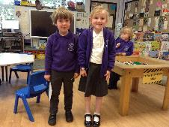
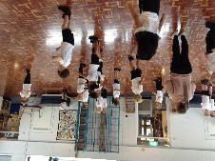
Reception School Uniform
Grey trousers/skirt/pinafore dress
White or purple polo shirt – logo optional
Purple sweatshirt or cardigan with school logo.
Black school shoes/ all black (inc sole) trainers.
Purple fleece (optional)
Black shorts, white T shirt and trainers for PE.
Spare underwear, socks and joggers.
School book bag with school logo.

Slide 4
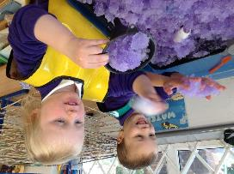
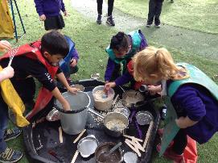
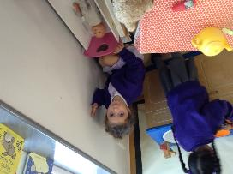
Induction
Why do children start part time?
To help children learn the routines and expectations in a smaller group.
To support the children at lunchtimes.
To complete baseline assessments.

Slide 5
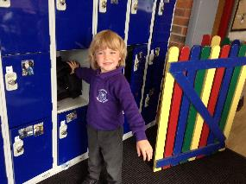
Settling In…
•Please encourage independence skills over the summer e.g. putting coats and shoes on by themselves.
•In the mornings, Reception staff meet the children and bring them into the cloakroom to take their coats off and go into the classroom. Please can adults stay outside and we can support the children in the locker area.
•If your child is upset about separating from you, please bring them to a member of staff.

Slide 6
Is your child ready for starting school?
Can your child:
Put their own coat on?
Can they get dressed and undressed independently?
Can they take off and put their own shoes on?
Go to the toilet independently?
Eat using cutlery?
Understand and follow an instruction?
Speak in sentences?
Share and take turns?
Write their name?
Recognise a few letter sounds?
Count out a small set of objects?

Slide 7
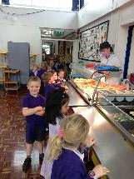
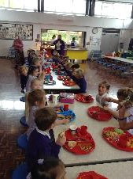
Lunch times…
All children from reception to year 2 are entitled to a feree school dinner
Reception children will go to the main school hall
Try them with the school dinners they can always change to packed lunch if needed. We will communicate with you.
Please select meal choices (on paper in pack then via Parent Pay)
Lunches need to be chosen by the Thursday for the following week.

Slide 8

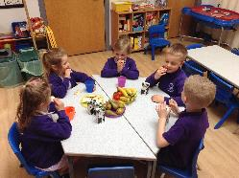
Snack times…
We provide milk and water, fresh fruit and other healthy snacks in the mornings.
Children do need a water bottle every day, filled at home with water not juice please. We provide fruit at snack time.
We ask you to make a contribution of £25.00 to cover the whole year for snacks as well as other resources. Children are entitled to free milk until they are 5.

Slide 9
Pupil Premium
Early years pupil premium
Your child’s early years education provider could get up to £570 per year to help with your child’s education. This will be paid directly to school
Who can apply
You can apply for early years pupil premium if you get any of the following:
30 hours of Free Childcare for Working Parents
15 hours of free childcare for 2 year olds if you get extra support
15 hours of free childcare for all 3 and 4 year olds
PLUS:
income-related Employment and Support Allowance
support under part six of the Immigration and Asylum Act 1999
the guaranteed element of State Pension Credit
Universal Credit - your household income must be less than £7,400 a year after tax, not including any benefits you get

Slide 10
Pupil Premium
You may also get early years pupil premium if your child is currently being looked after by a local authority in England or Wales or if your child has left care in England or Wales through:
adoption
special guardianship order
a child arrangements order
How to apply
To apply for early years pupil premium, speak to Mrs Fairweather or apply via the LA .
If you get early years pupil premium, this will not affect any other benefits you may be entitled to.

Slide 11
Disability access fund
We could get £938 a year to help with your child’s education and support.
This will be paid directly to school.
Your early years provider can apply to get disability access funding if your child receives Disability Living Allowance for children PLUS one of the following:
30 hours of Free Childcare for Working Parents
15 hours of free childcare for 2 year olds if you get extra support
15 hours of free childcare for all 3 and 4 year olds
You do not need to use all of your hours to be eligible for disability access funding.
How to apply
To get disability access funding, speak to Mrs Fairweather or the local authority.

Slide 12
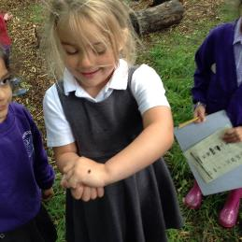
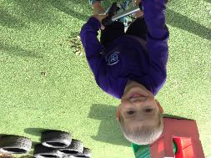
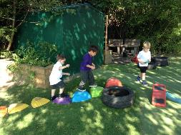
Outdoors…
We have lots of fun outdoors in all weathers. We provide waterproof, please send in a pair of named wellies to keep at school.

Slide 13
Parents as Partners…
We value your support and want to work closely with you to enable your child to develop and learn. We will keep in touch through:
•Home School Diaries
•Parent interviews in Autumn and Spring
•Termly reports
•School social events and Foundation Stage stay and plays.
•Learning Wall.
•Tapestry
Transition morning Wednesday 22nd July 9.15 till 11.30am
Any problems please talk to us at the start or end of the day or by phone 0161 4395925.

Slide 14
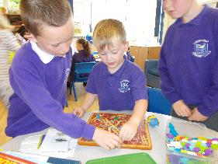
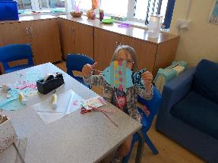
Out of School Club…
We have before and after school care based in the Foundation Stage building.

Slide 15
Absences…
Please ring us when your child is unable to come to school on 0161 439 5925.
If your child has a sickness/tummy bug please keep them off school for 48 hours after the last bout.
If your child is well enough to come to school but needs medication, please fill in a medicine form.

Slide 16
Asthma and Allergies…
Please inform school as soon as possible if your child suffers from any allergies, medical conditions or asthma.
Please let us know if your child has had speech therapy or they are being seen by a Paediatrician?

Slide 17
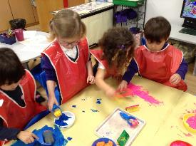
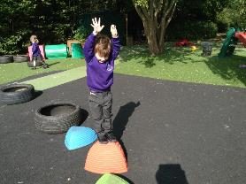
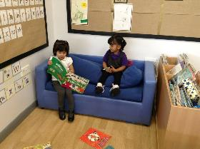
Thank you…
…We hope you and your child or children enjoy their time in our Foundation Stage.

