Slide 1


Ladybrook Foundation Stage
Teachers:
Miss Albery- Nursery
Miss Woodward and Miss Ridgway-Reception

Slide 2
Welcome to Ladybrook!
We are very pleased to welcome lots of new families to Ladybrook this year.
The following slides detail what you need to know to prepare for your child joining our school in September.

Slide 3
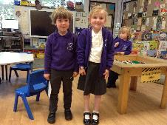
Optional Nursery Uniform
Grey trousers/skirt/pinafore dress
White or purple polo shirt
Purple sweatshirt or cardigan with school logo.
Black school shoes.
Nursery children need a full change of clothes in named bag each day.

Slide 4


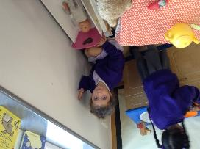
Induction
Children start part-time and are phased into full-time as soon as possible.
We do this to ensure children are happy, safe and secure. They will learn the routines and expectations in a smaller group.

Slide 5
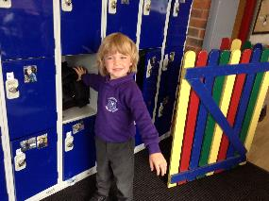
Settling In…
In the mornings, Nursery children will be greeted by staff individually and assisted in putting their coats into their lockers.
Please can adults stay outside and we can support the children in the locker area.
If your child is upset about separating from you, please wait for a member of staff to help you.

Slide 6
Is your child ready for a school Nursery class?
Can your child:
Find and put their coat on?
Take off and put on their shoes?
Go to the toilet independently?
Wait a short time for attention when an adult is helping another child?
Follow a simple instruction?
Accept when they have to stop playing or they are told not to do something?
Share with a little help?
Talk using simple sentences and communicate their needs?

Slide 7
Lunch times…
Nursery children stay in the Foundation Stage Building.
All children need to bring a packed lunch
No nuts or sweets (including peanut butter sandwiches and chocolate spread – we strive to be a nut free school)
Please cut grapes and small tomatoes in halves

Slide 8

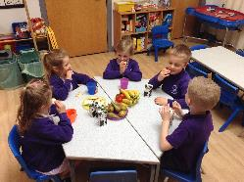
Snack times…
We provide milk and water, fresh fruit and other healthy snacks in the mornings.
Children do need a water bottle every day, filled at home with water not juice please.
We ask you to make a contribution of £25.00 to cover the whole year for snacks as well as other resources. Children are entitled to free milk until they are 5.

Slide 9
Pupil Premium
Early years pupil premium
Your child’s early years education provider could get up to £570 per year to help with your child’s education. This will be paid directly to school
Who can apply
You can apply for early years pupil premium if you get any of the following:
30 hours of Free Childcare for Working Parents
15 hours of free childcare for 2 year olds if you get extra support
15 hours of free childcare for all 3 and 4 year olds
PLUS:
income-related Employment and Support Allowance
support under part six of the Immigration and Asylum Act 1999
the guaranteed element of State Pension Credit
Universal Credit - your household income must be less than £7,400 a year after tax, not including any benefits you get
You may also get early years pupil premium if your child is currently being looked after by a local authority in England or Wales or if your child has left care in England or Wales through:
adoption
special guardianship order
a child arrangements order
How to apply
To apply for early years pupil premium, speak to Mrs Fairweather or apply via the LA .
If you get early years pupil premium, this will not affect any other benefits you may be entitled to.

Slide 10
Disability access fund
We could get £938 a year to help with your child’s education and support.
This will be paid directly to school.
Your early years provider can apply to get disability access funding if your child receives Disability Living Allowance for children PLUS one of the following:
30 hours of Free Childcare for Working Parents
15 hours of free childcare for 2 year olds if you get extra support
15 hours of free childcare for all 3 and 4 year olds
You do not need to use all of your hours to be eligible for disability access funding.
How to apply
To get disability access funding, speak to Mrs Fairweather or the local authority.

Slide 11
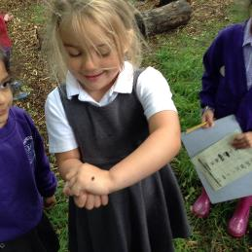
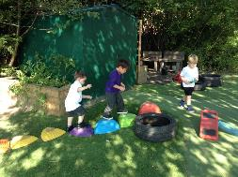

Outdoors…
We have lots of fun outdoors in all weathers. We provide waterproofs, please send in a pair of named wellies to keep at school.

Slide 12
Parents as Partners…
We value your support and want to work closely with you to enable your child to develop and learn. We will keep in touch through:
•Home School Diaries
•Parent interviews in Autumn and Spring
•Termly reports
•School social events and Foundation Stage Stay’n’Play sessions.
•Learning Wall.
•Tapestry
Any problems please talk to us at the start or end of the day or by phone 0161 439 8444.

Slide 13
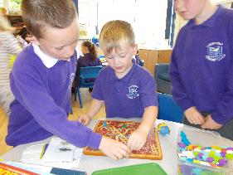
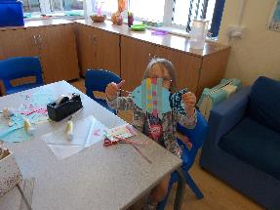
Out of School Club…
We have before and after school care based in the Foundation Stage building.

Slide 14
Absences…
Please let us know when your child is unable to come to school by contacting main school on 0161 439 8444.
If your child has a sickness bug please keep them off school for 48 hours.
If your child is well enough to come to school but needs medication, please fill in a medicine form.

Slide 15
Asthma and Allergies…
Please inform school as soon as possible if your child suffers from any allergies, medical conditions or asthma.
Please let us know if they have had speech therapy, occupational therapist or are being seen by a Paediatrician

Slide 16
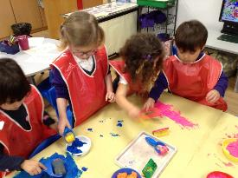
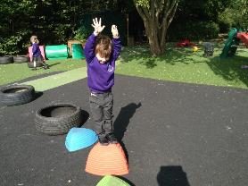
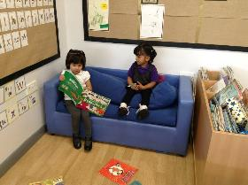
Thank you…
…We hope you and your child or children enjoy their time in our Foundation Stage.

