Slide 1
Year 3 welcome meeting.
2026

Slide 2
Meet the staff
Miss Sinnott – teacher
Mrs Lockett – teaching assistant (Monday, Wednesday, Friday AM (alternate)

Slide 3
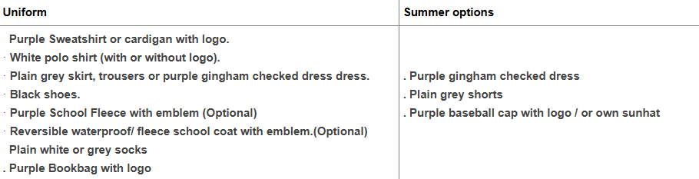
Uniform
Bookbags should only have 1 keyring on them as we do not have the space.
ALL uniform must be labelled.

Slide 4
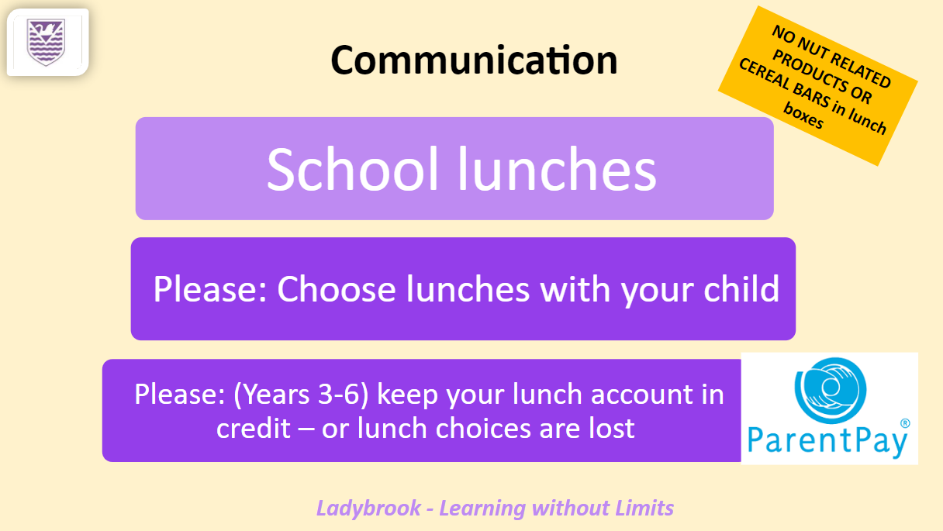

Slide 5


Slide 6
Communication
Home / School Diaries
Parents evening – Autumn and Spring
Open door
Reports – Autumn, Spring targets, Summer
Classroom / webpage

Slide 7
Reading
Reading book & diary in school daily – ERIC
Scheme – 2 books – a key read/supporting title.
Children change books independently when their diary has been signed to say they have completed the books.
Diary is not checked daily (once a week). It is the child’s responsibility to let somebody know if there is a note.
We buddy up with year 6.

Slide 8
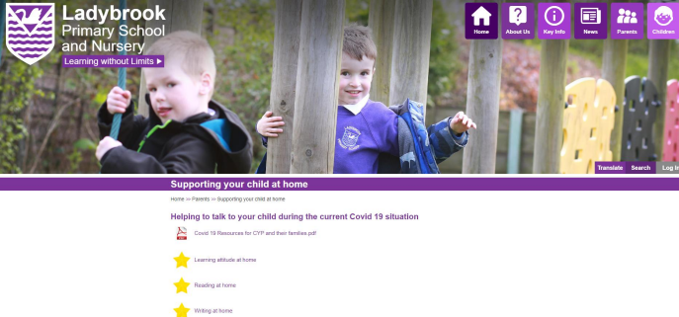
Reading guidance is on the website

Slide 9
Spellings
Spelling Shed programme – stage 3
Spelling test every Monday and new spellings given the same day.
Everyone will have the same spellings but some children may have 5 instead of 10.

Slide 10
Topics
Autumn | Spring | Summer
Prehistoric Britain – Stone Age – Iron Age | Romans | The UK and looking after our world Swimming

Slide 11
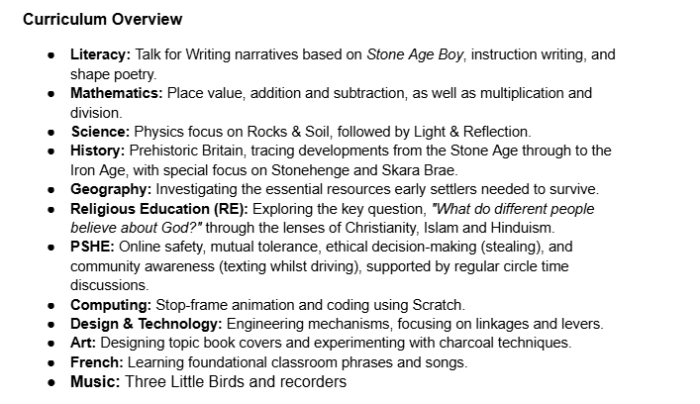
Autumn overview
Fundamentals

Slide 12
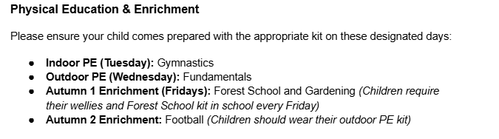

Slide 13
Maths
Mathletics – please only complete the tasks that are set
TTRocks – battles will be set half termly but 5/10 minutes daily is recommended
Daily times tables/number bonds challenge – these are timed in KS2
Other ways to help at home :
Telling the time / Money
Homework routines

Slide 14
Trips/visits
Autumn = Forest School Morning - Den building
Visitor – Stone Age
Spring = History field Trip - Roman related
Summer = Geography – field trip – recycling centre

Slide 15
Homework
Mathletics – set weekly on a Monday
Reading – daily
Spellings – set weekly on a Monday but need to be practised daily. Spellings will be on a handwriting sheet alongside a task to complete.
TTRS/Numbots – daily
Grammar
Maths mats
ALL LOGINS SHOULD BE IN YOUR CHILD’S DIARY

Slide 16
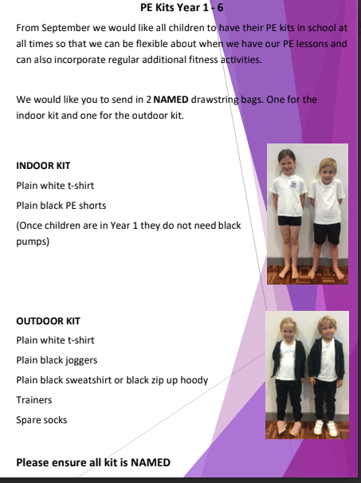
Indoor PE – Tuesday
Outdoor PE – Wednesday
Swimming – Summer term
- Please take your child swimming before the
Summer term.

Slide 17
Tables
Team tables – mixed ability Kagan teams
Happy rocks – reward system

Slide 18
Playtime
Tuck shop available morning play only – 25p more info to follow from the School Council
Healthy snack:
Piece of fruit/vegetable sticks/ breadsticks/raisins/bread roll
No nuts/ chocolate/crisps/cheese/yogurts/ cakes/ fruit winders/ sugary cereal bars/yogurt covered snacks

Slide 19
Enrichment
Forest school and gardening – Autumn 1 every Friday afternoon.
Please have labelled wellies in school at all times.

Slide 20
Any question?

